Slide 1






Remote Monitoring of Rheumatoid Arthritis
Digital Health Regional Networks Event - North
26th May 2022

Slide 2
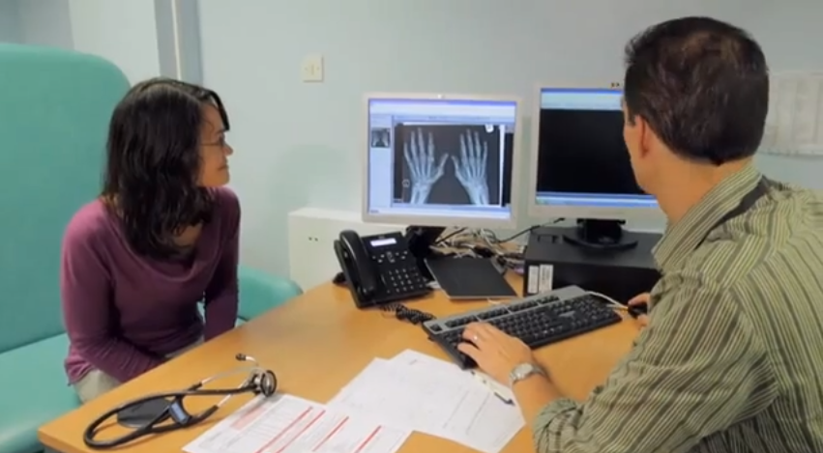

The consultation
“How have you been in the last six months?”

Slide 3
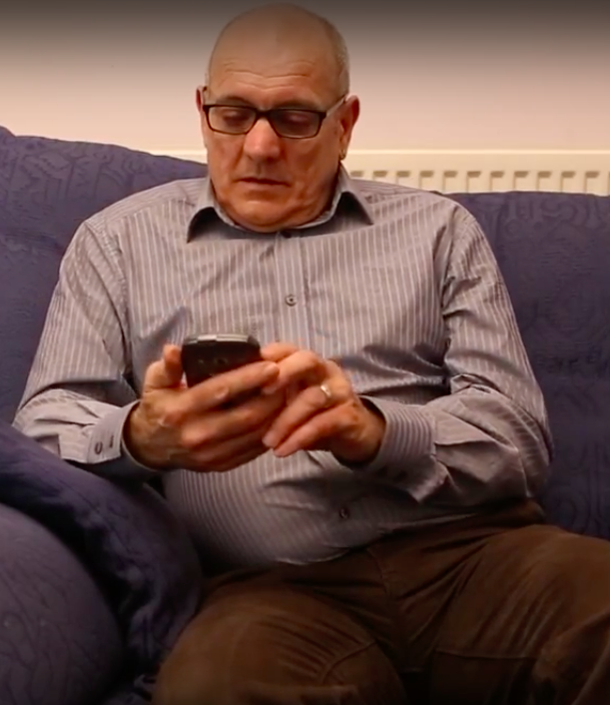
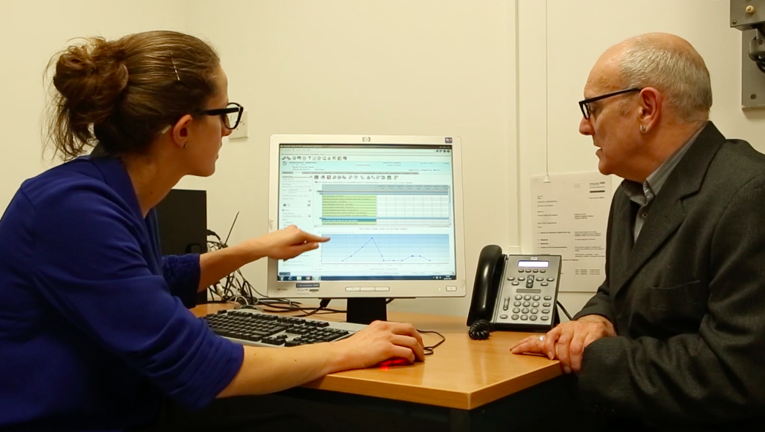
What is REMORA?
Co-designed smartphone app to collect daily symptoms in patients with RA, integrated into clinical care
  Self-management
  Clinical consultations
  Research

Slide 4
The REMORA programme
Pilot study: 2015-2017 Proof of concept
GM Digital Fund: 2020-2021 Scalable infrastructure
NIHR Programme Grant: 2021-2025 Evidence of better outcomes

Slide 5
REMORA1 (2015-17)
Qualitative research with clinicians, researchers and patients
  > Co-design of smartphone app with patients
Testing of app over three months with 20 patients
  > Qualitative research (all stakeholders)

Slide 6

Patients were positive about the app
  “a great idea”
  “a brilliant thing, I can’t wait until it’s out there properly.”
  >90% possible entries completion
Data collection
  “captured the moment”
  made “fleeting symptoms visible”
  picked up “changes that would otherwise be missed”
Symptom graphs in the EHR
  made it easier for a “shared conversation”
  the data “says it for you”, “provides evidence” and “personalises care”

Slide 7
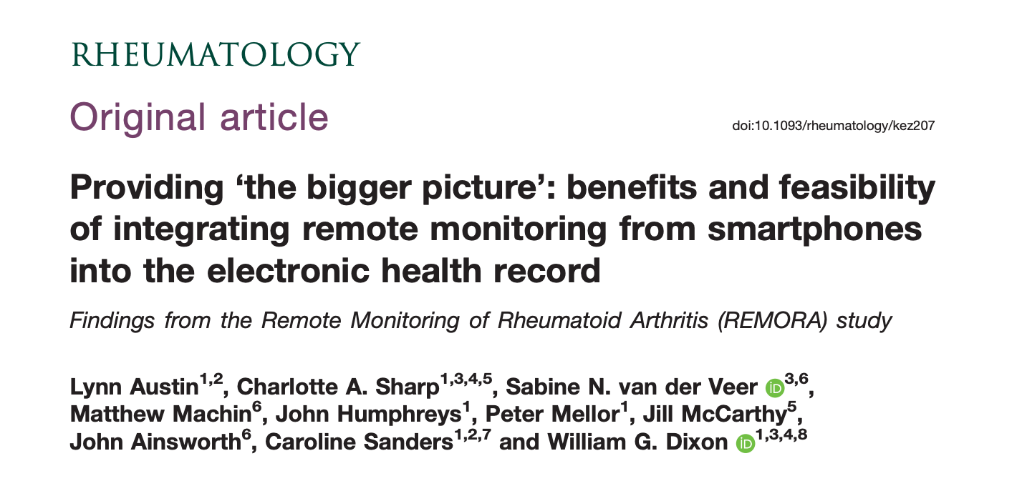
Publication: https://tinyurl.com/remora-study
Video: https://tinyurl.com/remora-study-video

Slide 8
The REMORA programme
Pilot study: 2015-2017 Proof of concept
GM Digital Fund: 2020-2021 Scalable infrastructure
NIHR Programme Grant: 2021-2025 Evidence of better outcomes

Slide 9
GM Digital Fund (‘20-21)
Update app
Develop and test scalable end-to-end infrastructure
Develop supporting materials
  eg video for self-assessment of T&SJC
Recruit 50-100 participants
  Track symptoms integrated into usual clinical care
  Analyse data: patterns of disease and treatment response
  Acceptability and feasibility NOT assessed

Slide 10


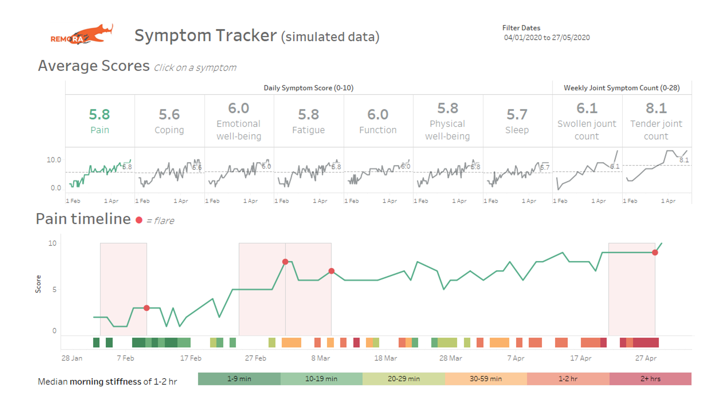

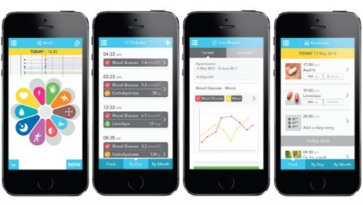



Local EHR system
Clinician
Graphical summary
of patient data
(5)
(1)
(3)
(4)
Regional NHS
digital infrastructure
Patient ID
Symptom data
Patient
Patient
eConsent
(2)
Patient-generated
data repository
NHS Login
GM Digital Platform (GM)
Whole Systems Integrated Care (NWL)
Identity and access management system
Notes:
Title:
App set-up and data flow
Figure 1: Visual representation of the infrastructure we are currently establishing and testing to facilitate deployment of the proof-of-concept of our intervention, and subsequently support its evaluation in a multi-site trial.
During a clinic consultation, the rheumatologist prescribes symptom tracking to patients [explain what this means; including download from app store].
User authentication using NHS Login functionality embedded within the identify and access management system that is part of the Greater Manchester Digital Platform (https://www.northerncarealliancegde.nhs.uk/greater-manchester-digital-platform/about-us/)
Consent stored alongside patient’s PGHD and transferred to a central repository within secure NHS environment using FHIR standards. The repository is also part of the GM digital platform.
For patients who consented, graphical summaries of symptom data become available via a web-based interface, which provides a view onto the repository
The graphical summary is integrated into the Trust’s EHR system. This means that clinicians –once they selected the right patient in the EHR– can securely view the summary for that patient within the EHR without having to login again (i.e. single sign-on)

Slide 11
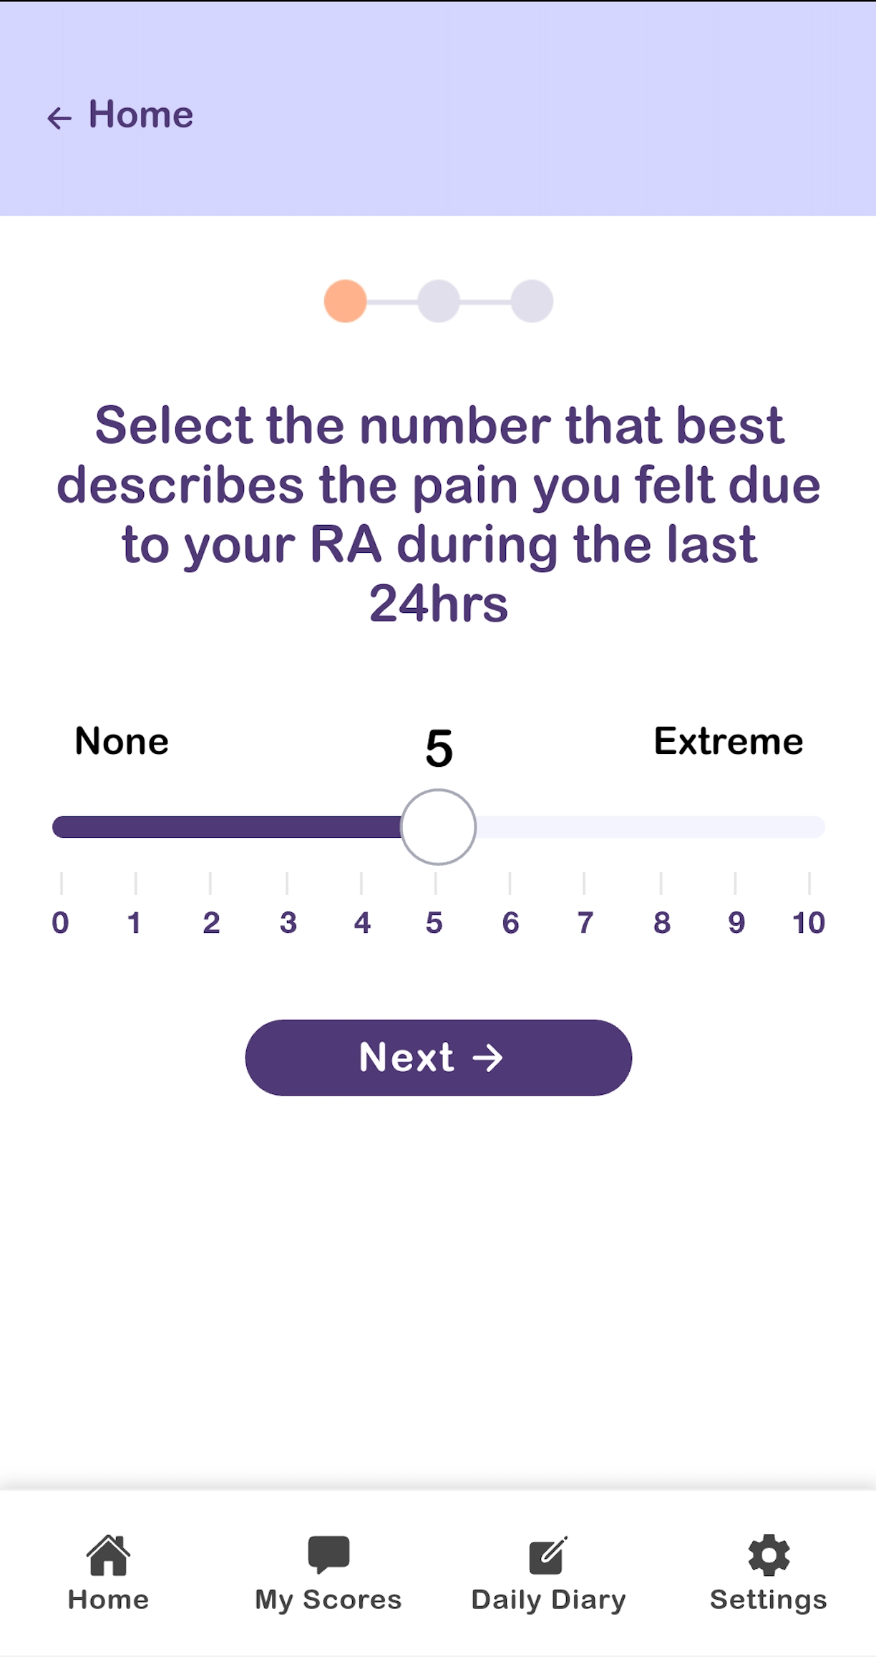
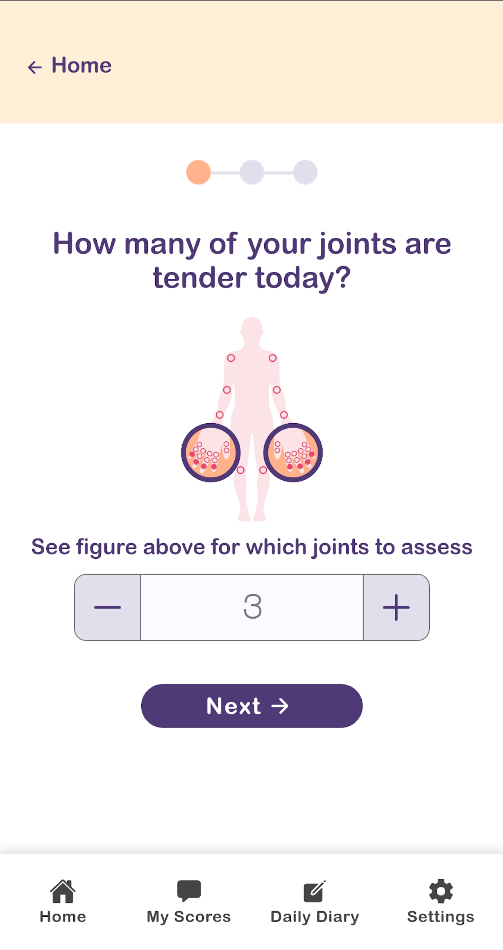
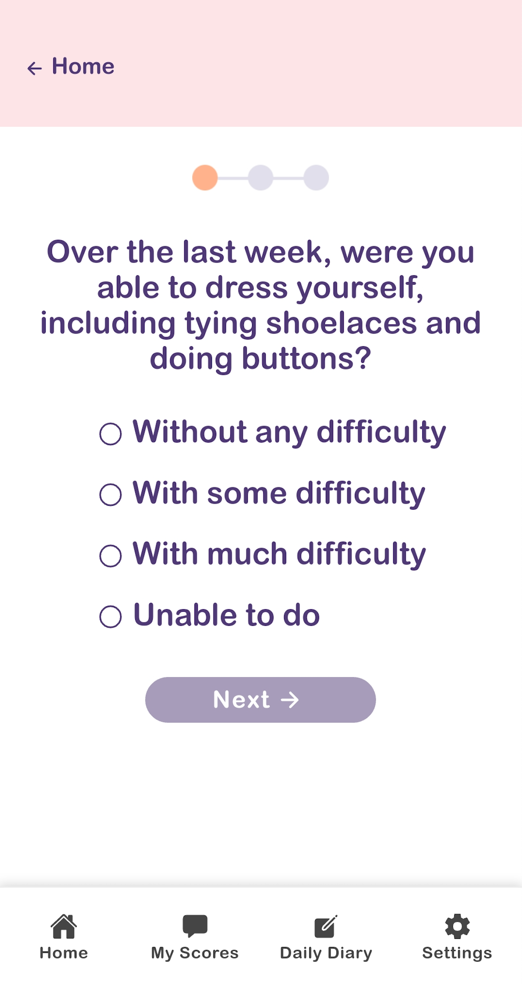
App screenshots

Slide 12
At the consultation
REMORA data within EPR
(Allscripts, Salford Royal)

Slide 13
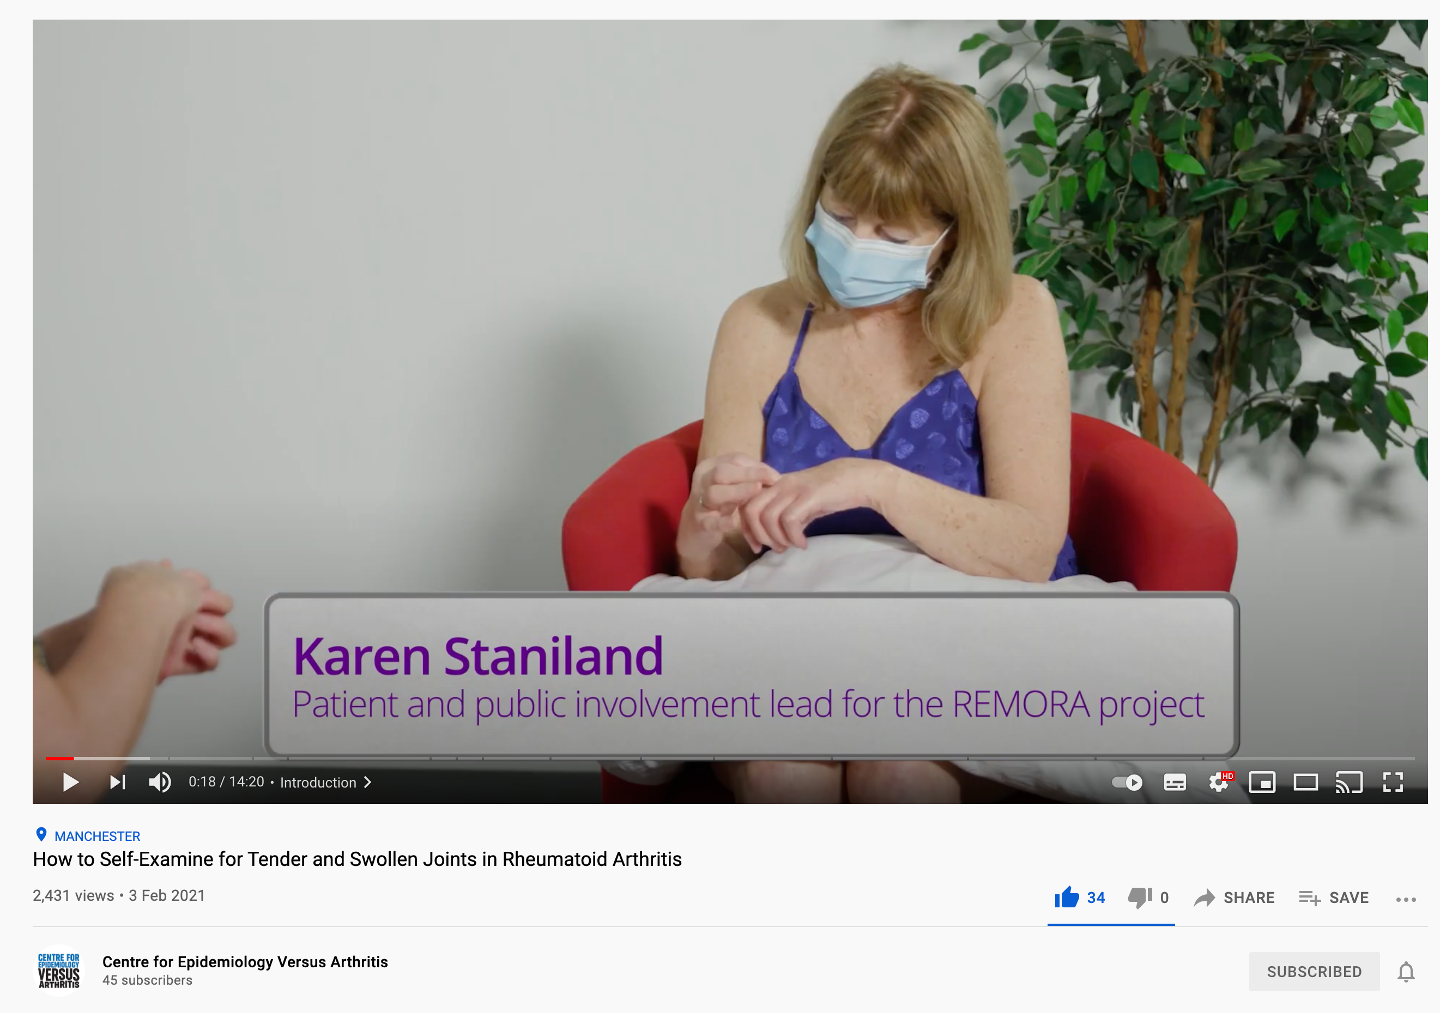
Self-examination video of T&SJC
>44,000 views

Slide 14
The REMORA programme
Pilot study: 2015-2017 Proof of concept
GM Digital Fund: 2020-2021 Scalable infrastructure
NIHR Programme Grant: 2021-2025 Evidence of better outcomes

Slide 15







Stepped wedge trial
Month 0 3 6 9 12
1) Usual care
2) Symptom tracking
12 rheumatology depts
Early inflammatory arthritis
& drug education clinics
Nurse-led recruitment
Continuous recruitment,
blinded to intervention:
Smartphone owners;
Willing to participate
Consent
Notice of intervention
1) Usual care, or
2) Symptom tracking
Sites sequentially crossover
from usual care to symptom tracking
Clinical assessment (incl DAS28 score) as per usual follow-up
Outcome assessment
for all participants
Web-based patient reported outcomes
Month 0 3 6 9 12
Notes:
Title:
Pathway of participant recruitment, allocation of intervention and outcome assessment

Slide 16
Outputs
Demonstrate improvements in clinical outcomes
  Primary outcome = improvement in DAS28 score
Health economic evaluation
How to implement at scale, including supporting materials
Digital inequalities
eConsent for sharing patient-data for care and research

Slide 17
Beyond REMORA2
Using PGHD between visits
  Scheduling visits according to clinical need
  Enabling ‘just in time’ interventions
Digital interventions including coaching, self-management
Expansion to other data types
  Images; sensor data

Slide 18
Remote Monitoring of Rheumatoid Arthritis
Digital Health Regional Networks Event - North
26th May 2022
will.dixon@manchester.ac.uk

