Slide 1


User-centred design
Introducing a UCD approach to a local system ~
provider and system perspectives
Ayesha Rahim, Chief Clinical Information Officer, Lancashire & South Cumbria FT
Linda Vernon, Digital Culture and Transformation Clinical Lead, Lancashire & South Cumbria ICS
Digital Health webinar 26th May 2022

Slide 2
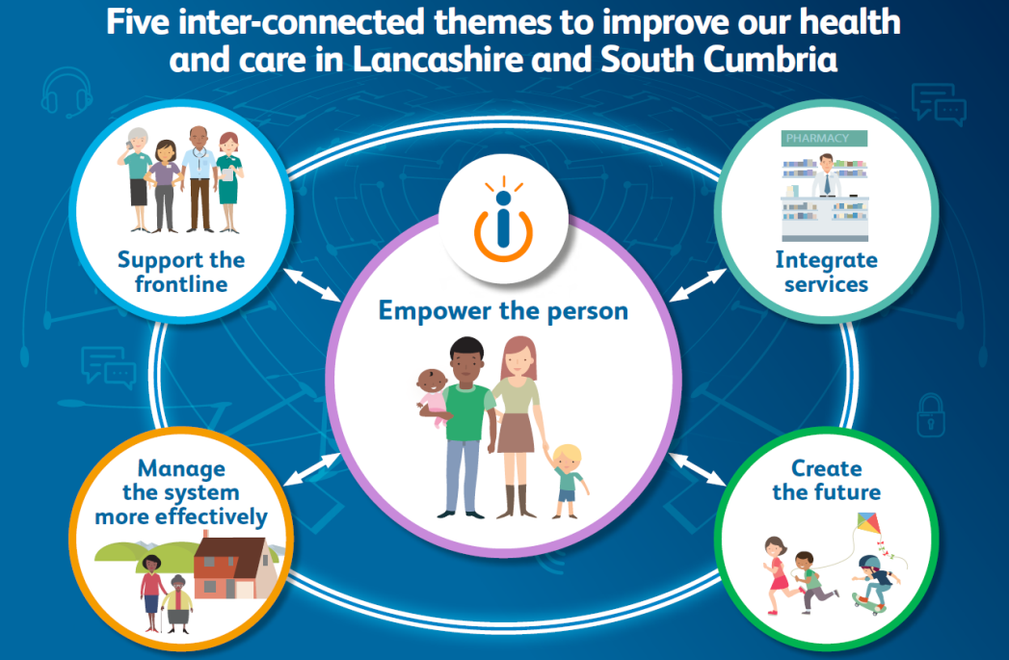
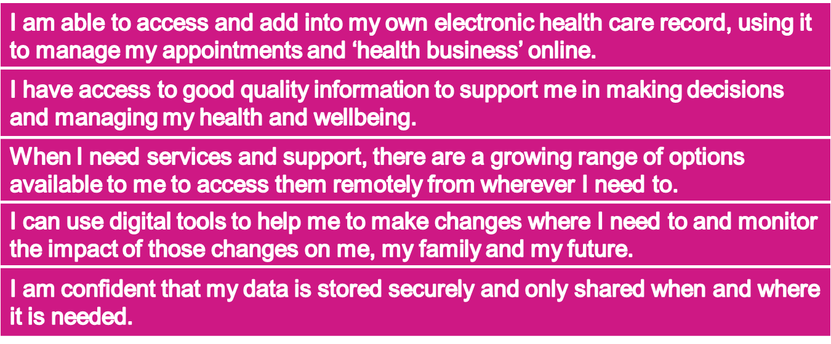
Our Digital Future
Empower the Person
Lancashire and South Cumbria Health and Care Partnership :: Our Digital Future (healthierlsc.co.uk)
Notes:
LV set the scene – strategy double edged arrows meaning the Person would influence how we … by adopting a co-design approach
ICS context
General context

Slide 3
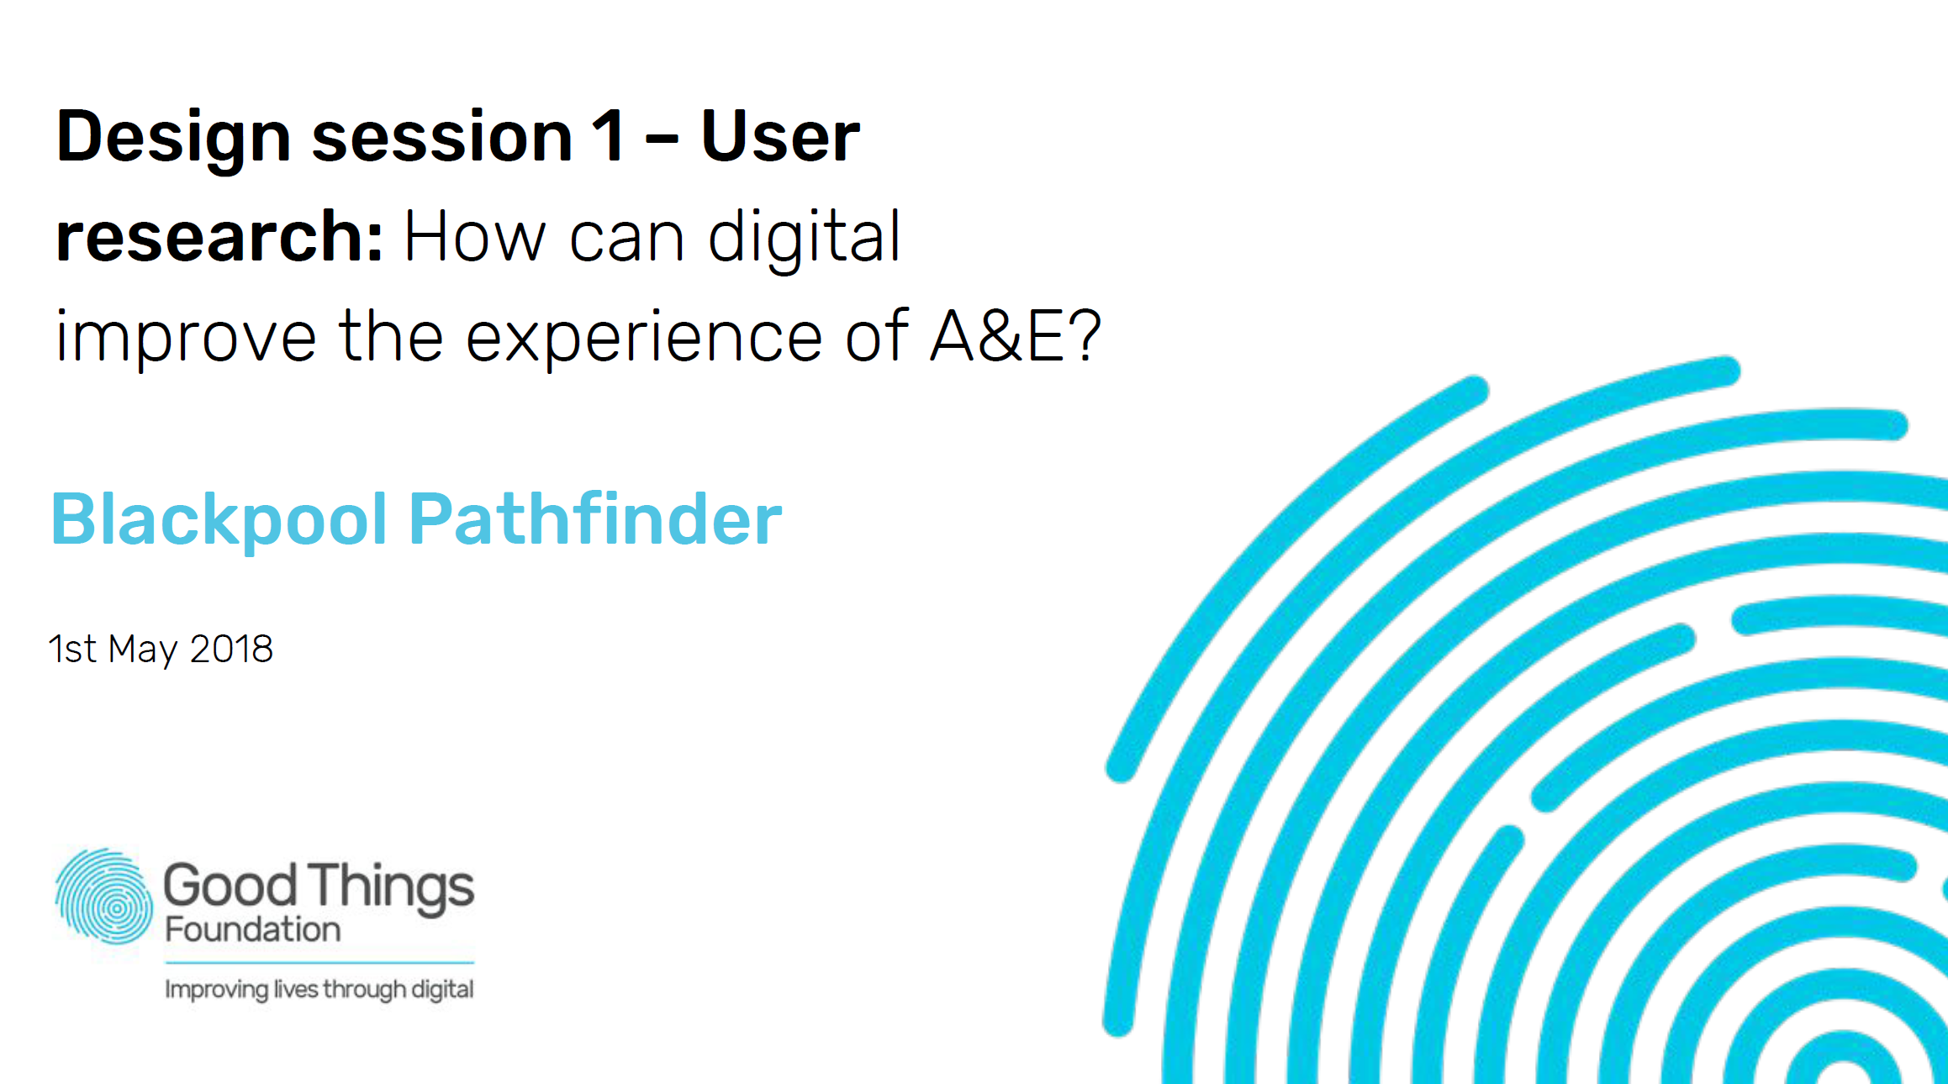
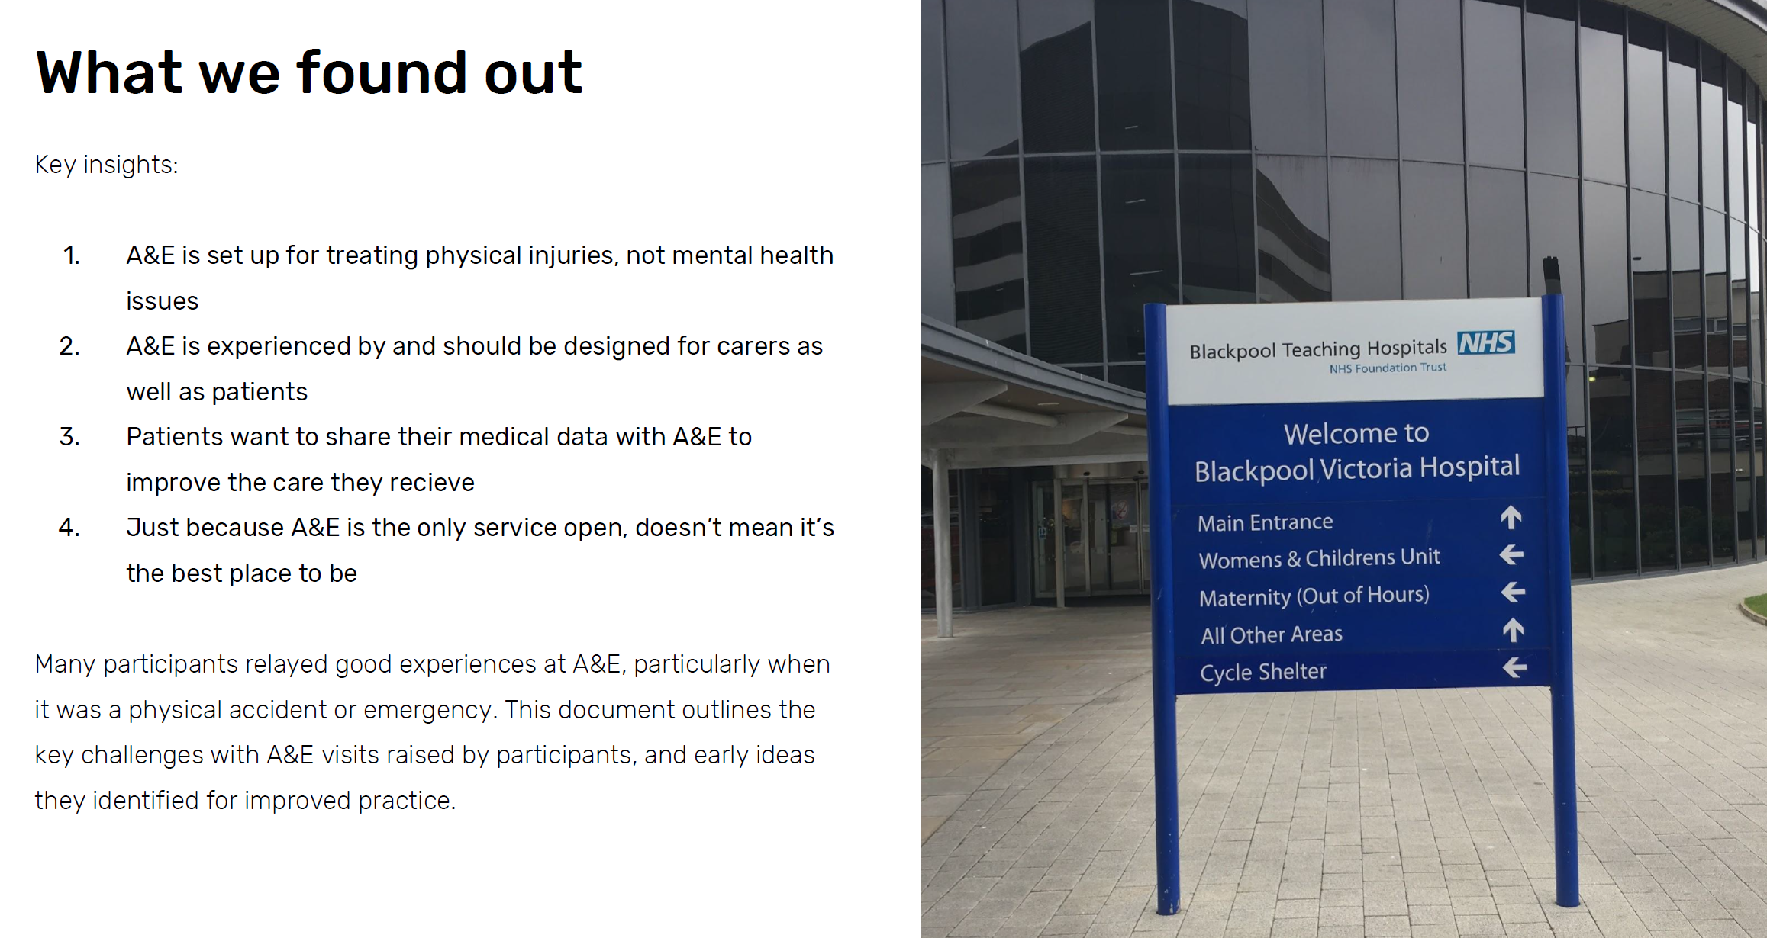
First steps in UCD - Widening Digital Participation
Notes:
LV Early work – working with Pete in GTF days …

Slide 4
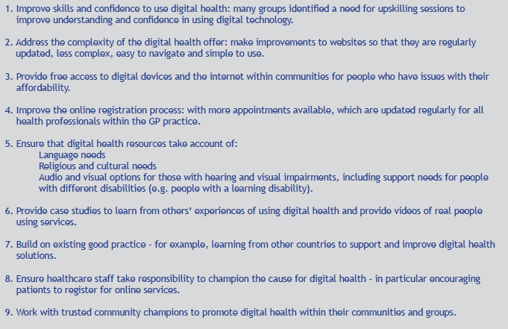
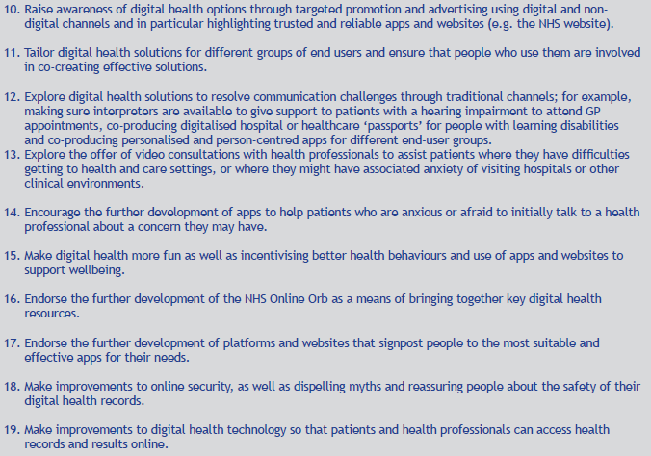

Hearing from our public ~ insights 2019
https://www.healthierlsc.co.uk/news-and-events/latest-news/putting-local-people-lancashire-and-south-cumbria-at-the-heart-of-our-digital-health-plans-healthwatch-digital-report
Notes:
LV Early work – not quite UCD but hearing What Matters to our public about digital health

Slide 5
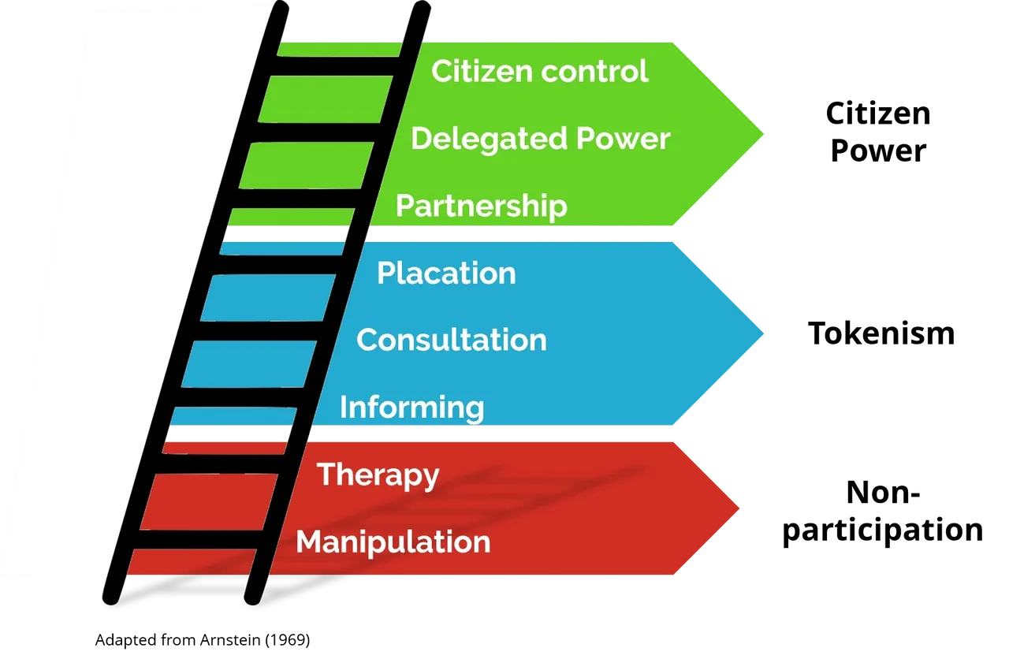
Revisiting a person-centred approach…
Notes:
Background
Patient portal project – started off as LSCFT project, then à ICS-wide
Desire to co-produce solution with citizens
Some experience of working with patients in LSCFT, but not highly structured

Slide 6
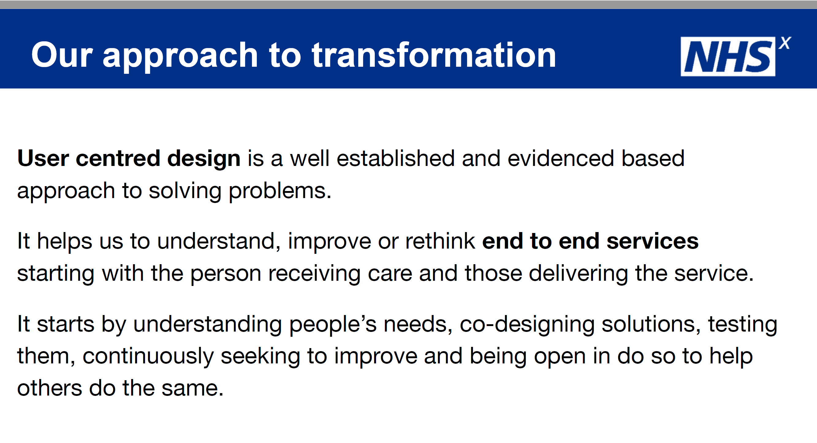
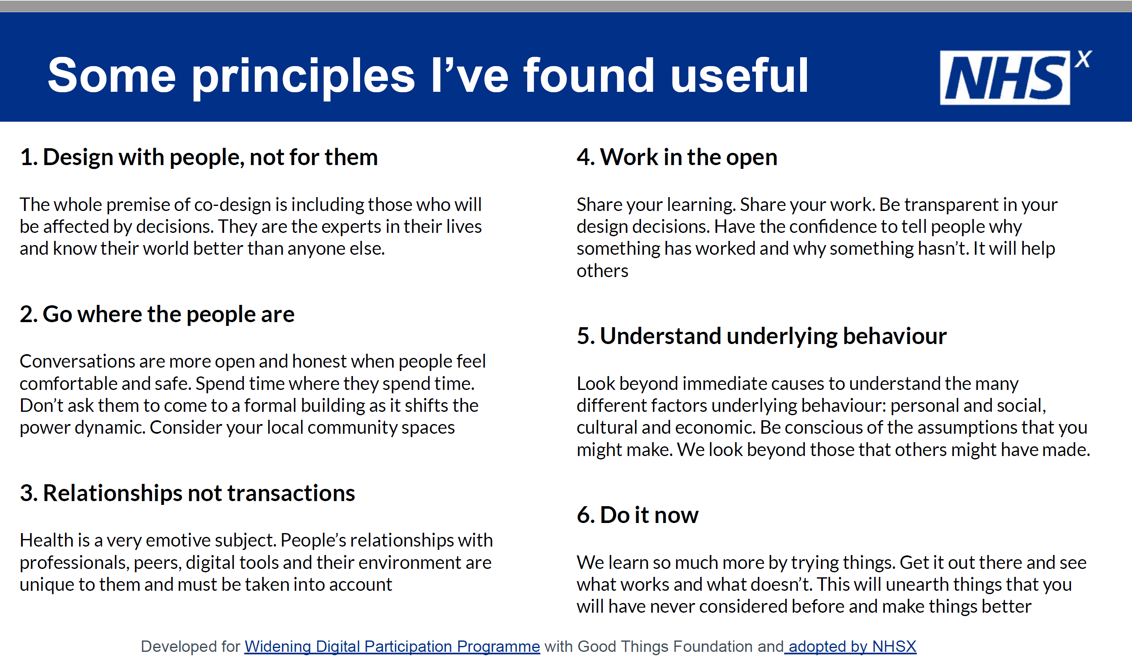
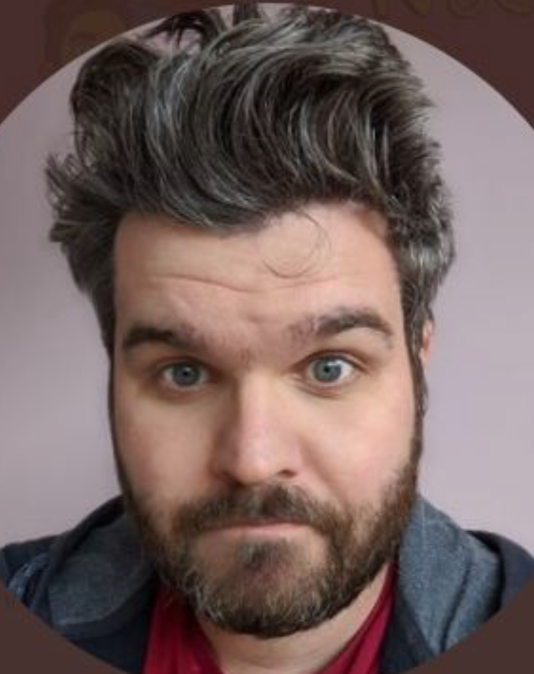
NHSX (NHSE Transformation Directorate) support
Notes:
AR background to patient portal, ideal opportunity to revive a UCD approach, Pete came to do the initial workshop … 2 subsequent slides I used for illustration in another slidedeck but feel free to delete!!
Actions
Sounded out Pete via NHSX, learned about plans to upskill regions on UCD – serendipitous timing!
Talked with Linda/Mark about the idea
Arranged introductory webinars – good discussions, but also helpful challenge
The Well workshop [reflections from Linda and Ayesha]

Slide 7

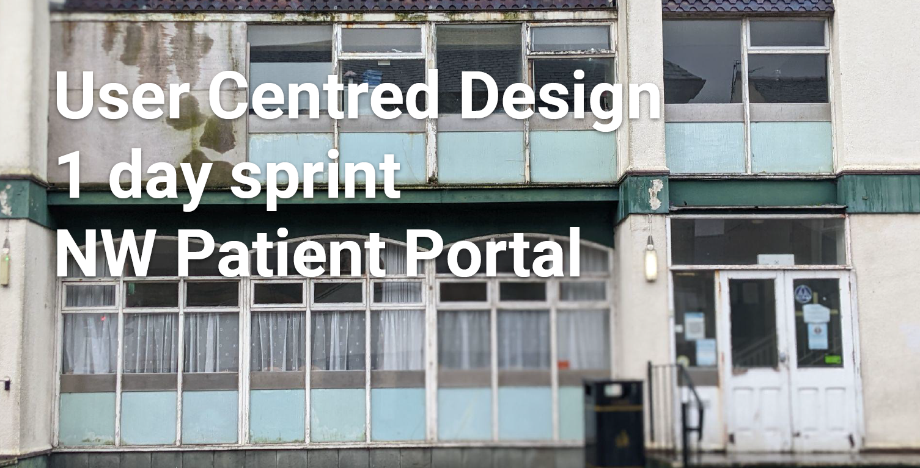
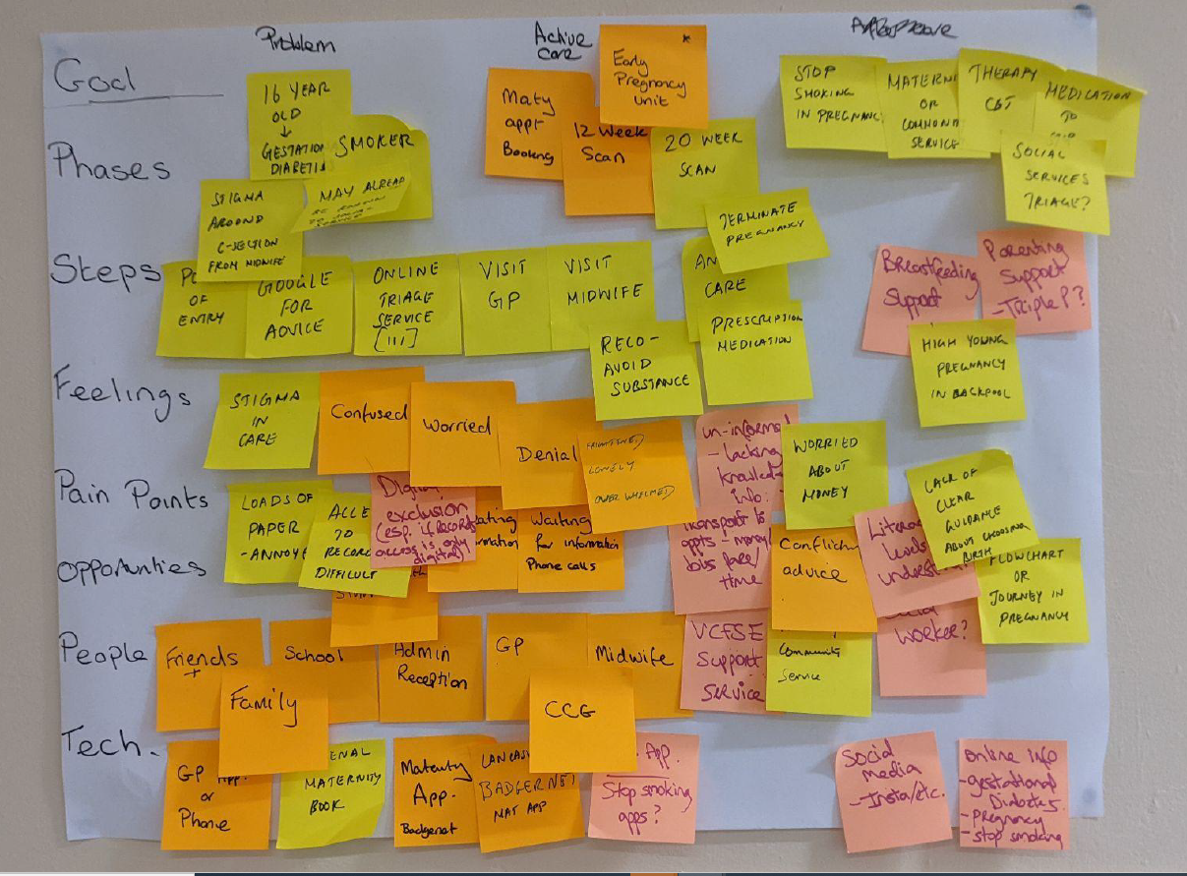
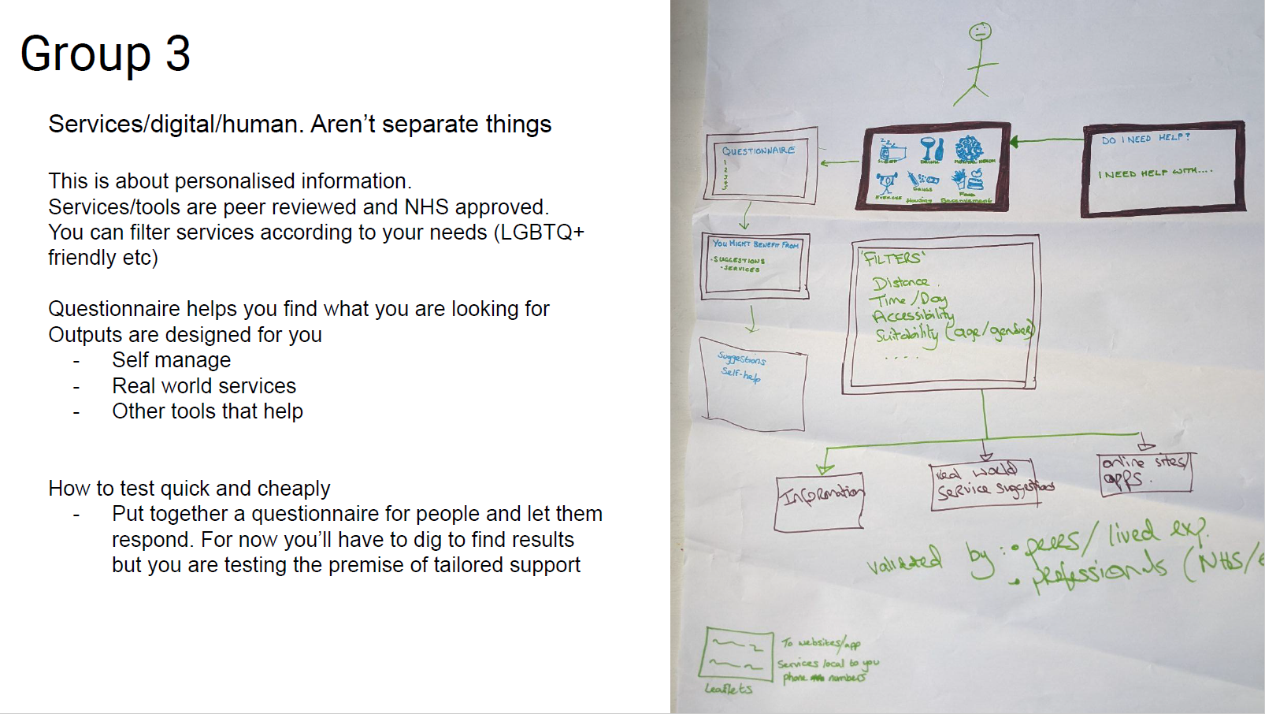
UCD to understand people’s needs from a patient portal
Notes:
Impact
How the Well session has impacted on the Pt portal project
How the UCD stuff has been received in general
Future plans
Further workshops planned x 2
More important change is the cultural one, not just the practice
Plans for more resource nationally – so watch this space…

Slide 8
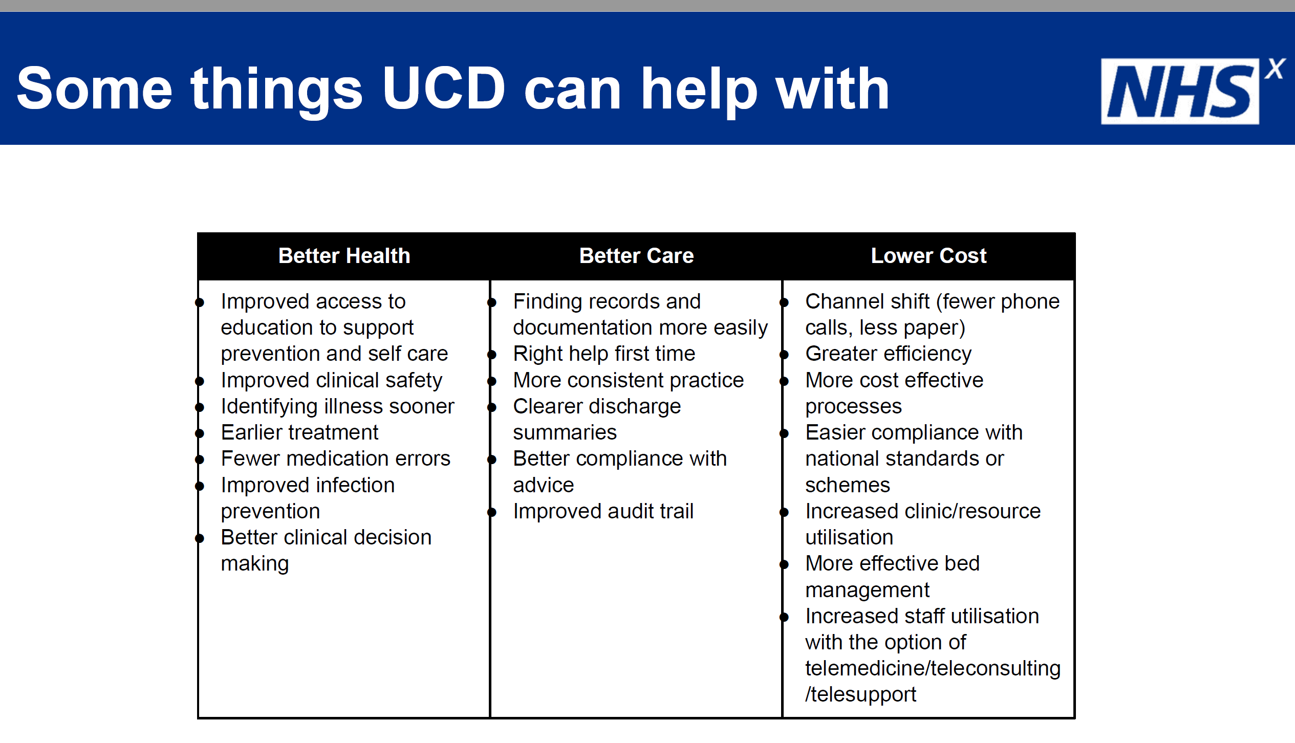
Why UCD is the right thing to do …
Notes:
AR/share slide… reason to do – ultimately better digital service design, meeting real needs, and increased chance of adoption

Slide 9
Can be a challenge to implement …
Time
Funding
Skills/talent
Value added (ROI as well as experiential)
…but well worth the effort!
Notes:
LV/share slide … challenges identified during our NW workshop

Slide 10
Thank you!
Web healthierlsc.co.uk | Facebook @HealthierLSC | Twitter @HealthierLSC

