Slide 1
Northumbria Healthcare NHS Foundation Trust Mimecast Journey
Simon Sleightholm, Information Assurance and Security Manager.
Simon.Sleightholm@Northumbria.NHS.UK

Slide 2
Where we were
Exchange 2010
Office 2010
Egress for encryption (500 users)
Fortimail for mail hygiene (coming to end of contract)

Slide 3
Where we wanted to be
Supported Exchange (DSPT)
Supported Office (DSPT)
Encryption for everyone!
DCB1596 NHS Secure Email Standard Accreditation
Comprehensive email hygiene – Green Lights on NCSC Mail Check.
Disaster Recovery – email available if on-site servers lost (post Wannacry requirement)
Security Awareness Campaigns (from Security Strategy)

Slide 4
Email Options
NHS Mail
Office 365
On-Prem Exchange
Initially opted for Office 365 (pre-NHS offering) and completed partial email migration.
Acceptable service capabilities sized with a 3rd Party Partner and Microsoft financially unsustainable at the time.
Backed-out and reframed for On-Prem Office 2019 and Exchange 2016.

Slide 5
Why Mimecast?
Looked at a range of products and selected Mimecast as best value, capabilities vs cost.
Mimecast are approved as a UK GOV provider in this sphere.
Journaling to give us two months of DR meeting board requirements.
Secure Messaging to allow ALL users to have Egress-style encryption.
Awareness Training module, which goes beyond phishing simulations.
Very comprehensive email hygiene filtering (incoming and outgoing)
URL protection on all devices.

Slide 6
Key Lessons Learned
HSCN would not allow us to open the appropriate ports on their firewalls so we have to operate via our Virgin internet link.
Number of Third Party system have been ‘spoofing’ Trust or NHS addresses for branding/familiarity purposes. Improved DMARC interrupted these, and switching from Quarantine to Block – as required by DCB1596 – in December will be fun.

Slide 7
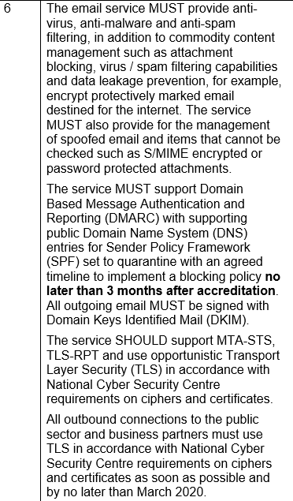
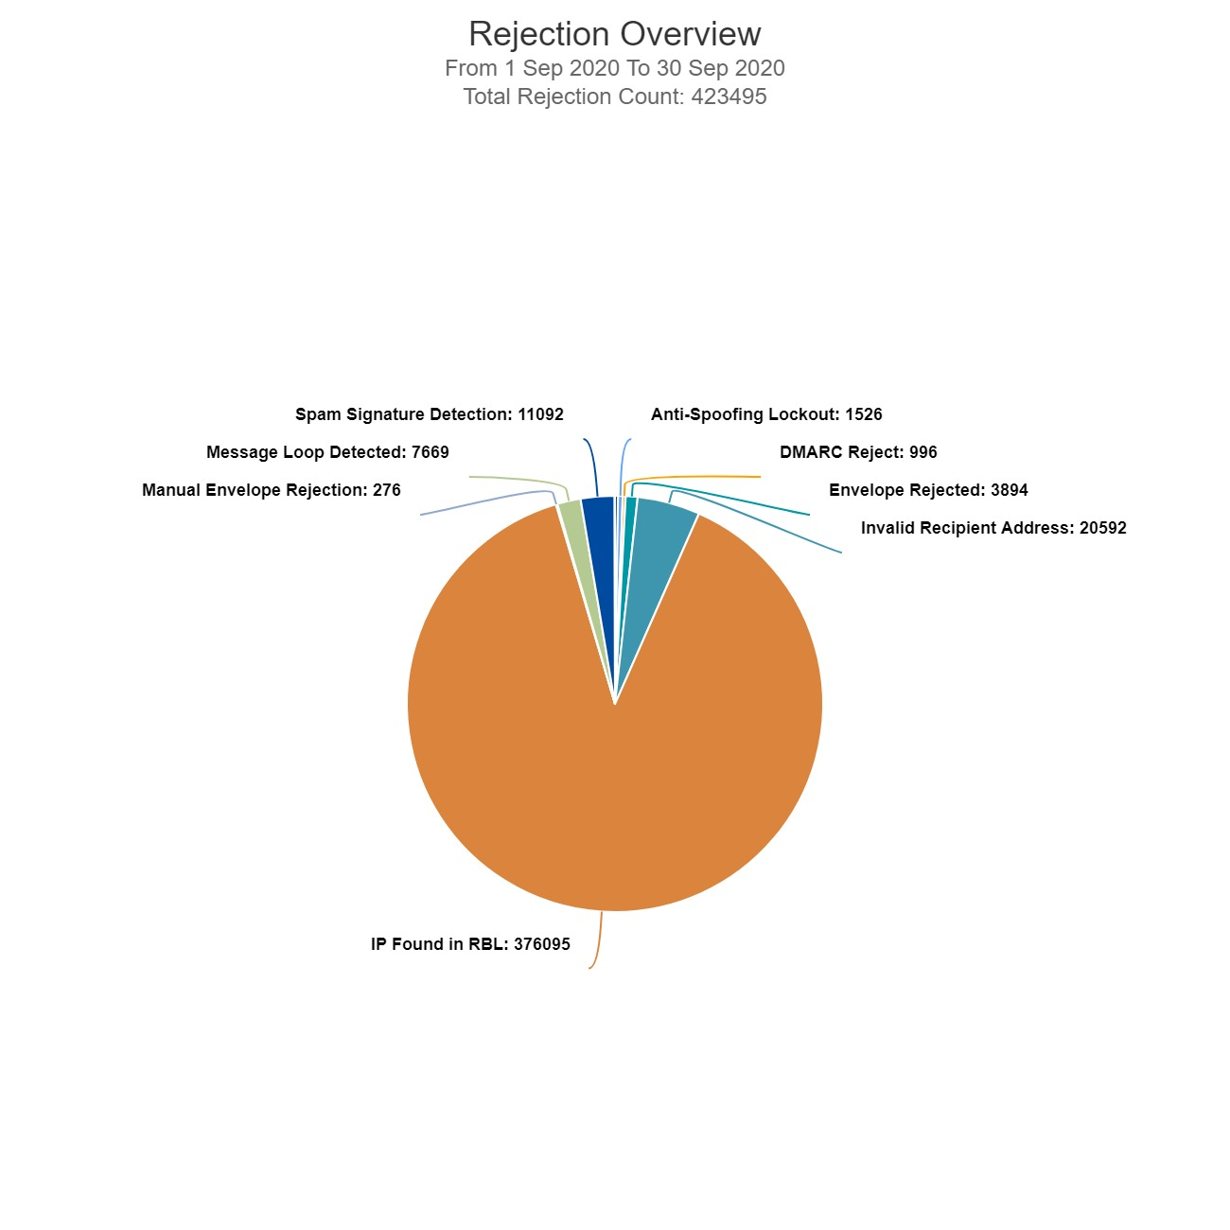
Benefits
Mimecast allowed to comprehensively comply with section 6 of the NHS DCB1596 Conformance Self Assessment . We’re one of only 8 NHS Trusts who accredited their on-premises Exchange Environment.
With Fortimail we trapped 40,000 unwanted emails a month, September’s report from Mimecast was over 10x better.
NCSC Mail Check Green Lights for DCB1596 and DSPT compliance.

Slide 8
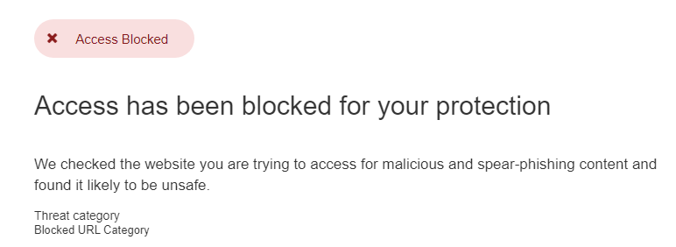
Benefits
Emails from our local WARP (Warning, Advice & Reporting Point) advising of phishing emails with malicious links – Mimecast is already on it…

Slide 9
Next Steps
Awareness and phishing-simulations campaigns scheduled to launch Jan 2021
Auto-encryption of Sensitive Data based on DLP/Content Analysis rules.
Tweaking and tightening of rulesets.
Reviewing current mail provision in light of new Microsoft offerings, and considering moving to M365 in 2021.

