Slide 1
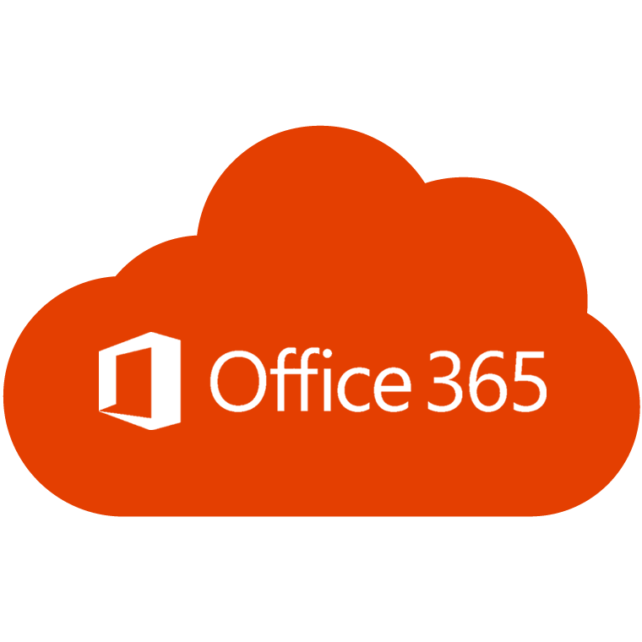

M365: Rhetoric vs. Reality
with J. Peter Bruzzese

Slide 2


J. Peter Bruzzese
Co-Founder and Chief Content Officer of ClipTraining.com
8x Awarded Microsoft MVP (Exchange/Office 365) – 2010 to 2019
Technical author with dozens of books sold internationally
Global technical speaker for Techmentor, Connections, MEC and Microsoft’s Ignite
Journalist for MSExchange.org, Redmond Magazine, Petri (and others)
Journalist for InfoWorld (Enterprise Windows)
Mimecast Techvangelist

Slide 3
Microsoft 365 – Essential For Your Business
Enterprise Mobility
Analytics
Office Productivity
Microsoft has developed the greatest business productivity suite on the planet
Microsoft 365
Office 365 + Windows 10
Azure
Email/ Exchange
Identity
SharePoint
Teams
OneDrive

Slide 4
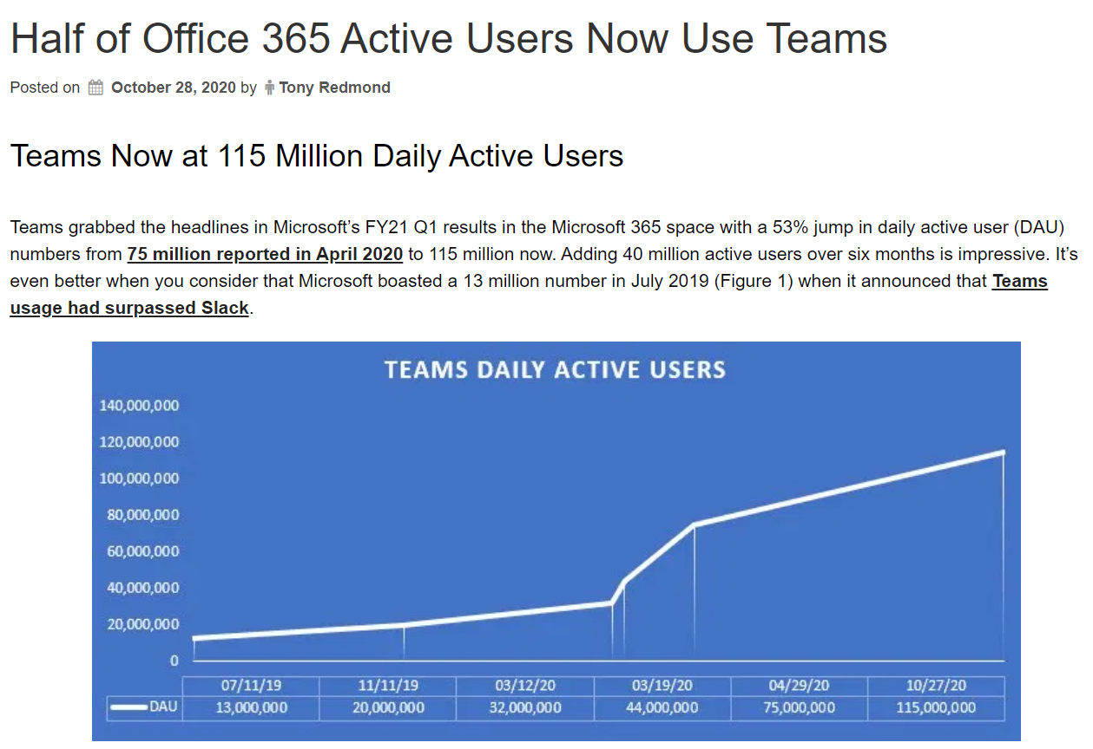
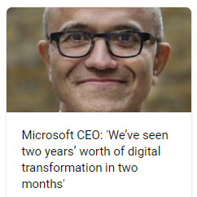
M365’s Explosive Growth
M365 sees impressive growth in 2020

Slide 5
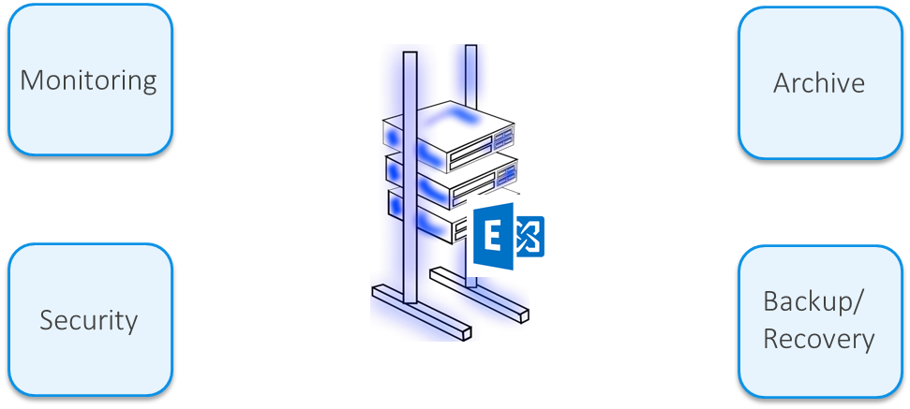
Ecosystem Solutions with Exchange On-Premises

Slide 6
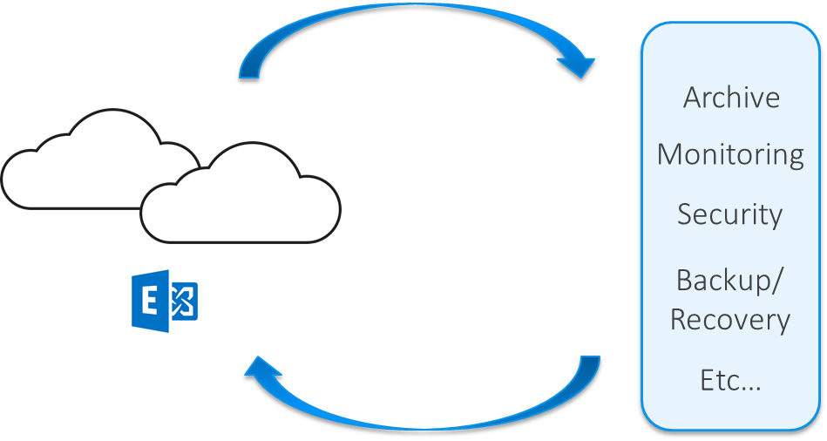
Ecosystem Solutions for Exchange Online/O365

Slide 7
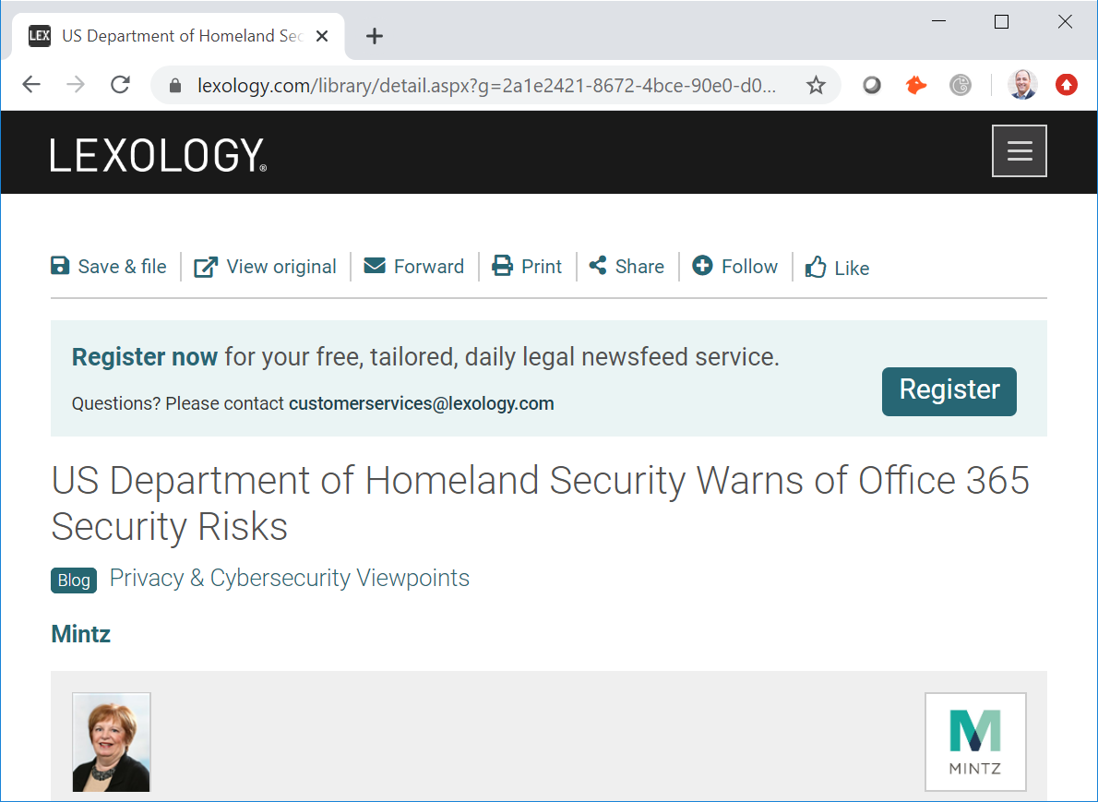
Security Concerns

Slide 8
Office 365 | Exchange Online Concerns | Security
Security
  Single code base vendor (one lock to pick) “security monoculture”
  Multi tenant (target rich/large attack surface)
Solution?
  Defense-in-Depth
  Security-through-Obscurity
“Having a security feature is not the same as having high security efficacy.” – Michael Osterman (Osterman Research)

Slide 9

Often… the Danger Starts with Email
90+% of all attacks start with some form of phish
(some say it’s higher)
  According to the Wall Street Journal “About 97% of all cyber attacks start with phishing”

Slide 10
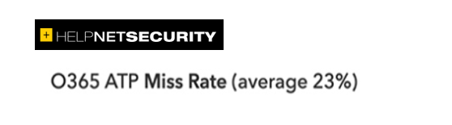
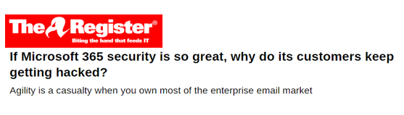
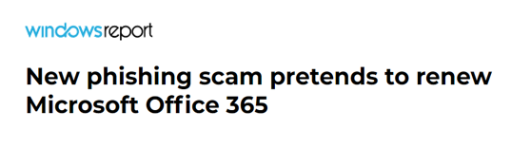
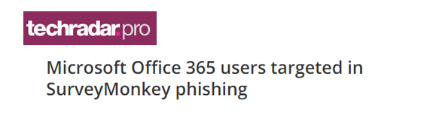
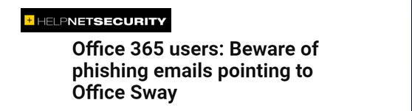
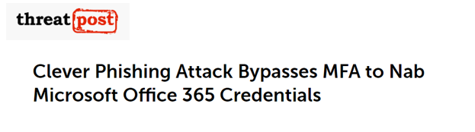
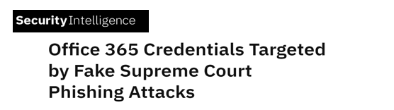
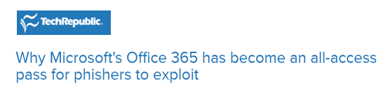
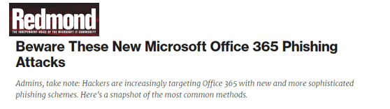
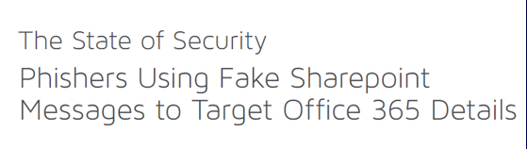
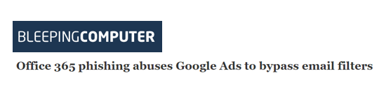
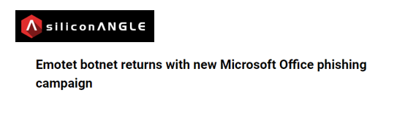
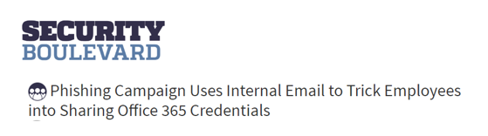
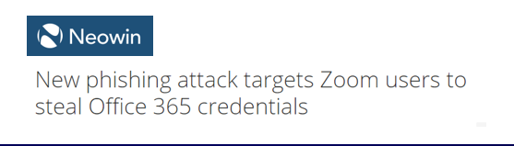
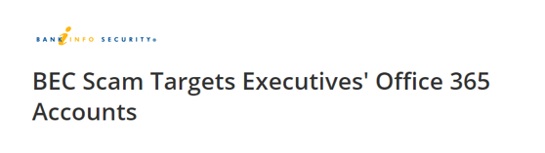
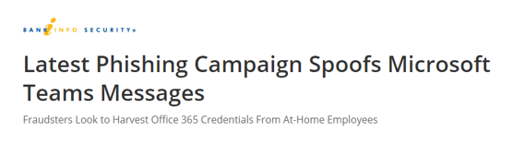
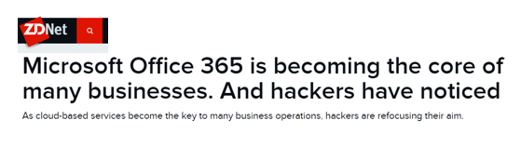
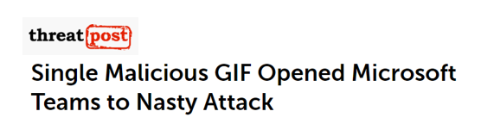
You’ve seen it, we’ve seen it, hackers see it…

Slide 11
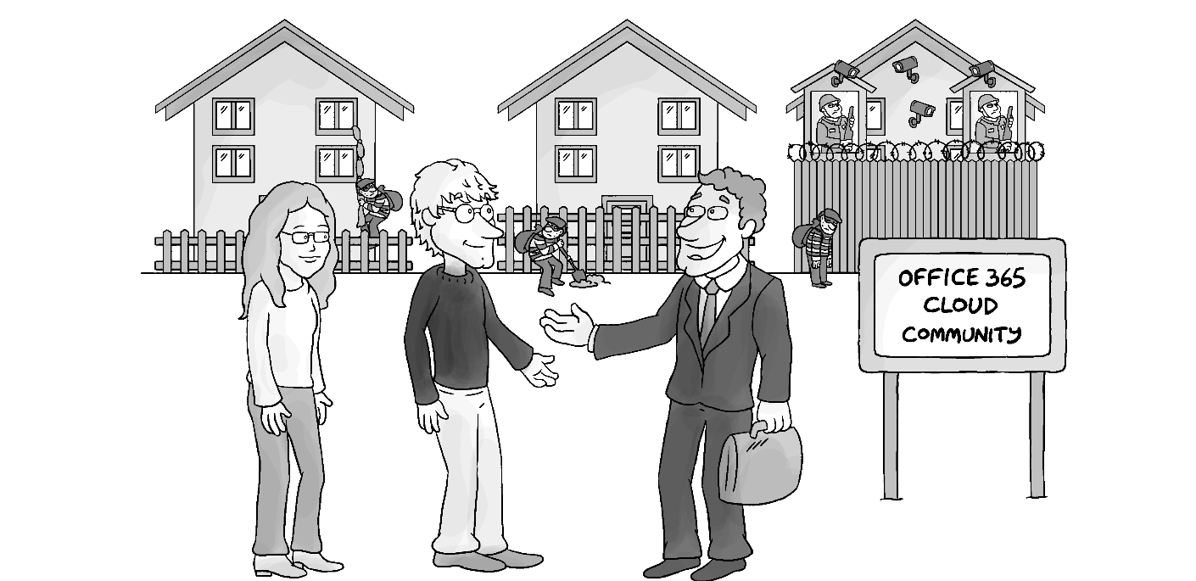
Office 365 Efficacy

Slide 12
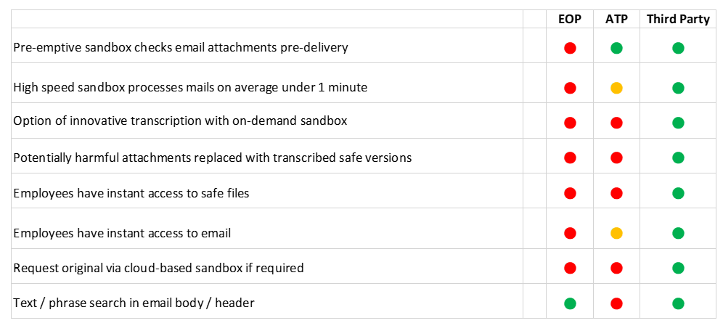
Attachment Protection: Example

Slide 13
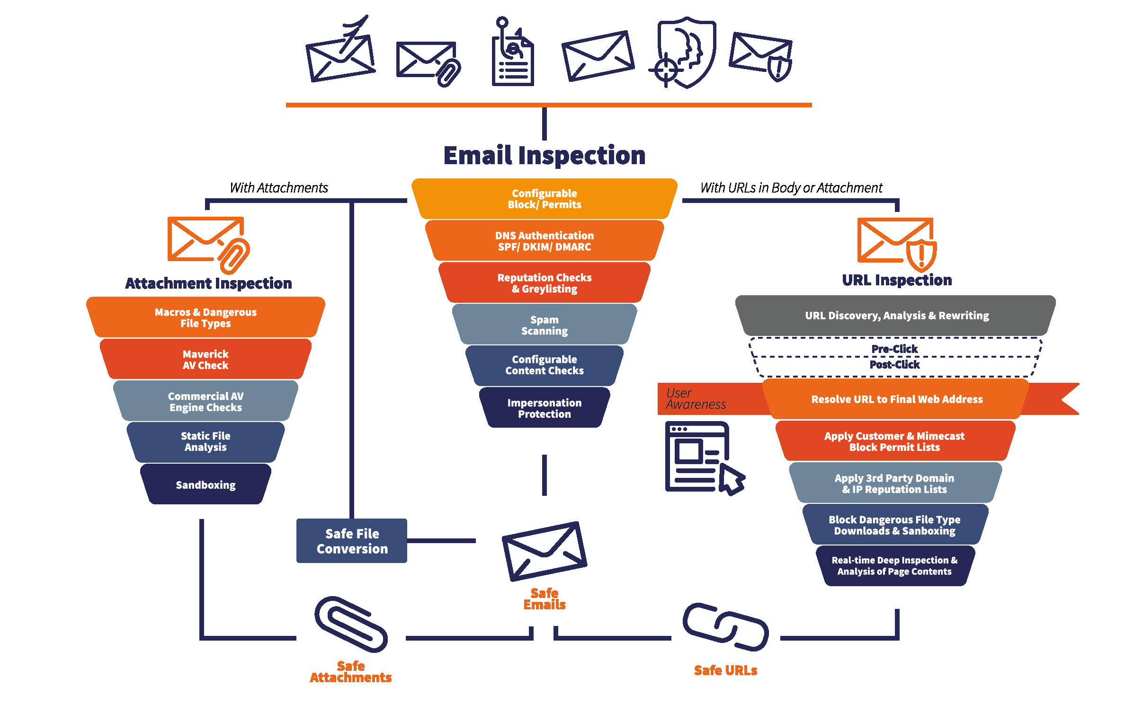
Layered (Bolt-on) Gateway

Slide 14
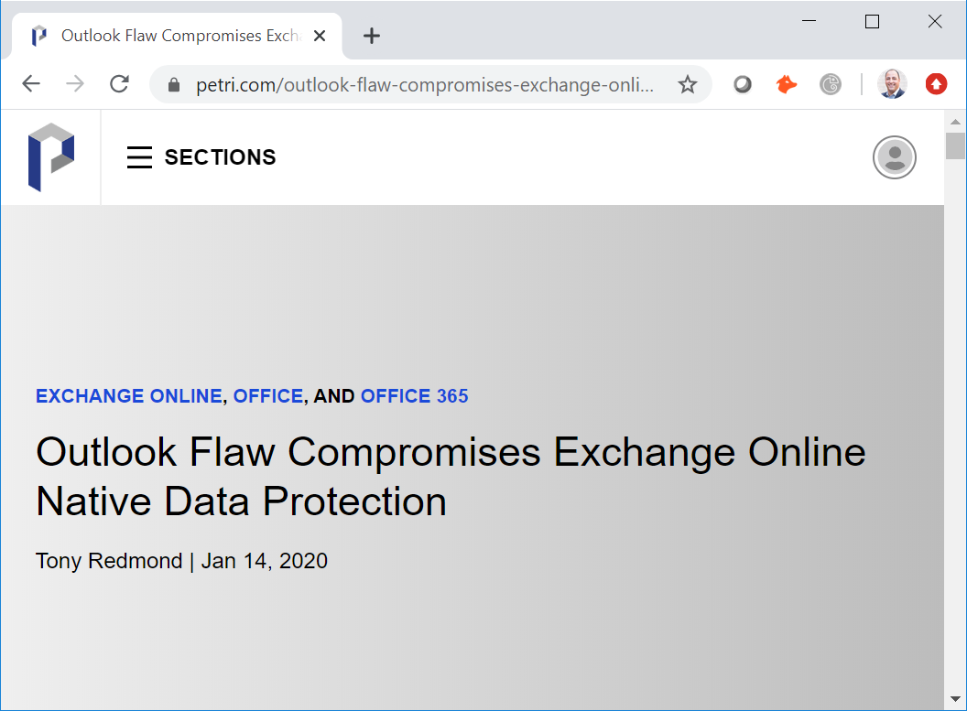
Compliance Concerns
Point in time restoration of mailbox items is out of scope for the Exchange Online service, though there might be third-party solutions available that provide this functionality.
https://docs.microsoft.com/en-us/exchange/back-up-email

Slide 15
Office 365 | Exchange Online Concerns | Archive
Compliance
  No single pane of glass for hybrid deployment
  No interactive read-only solution for end-users
  In-place Archive (aka PST repository)
  Legal (In-place) Hold lacks flexibility (ie. purge through PowerShell)
Solution?
  Separate data bank archive
  Location? Cloud preferable
"Reference Customers note inconsistencies with the search" -Gartner
"Reference customers report usability and performance concerns when discovery volumes are high and searches are complex." Forrester

Slide 16
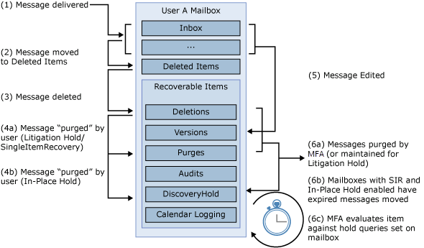
Exchange/Office 365 Archive

Slide 17
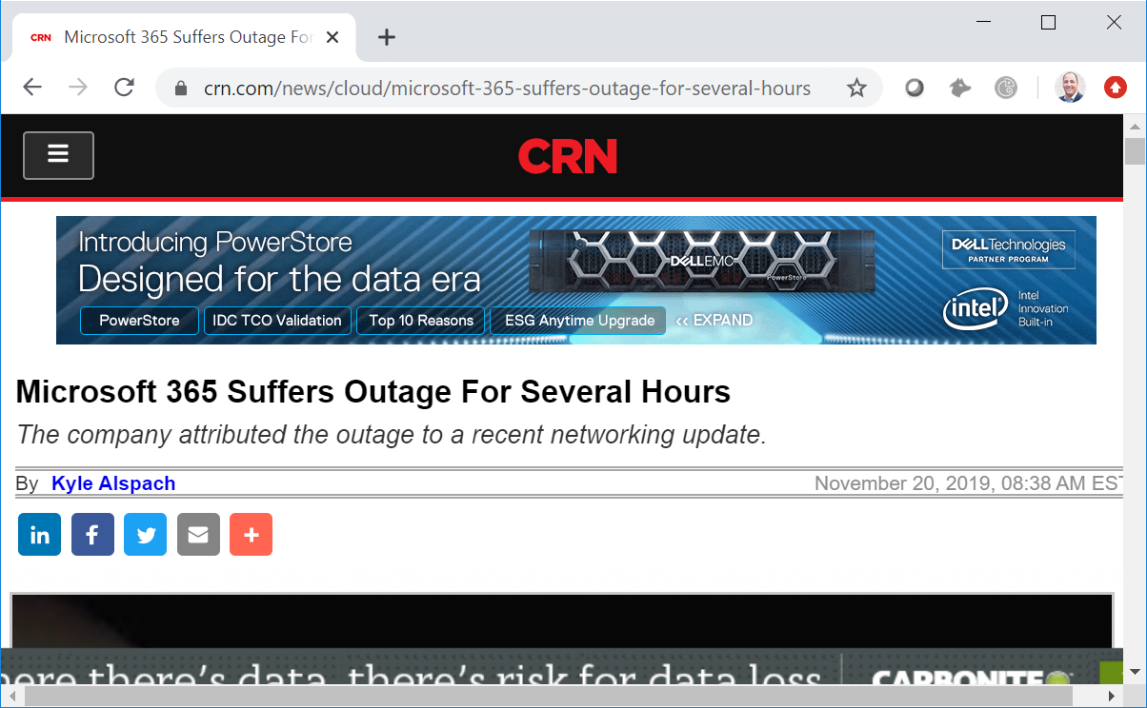
Continuity: Shadow IT Risk

Slide 18
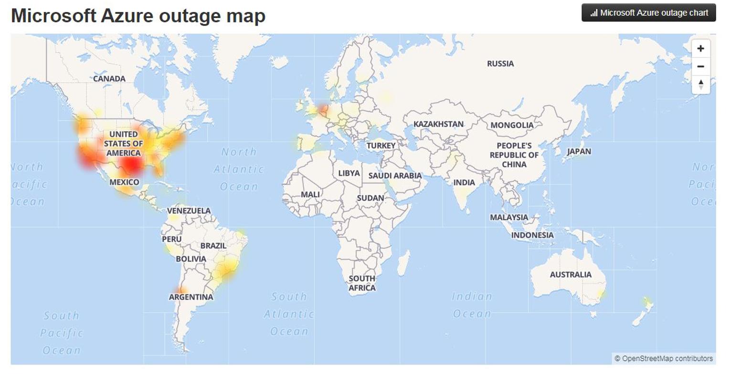

Slide 19
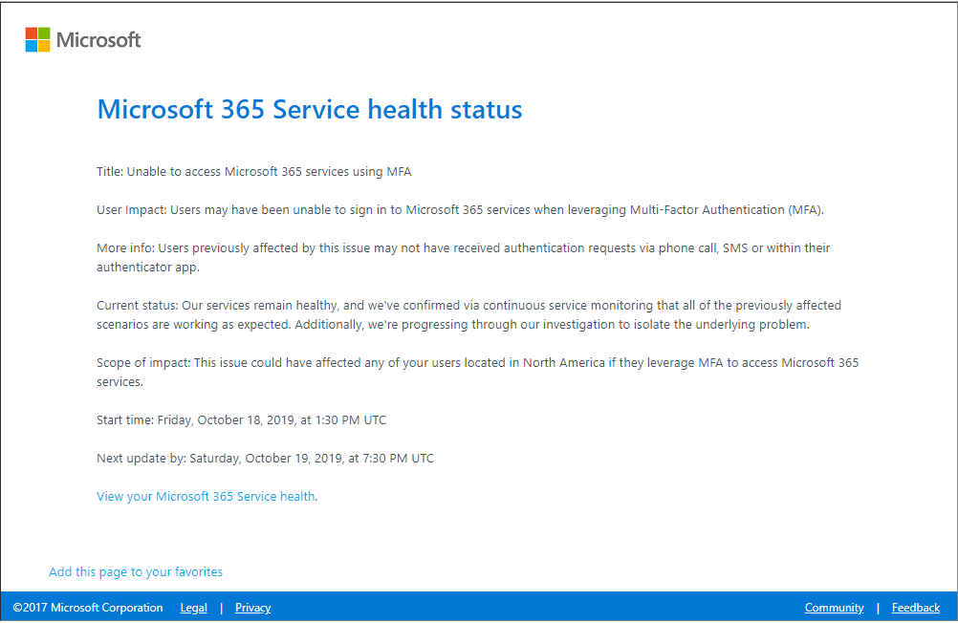
Whole/Parts and Pieces

Slide 20
Office 365 | Exchange Online Concerns | Continuity
Built-in Availability/Resiliency
  Native Data Protection
  NO backup/recovery solution
  Result: Multiple long-term outages (whole/parts/pieces)
Solutions?
  Alternative approaches to provide cyber resilience
  People DO keep working (using Shadow IT) so you need to provide a way to avoid that

Slide 21
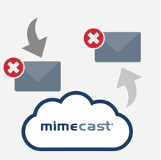


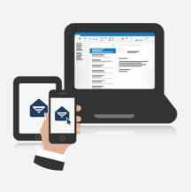
Continuity Event Management
Monitor
Alert
Respond
Stay Productive
Detect mail flow issues:
On-premises
Cloud
Hybrid
Receive alerts:
Delivered via SMS or an alternate email address.
Continuity portal for quickly assessing the situation.
Respond:
One click activation.
Employees notified via a Mimecast for Outlook or SMS notification.
Stay Productive:
Employees continue to send and receive email as well as access calendars via Outlook, mobile, web and Mac apps.

Slide 22
Conclusion: Rhetoric vs Reality
It’s too easy to sleepwalk into M365
  You can believe every word the brochure says or you can do your own research into “gaps” and solutions that fill those “gaps”
  Areas that are currently worth investigating include security, compliance and continuity
  An all-in-one solution that hits all gaps and does it at a high level across the board is key

Slide 23







38,000 Customers Worldwide
13 Million End Users
98% Customer Retention Rate
66 Bn Emails Managed Monthly
1 Trillion URLs rewritten
700 Million web requests
420 Million attachments deep scanned
Founded in 2003, IPO Nov 2015
9 Global Offices, >1,800 Staff
16 Data Centers, 7 Countries
US, UK, Germany, Jersey Islands, Australia,
Canada, South Africa
100% Cloud Native Cybersecurity Platform
Built On An Email
Security Foundation

Slide 24
THANK YOU

