Slide 1
How technologies from Nuance and Microsoft are supporting NHS Trusts during the Covid-19 pandemic and beyond
Featuring:

Slide 2
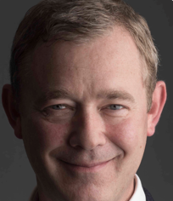
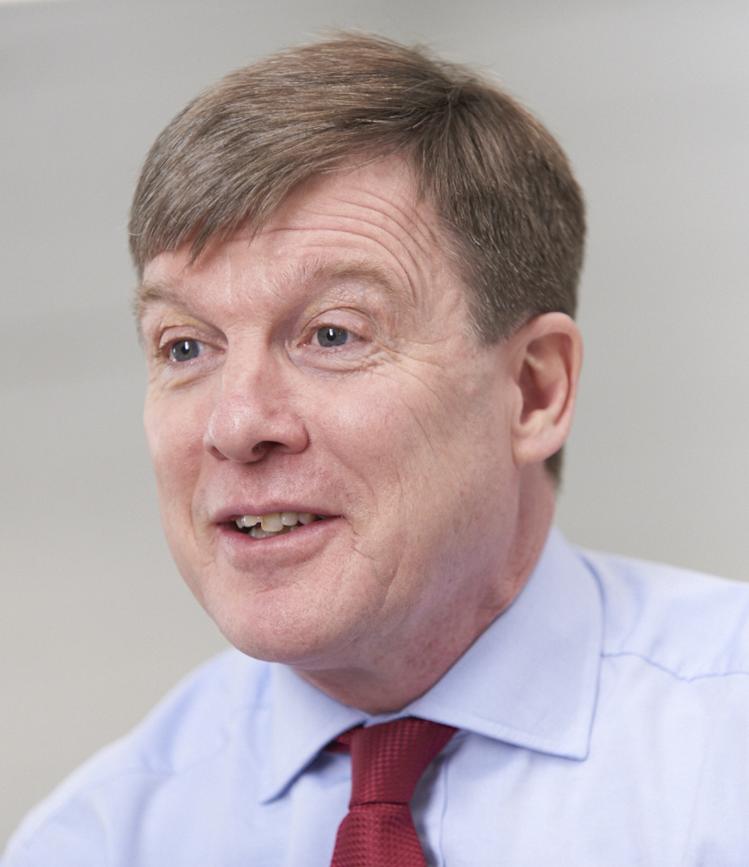
Webinar speakers
Introduction from Jon Hoeksma, Digital Health
Luke Stockdale Director of Digital Transformation and Innovation | Ian Nicholls eHealth Transformation Manager | Stephen Docherty Industry Executive for Health | Dr Simon Wallace Chief Clinical Information Office
Calderdale and Huddersfield NHS Foundation Trust | Royal Cornwall Hospitals NHS Trust | Microsoft | Nuance Communications

Slide 3
Poll question 1:
Have you used speech recognition at home or on your mobile phone?
Yes, I’ve used it
I don’t know / I’m not sure
No, I have not

Slide 4
The complexity of healthcare
“Medicine used to be simple, ineffective and relatively safe” “Now it is complex, effective and potentially dangerous”
Professor Sir Cyril Chantler, Honorary Fellow, ULC Partners
Former Chair of General Medical Council Standards Committee – stated in 1998

Slide 5
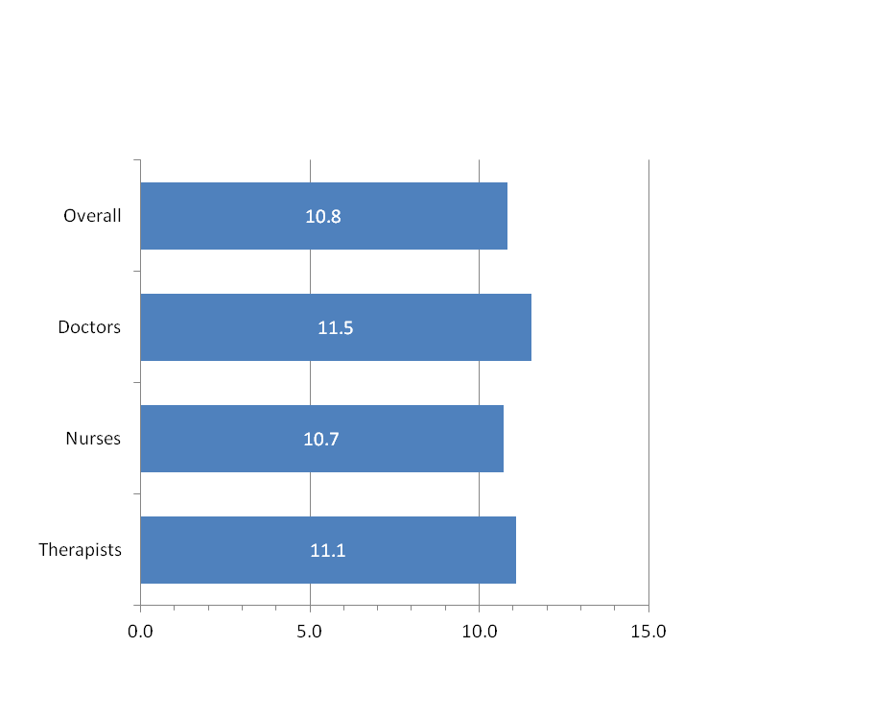
The challenge of clinical documentation
Clinicians are overwhelmed and de-motivated by excessive admin
Almost 1 in 3 doctors ‘burnt out’ and stressed
(Based on UK survey conducted before COVID-19 pandemic).¹
47% cited having too many bureaucratic tasks (e.g. note-keeping, paperwok) as their reason for burnout.¹
Research suggests clinicians spend on average around 11 hours per week adding to clinical documentation (doctors slightly more than nurses)²
References:
Medscape UK Doctors' Burnout & Lifestyle Survey 2018
Nuance Clinical Documentation Challenge Report
Notes:
‘Clinical Documentation Challenge’ - research undertaken with 3,000 healthcare professionals from across the United Kingdom, Germany and the United States. (Research commissioned by Nuance
and carried out by specialist research company, Ignetica.)

Slide 6
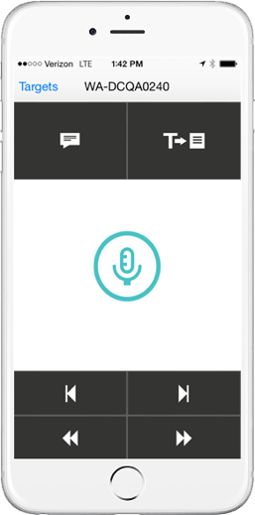
Cloud-based clinical speech recognition
Dragon Medical One
AI-powered clinical speech recognition
PowerMic Mobile
Secure wireless microphone for iPhone and Android
Voice to text into clinical notes (e.g. EPRs) – digital tool to support the ‘paperless’ journey
Dictate at the point of cursor
We speak 3x faster than we type
Mature, proven technology – 99% accurate
Smart AI and comprehensive medical dictionary
NO initial speech profile training required
Single voice profile – accessible on different devices in different locations
Use of macros to improve quality and speed of documentation
Microphone can be on smartphone – iOS/android
Dictation Box
Transfer Text
Dictate (Record)
Toggle on/off button
Tab backward
Tab forward
Rewind
Fast forward

Slide 7
Poll question 2:
2. Do you use clinical speech recognition or are you considering it?
Yes, I’m already using it
Yes, I’m considering it within the next 12 months
Yes, it’s under consideration but not for over a year
I don’t know / I’m not sure
No, I don’t need this

Slide 8
The Challenges of Covid-19

Slide 9
Calderdale and Huddersfield NHS FT
Introduction by Luke Stockdale
2 main sites: Calderdale Royal Hospital / Huddersfield Royal Infirmary
Greater Huddersfield has a population of 250,000 people and Calderdale has a population of 220,000 people
Approx. 800 beds
Approx. 6,000 staff
Notes:
Source: Calderdale and Huddersfield NHS Foundation Trust, Annual Report and Accounts 2018/19

Slide 10
The impact of Covid-19 on our hospitals
Calderdale and Huddersfield NHS FT
Stopped
Started
Elective services
Certain projects/programmes have been recast
“Redesigned/restructure” hospital to deal with Covid-19 (i.e. Red Areas, Super Green Areas)
Further increased Partnership working across the communities (i.e. Local Authority, Care Homes etc)
Embedding new ways of working e.g.
Non-clinical staff working from home to create additional space and capacity
Virtual consultations (and visitor virtual consultations)
Increased working with private sector

Slide 11
How speech recognition helped with Covid-19
Calderdale and Huddersfield NHS FT
How cloud-based clinical speech recognition is used:
Cerner Millennium electronic patient record (EPR) since 2017
Cloud-based Dragon Medical One integrated into Cerner EPR - Simplify workflow - use voice to enter patient notes direct into EPR
PowerMic Mobile app for Dragon Medical One - Supports clinicians on the move - voice profile in cloud wherever they are working
Moved from various mobile devices to Zebra TC51 Touch Computer…

Slide 12
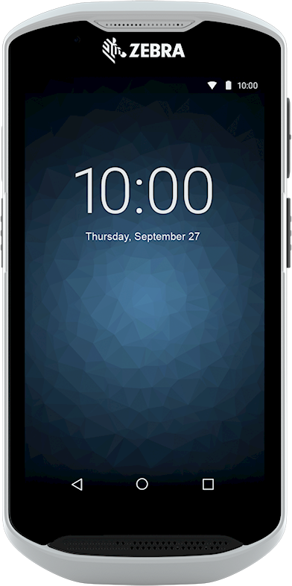
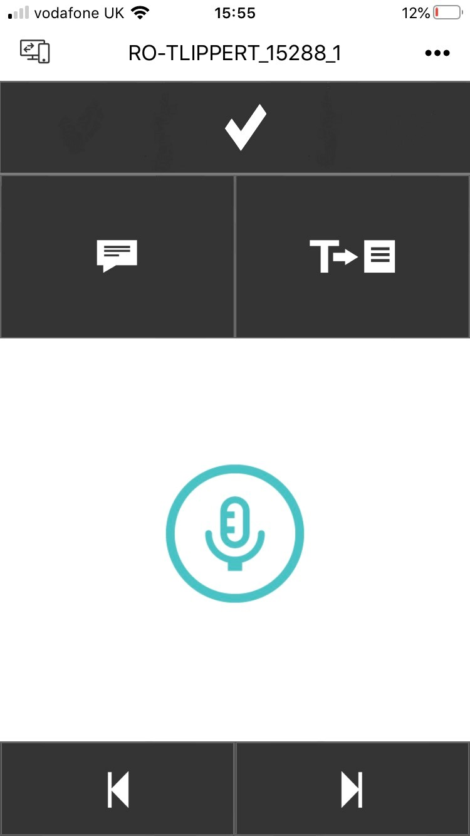
How speech recognition helped with Covid-19
Calderdale and Huddersfield NHS FT
Benefits of PowerMic Mobile on the Zebra TC51 Touch Computer:
Durable device, easy to disinfect after use
Bedside electronic capture of clinical observations
Multi-functional device can be used for many tasks (enabled for NerveCentre and access to Microsoft Teams)
No need to touch shared keyboards, use voice to access and navigate the patient record
Faster/easier to add notes on ward rounds, free-up time for patient care
No need to remove PPE in high-risk areas, more efficient use of limited PPE and helps to minimise infection risk
Used by entire healthcare team, doctors, nurses, healthcare assistants

Slide 13
Rollout of speech recognition
Calderdale and Huddersfield NHS FT
DMO pilot before Covid-19:
Agile approach - didn’t just focus on one area – helped us to learn what works well and how best to support digital journey within different workflows
Certain wards very successful and provided great feedback (e.g. MSK and ED)
During Covid-19:
Additional goodwill DMO and PMM licenses provided
Cloud-based solution implemented remotely (IT/support teams working from home)
Developed automated process using MS Forms
Form linked to online training videos from Nuance - new users had to watch online training before license was triggered
New virtual support and digital tools facilitate patient flow, reduce infection risk and help “give hospital over to clinicians”

Slide 14
What’s next?...
Calderdale and Huddersfield NHS FT
Continuing rollout of DMO and PMM but taking a slower approach than during crisis:
Working collaboratively with different teams to help maximise adoption & designing workflows that work best for them
We need to jointly go on a journey, the digital team in conjunction with Nuance/Cerner need to create an environment/framework for the teams to develop their workflows
Phased approach, focusing on simple workflows building confidence then introducing more complex workflows
Also now looking at how speech recognition can support virtual consultations conducted over the phone/MS Teams
Trust objectives for AI-powered clinical speech recognition:
Enriching EPR records and encouraging more comprehensive clinical documentation
Improving EPR utilisation - “frictionless input and more consistency”
Creating capacity for care and enriching patient experience
Positioning for future AI advances to improve data quality

Slide 15
In summary…
Despite the many difficult challenges of Covid-19 it has also provided a platform for accelerating digital transformation. Digital technology has transformed ways of working and helped to ensure safety during the pandemic. We continue to embed digital transformation and it’s “business better than usual” instead of “business back to usual”.

Slide 16
Royal Cornwall Hospitals NHS Trust
Introduction by Ian Nicholls
3 main sites: Royal Cornwall Hospital, Truro / St Michael’s Hospital, Hayle / West Cornwall Hospital, Penzance
Population approx. 430,000+ people (significantly higher during holiday periods)
Approx. 750 beds
Approx. 5,700 staff (1,000+ flexible workers)
Notes:
Source: Royal Cornwall Hospitals NHS Trust Annual Report 2018/19

Slide 17
Aims for speech recognition before Covid-19
Royal Cornwall Hospitals NHS Trust
Trust requirements for clinical speech recognition:
Ensuring that all specialties can meet the contractual deadlines for the turnaround of clinical correspondence
Removing the reliance on outsourced typing to make cash releasing savings
Assisting clinical staff who currently type their own correspondence to release time to provide additional care
Refocusing administrative staff roles on RTT management rather than transcription of correspondence
Providing assistive technologies to staff who are unable to type due to physical constraints
Gastroenterology Pilot:
Pilot using Dragon Medical One clinical speech recognition solutions led to 72% reduction in document backlog.

Slide 18
The impact of Covid-19 on our hospitals
Royal Cornwall Hospitals NHS Trust
Stopped
Started
Hospitals reconfigured to manage expected rise in Covid-19 Patients
Halted much elective work
Reduced capacity of outpatient areas
Services moved to different locations, where possible
Rapid introduction of home working
Video teleconsultations
Prepared for staff from other Trusts to type our correspondence

Slide 19
Covid-19 accelerated speech requirements
Royal Cornwall Hospitals NHS Trust
Impact of Covid-19:
Case for speech recognition was accelerated due to Covid-19 and in preparation for if/when a second wave hits
Anticipated peak did not happen in Cornwall, modelling suggests maybe peak later in 2020 after summer holiday season
Accelerated requirements for clinical speech recognition:
Mitigate the unavailability of administrative staff to transcribe clinical documents in the event of a significant amount of sickness or more staff working from home
The increased need to reduce the administrative burden of creating documents for clinicians - releasing more time for more patient care
The increased need to refocus administrative staff on RTT management, especially as we catch-up on suspended services

Slide 20
Implementation during Covid-19
Royal Cornwall Hospitals NHS Trust
Cloud-based solution quick & easy to deploy remotely during the Covid-19 crisis:
Cardiology nurses up and running in just two days (Nurses sent Nuance’s online training videos)
Eased the administrative burden for the nurses and helped free-up more time for patient care
Deployment managed entirely remotely with planning and support provided by MS Teams
Followed up with Nuance Masterclasses via MS Teams
Rapid deployment across the Trust with generally good levels of clinical acceptance
“The software just works!”
“Deployed
at pace”
“Frees up time for patient care”
What our users say
“It works with such a variety of accents”
“It works straight out of the box”
“Faster turnaround of letters”

Slide 21
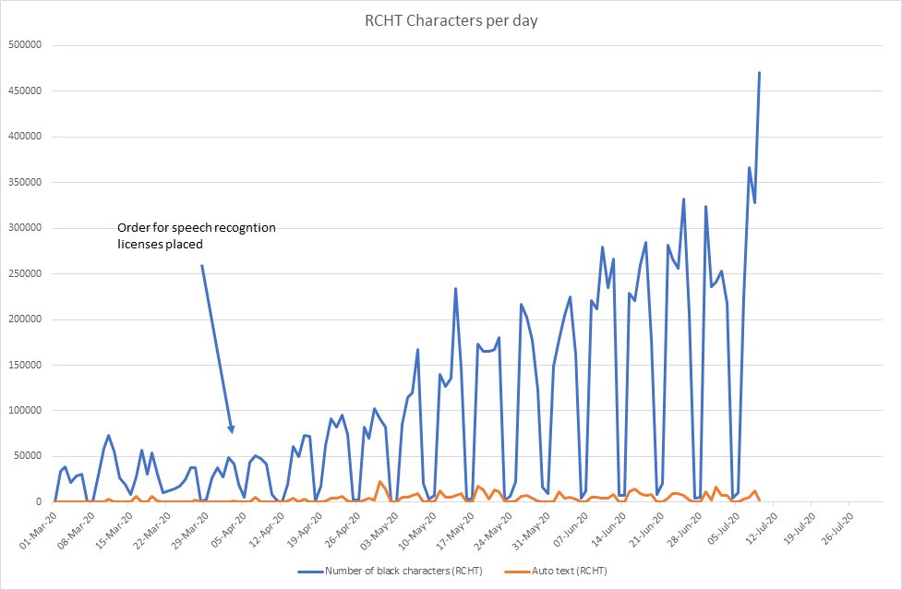
Growing usage of speech recognition
Royal Cornwall Hospitals NHS Trust

Slide 22
Lessons learned…
(1) Although clinical speech recognition works well, it needs to be considered in the context of the systems in which it will be used – if these are unwieldy then the acceptance of speech recognition can be poor. (2) When carrying out pilots, ensure that the metrics monitored include physician facing metrics (e.g. if a system allows reduction in correspondence backlog but clinicians feel that it takes them longer it will not get their buy-in). (3) It’s important to talk to clinicians about the different technique that Speech Recognition requires compared to dictation and to expect a period of adaption.

Slide 23
What’s next?...
Royal Cornwall Hospitals NHS Trust
Our digital transformation journey:
Current “best of breed” IT strategy = digitally mature, but in many disparate systems
Speech Recognition deployed in a variety of ways in the Trust to best fit the way clinicians work
Use in specific clinical systems such as Medisoft and WinPath
Use in Dragon Medical Workflow Manager
Plans to move to a Trust-wide EPR to be completed by 2023
Cornwall Foundation Trust also deploying Dragon
Trust objectives for AI-powered clinical speech recognition:
Embed use of speech recognition technologies with clinical staff now in preparation for future deployment of EPR solution - because speech recognition is significantly advantageous to clinical uptake of these systems
Further ahead, the vision is to embed clinical speech recognition across Cornwall in both primary and secondary care

Slide 24
Introduction by Stephen Docherty
Microsoft and Nuance partnership announced October 2019
Nuance cloud-based speech recognition solutions are hosted on Microsoft Azure
Supports the digital ambitions of the NHS Long Term Plan:
Use intuitive tools to capture data as a by-product of care in ways that empower clinicians and reduce the administrative burden
Rapid uptake of health technology happening at scale globally (e.g. health bots, MS Teams)
Microsoft Cloud for Healthcare
References:
https://www.longtermplan.nhs.uk/publication/nhs-long-term-plan/
https://cloudblogs.microsoft.com/industry-blog/health/2020/05/19/deliver-better-experiences-insights-and-care-with-microsoft-cloud-for-healthcare/
https://www.microsoft.com/en-us/industry/health/microsoft-cloud-for-healthcare
Notes:
I would really like to thank you Ian and Luke for sharing your experiences, it’s great to hear your stories.
What I picked out is that both Trusts had to stop Elective services as a result of the pandemic, and so helping free up staff to focus on RTT management is critical. We know this has been happening up and down the country - Hospitals could end up dealing with the backlog of those suspended services for the next 6 – 12 months. So the use of clinical speech recognition for me is something that we must adopt at scale.
As Eric Topol mentions in his review that was published in February 2019 and I keep referring to it. Topol came up with the phrase 'The gift of time'. There has never been a time more in need than now and so its great to hear from Ian & Luke and how they are giving back the gift of time to their clinicians and frontline staff.
I really liked that Luke and his Trust are taking their teams on a journey – realising that adoption and use will continuously evolve but using this opportunity to help accelerate digital transformation – ‘business better than usual’ is a nice way that Luke put it.
I also liked how Ian at Royal Cornwall mentioned that Nuance masterclasses were delivered using MS Teams, and then Ian mentioned their vision is to embed clinical speech recognition across primary and secondary care in Cornwall. A great forward-thinking vision.
So – coming back to the Microsoft & Nuance partnership – this was announced in October last year and Nuance's speech recognition solutions are hosted on Microsoft Azure.
If we consider one of the digital ambitions set out in the long-term plan ' Empower clinicians and reduce the administrative burden' then this is exactly what the Microsoft and Nuance partnership aims to do.
In my experience - I do believe that NHS colleagues are heading in the right direction in terms of digital transformation - and both Luke and Ian's respective stories show this is happening...and we are seeing rapid uptake of technology in health globally.
Since March, more than 1,600 instances of COVID-19 bots based on our service have gone live impacting more than 31 million people across 23 countries as health organisations have been using this service to create COVID-19 self-assessment tools to reduce some of the strain on their emergency hotlines.
Here in England we have seen Microsoft Teams usage in health alone rise to at 500 - 600,000 daily active users across the NHS. A fantastic achievement.
Last month we announced the Microsoft Cloud for Healthcare, which is the first industry-specific cloud offering that brings together existing capabilities and is developing future capabilities to accelerate health transformation into the future. Of course this is only achieved by working with our customers and our partners to develop the ecosystem, of which Nuance is a part of.
But to reiterate an earlier point - we are all on a journey. An important journey to transform healthcare.
Looking to the future - its a brilliant time for digital technologies in healthcare and I'm really excited about the partnership with Nuance. I've seen how the technology is evolving and it will be a game-changer... and without stealing Simon's thunder - will let him talk about the advancements that Nuance & Microsoft are working on together.
Thank-you.

Slide 25
Innovation roadmap
Advancing AI innovation for healthcare
Transcription & back-end speech recognition
Front-end speech recognition integrated into EPR
Virtual assistants
Ambient clinical intelligence
Real-time intelligence
Clinical guidance & SNOMED CT coding support
Cloud-based speech recognition solutions

Slide 26
Clinic room of the future
Ambient clinical intelligence (ACI) - AI assisted speech technology
Highly optimized microphone array for capturing conversation - Multi sensory, wall mounted and always available - No desktop computer
Voice biometric support for identifying speakers - ‘My voice is my password’
Integrated machine vision for motion tracking - To identify speakers and pick up non-verbal cues
Ambient skills for voice-enabled real-time actions in EPR - Proactive virtual assistants - Show me the last…… Start my knee pain pathway
Diarise the whole conversation: both patient and doctor - Proactive virtual assistants - Show me the last…… Start my knee pain pathway
Creates a summary clinical note: Clinical language understanding (NLP) - Structured note with key headings - Codes clinical terms (ICD10, SNOMED CT)
No typing, No clicks, No back turned to the patient

Slide 27
Phone: +44 (0)162 849 1600 | Email: info.healthcare@nuance.com

