Slide 1


Digital Readiness
Planning for our future workforce
Nicola Calder, Digital Readiness, Workstream Lead

Slide 2
Agenda
Introduction: Digital Readiness – Workforce Planning (Nicola Calder)
Project 1: Current workforce national workforce data collection – purpose and benefits to end user (Chris / Di) 10 minutes
Project 2: Future Workforce (strategic workforce planning): Forecasting future demand (Rupert and Don) 20 - 25 minutes
Questions

Slide 3
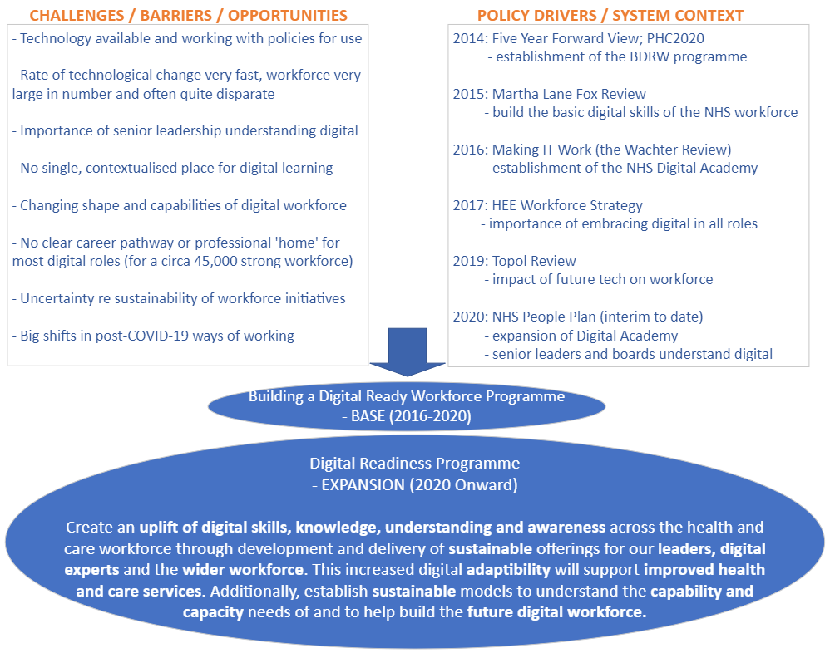
Delivery Programme: Digital Readiness (Building a Digital Ready Workforce )
Notes:
The Digital Readiness programme is commissioned by NHSX and delivered by Health Education England (HEE), an Arm’s Length Body (ALB) of the NHS. The programme aims to establish sustainable models to understand the capacity and capability of the current digital workforce and to help build the future digital workforce. Since the impact of Covid 19 - Digital transformation has occurred rapidly across the NHS, with around 550,000 video consultations taking place in primary and secondary care, and 2.3 million online consultation submissions to primary care, in June. Video consultations are now used widely, including in community and mental health services, and in ambulance services. This has enabled staff across primary, community and secondary care to work differently, with some choosing to do part of their work from home. Healthcare leaders operating in a ‘digital first’ health system will require higher levels of decision-making capability and to be able to operate confidently under uncertainty.

Slide 4
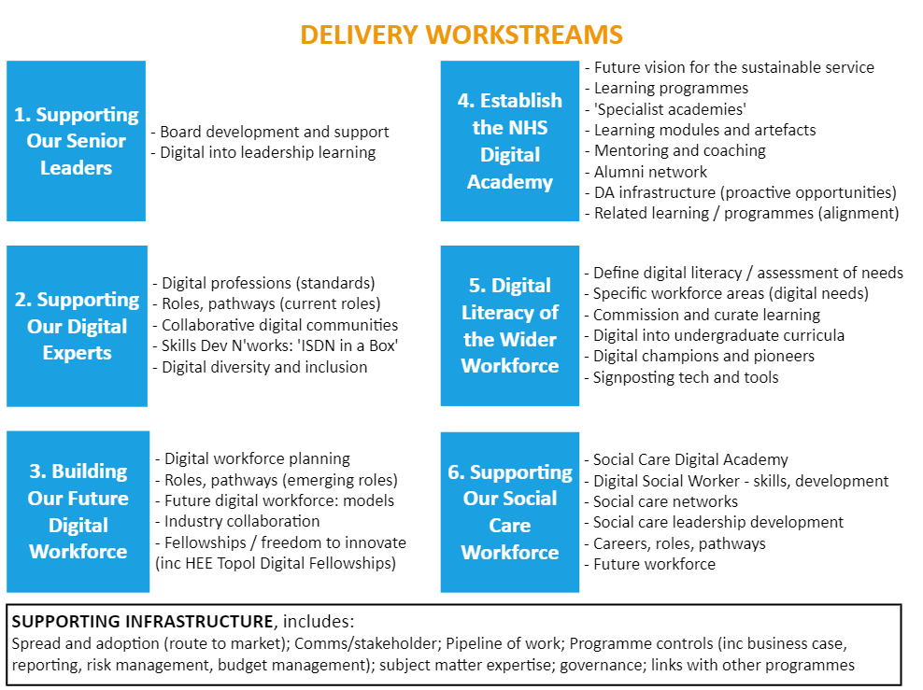
Delivery Programme: Digital Readiness (Building a Digital Ready Workforce )
Notes:
Today we will talk about these two projects which are contributing to a serious of workforce planning projects to help us better understand the current workforce and make plans for investing in the future workforce. We aim to develop models and mechanisms that can help employers fill vacancies that may be in competition with other sectors and to grow their own workforce.. Demand for cyber security skills are growing year on year 22% last year, Data Science 46% last year, software development is the number line in demand tech role in the year.

Slide 5
Planning for digital: Theory of Change
@NHS_HealthEdEng #BDRWFutureWorkforce
Notes:
It’s just another name for a road map..​
It presents the shared relationships among the resources, activities, outputs, outcomes, and impact for a program of work. It depicts the relationship between a program's activities and its intended effects.​
What it does do..​
Describes ‘cause and effect’​
Iterative, changes and adapts with emerging evidence​
Ensure, as far as possible, that ‘implementation’, ‘mechanisms of impact’, ‘outcomes’ and ‘context’ are separated in a logic model because these are conceptually distinct​
Change is messy, complex and hard…​
Not linear and mechanistic ​
Not steady state over a defined time​
do not reflect the full complexity of the real world but can provide a simplicity that has advantages for planning and evaluating​

Slide 6
Notes:
Product Owners – translate user needs into technical terms for software developers and into lay terms for users to understand.
Health data analysts - translate numerical data into information and intelligence to support health and care decisions. Increasing use of AI techniques such as ML.
Knowledge Engineers - translate explicit and tacit knowledge into tools and products that support decision-makers in health and care. ML / AI
Implementation Facilitators - work with health and care staff and organisational processes to translate digital innovations into routine use in health and care services.

Slide 7
NW Skills Development Network
Workforce Profile 2020
Christine Banks
NW Informatics Skills Development Manager
Di Ormandy
Head of NW Skills Development Network

Slide 8
Overview
NW Informatics Skills Development Network- a very brief summary
History of the workforce profile
Benefits to our members
What and how we are collecting information

Slide 9

ISDN – membership network
Learning and Development
Sharing best practice and networking
NW Informatics Awards
Annual Workforce profile
Excellence-in-Informatics Accreditation (including Digital Maturity Assessment)
Informatics Skills Framework
Professionalism

Slide 10
Annual Workforce Profile
Completion during July and August each year as 30th June
1st census collated 2011
Baseline = roles from www.hicf.org.uk
Refined over the years
Not perfect – but a great start!
Informatics staff in all NW organisations
what areas of informatics they work in
what banding
highest level qualifications they hold
whether they are members of professional bodies
Not currently - age / ethnicity

Slide 11
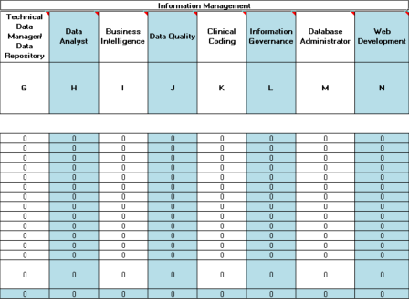
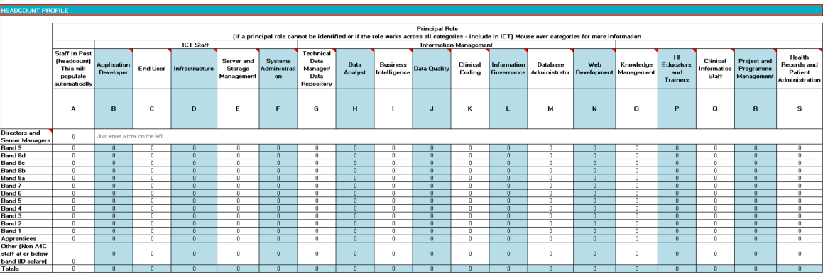
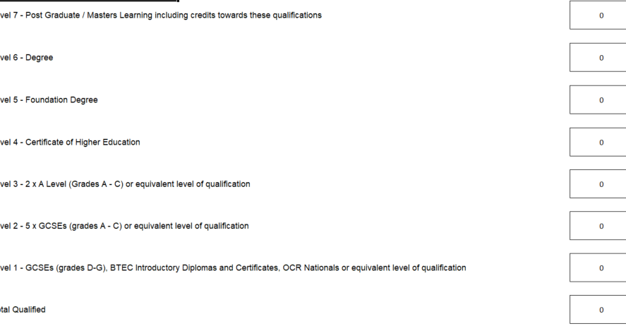
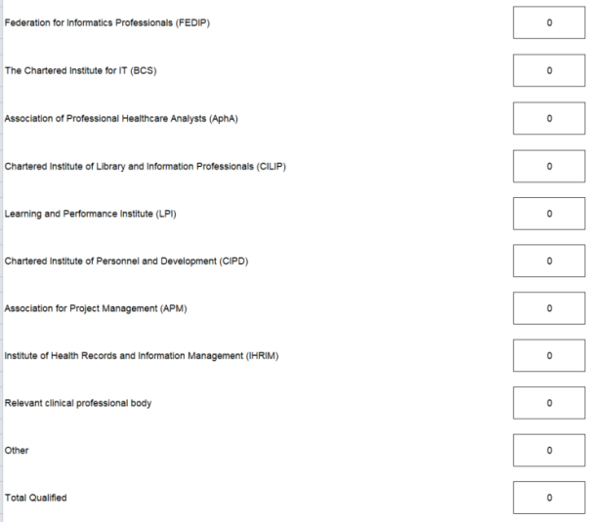
What does it look like?

Slide 12
What’s in it for you?
As a leader you will be able to:
Understand what your workforce looks like (across all disciplines of Health Informatics)
Biggest & most expensive resource / greatest asset
Manage transition into the new land scapes
Identify gaps and overlaps
Deploy skills and competencies flexibly
Plan staff development effectively
Measure and evaluate change/progress

Slide 13
Quote from stakeholder
I joined my organisation following a period of upheaval, as they had been through a recent acquisition of another mental health provider and were still in the forming stage as a new organisation. The IM&T team at the time I joined was made up of groups of staff from the 2 previous organisations who had come together but had not gone through any proper restructuring to form a cohesive unit, fit for purpose for the new organisation. I found the benchmarking information that was available from the ISDN invaluable, in giving me a clear view as to the structure that would be required to support the new organisation. It was helpful in identifying skill mix, numbers and grades of staff that would be optimum for an organisation of our size. Without the benchmarking information, I would have had difficulty in providing some of the evidence base that was required to gain support for the new structure.
Grace Birch
Associate Director of IM&T
Greater Manchester Mental Health NHS Foundation Trust

Slide 14
Benefits to Member Organisations
Agreement to share data between member organisations
Need to understand whole picture around data
Ways to use data:
  Benchmarking whole organisation
  Benchmarking parts e.g. grades/roles etc.
  Collaboration in a local foot print
Mapping the development of the informatics workforce
  Directors
  CCIOs
Enables focused learning and development on specific workforce issues

Slide 15
Quote from stakeholder cont.
As you know I am trying to get time to use the data for an overall review of the digital workforce in C&M. Whilst it is early days I believe we have the source of data to start working on a joint plan for digital workforce development.
We have also used it as a basis for an initial review of Cyber skills and as you know we are now building on the original data for a further more in depth view of cyber skills across the North West.
In my previous role as CIO at WUTH we used it frequently when reacting to requests for more resources to adjust to new workloads in specific areas such as BI analyst, Clinical coding and developers.
Paul Charnley
Digital Lead
Cheshire & Merseyside Health & Care Partnership

Slide 16
Total Staff
Headcount
 | 2017 | 2018 | 2019
Staff (Headcount) | 4618 | 4580 | 5072
Agency Staff | 202 | 106 | 105
WTE
 | 2017 | 2018 | 2019
Total Establishment | 4463.32 | 4449.01 | 4996.49
Total Staff in Post | 4196.59 | 4265.58 | 4739.47
Vacancies | 266.73 | 183.43 | 257.02
Vacancy Rate | 5.97% | 4.12% | 5.14%
NB: All above figures exclude partial returns

Slide 17
Headcount by Band

Slide 18
Headcount by Role (Information)

Slide 19
Chief Clinical Information Officers
 | 2017 | 2018 | 2019
Number of organisations without a CCIO | 22 | 15 | 19
Total number of organisations with at least 1 CCIO | 34 | 37 | 38
Total number of CCIOs | 52 | 51 | 63
Organisations with more than 1 CCIO 2019:
Organisation | No. of CCIOs
Manchester University NHS Foundation Trust | 9
East Lancashire Hospitals NHS Trust | 6
Salford Royal NHS Foundation Trust | 5
Bolton NHS Foundation Trust | 4
Alder Hey Children's NHS Foundation Trust | 3
NHS Morecambe Bay CCG | 2
The Christie NHS Foundation Trust | 2
Wrightington, Wigan and Leigh NHS Foundation Trust | 2

Slide 20
Qualifications
Level 7 | Post Graduate/Masters Learning including credits towards these qualifications
Level 6 | Degree
Level 5 | Foundation Degree
Level 4 | Certificate of Higher Education
Level 3 | 2 x A Level (Grades A - C) or equivalent level of qualification
Level 2 | 5 x GCSEs (grades A - C) or equivalent level of qualification
Level 1 | GCSEs (grades D-G), BTEC Introductory Diplomas and Certificates, OCR Nationals or equivalent level of qualification
Based on the National Qualifications Framework (NQF)

Slide 21
Qualifications
Please note, not all organisations submitted qualifications data.
Post Graduate/Masters
Degree
Foundation
Cert. of Higher Education
2 x A Level (Grades A - C)
5 x GCSEs (grades A - C)
GCSEs (grades D-G)
Totals:
2017 - 3604 staff of 4618 2018 – 3129 staff of 4580 2019 - 4092 staff of 5072

Slide 22
Professional Bodies
Professional Body | 2018 (4580 staff) | 2019 (5072 staff)
BCS | 86 | 95
BCS ASSIST | 21 | N/A
FEDIP | N/A | 4
UKCHIP | 4 | N/A
APHA | N/A | 55
Chartered Institute of Library and Information Professionals (CILIP) | 26 | 32
Learning and Performance Institute (LPI) | 0 | 0
Chartered Institute of Personnel and Development (CIPD) | 5 | 5
Association for Project Management (APM) | 20 | 18
Institute of Health Records and Information Management (IHRIM) | 38 | 66
Relevant clinical professional body | 102 | 110
Other | 148 | 181
TOTAL | 450 | 566

Slide 23
Questions?
Christine Banks
NW Informatics Skills Development Manager
christinebanks@nhs.net
07826 902428
Very happy to talk about the profile or ISD in general!

Slide 24


NHS Digital Technology and Health Informatics Workforce:
Current Supply and Future Demand Forecasting - 2020 to 2030
Don Liu and Rupert Milsom
National Workforce Planners
HEE Workforce Planning and Intelligence Directorate

Slide 25
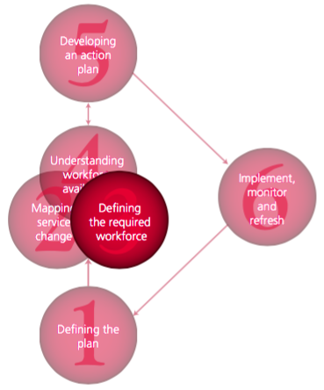
Six Steps Methodology to Integrated Workforce Planning
Define the plan
Map service change
Define the required workforce
Understand workforce availability
Develop action plan
Implement, monitor and revise
Notes:
Welcome to Delegates; Remind of agenda; Purpose
Rules – reiterate those on ‘landing slide’ e.g. all on mute unless asked to speak; use chat to ask questions / tech issues etc
We have invited you here as experts in your own right and we want YOUR views based on your expertise.
Don’t feel the need to defend a ‘position’ or an organisation.
The discussions will be conducted under a form of ‘Chatham House’ rules, i.e. we will report on the groups’ considerations but not on individual responses.
At end, hand over to David Farrell

Slide 26
NHS Digital Technology and Health Informatics:
Current Workforce Size
HEE Phase 1 Project Report (December 2019)¹
Workforce observed in nine relevant occupational categories (areas of work) in the NHS Electronic Staff Record (ESR) dataset
17% increase over five years or 3.4% increase on average per year
  2014: 29,739 FTEs
  2019: 34,754 FTEs
Workforce Estimation differ considerably
  National Information Board ~ 47,000 (HC)
  The Health Foundation ~ 44,500 (WTE)
  Department of Health and Social Care ~ 60,000 (HC)
1. https://www.hee.nhs.uk/our-work/building-digital-ready-workforce

Slide 27

NHS Digital Technology and Health Informatics:
Current Workforce Size – “The Denominator”
Function
Organisation Size
Staff Distribution
44,666 FTE
Composite Index based on “UK Tech Innovation Index”

Slide 28
NHS Digital Technology and Health Informatics:
Current Establishment Size – “What Good Looks Like”
The Digital Maturity Assessment (DMA) measures how well secondary care providers in England are making use of digital technology (Readiness, Capabilities & Infrastructure)
Using the 2017 DMA scores, the 38 highest performing trusts have been deemed "Good" for the purpose of this work.
A blue print for a high performing digital workforce that was then used as a proxy for establishment.

Slide 29
Data Definitions
Project Supply– Estimated future supply based on the assumption that trends observed in the past will continue.
Population based Demand – Estimated future demand based on projected population growth applied to previously established workforce blue print.
Prevalence based Demand – Estimated future demand based on projected changes in population demography applied to previously established workforce blue print.

Slide 30
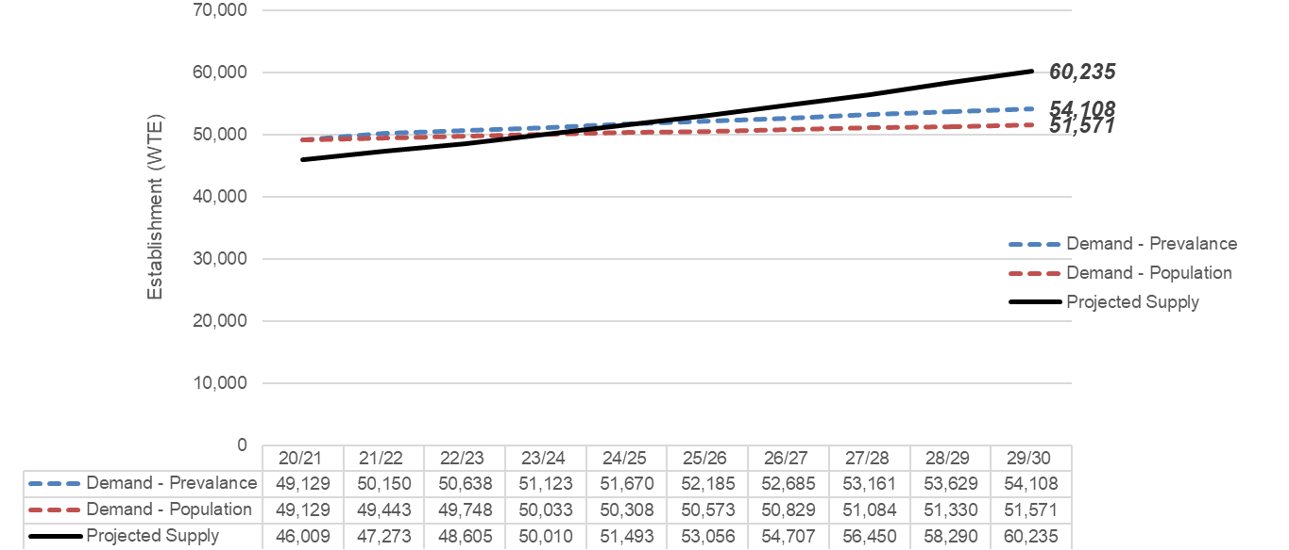
Projected Supply and Workforce Size - Next 10 Years
NHS Digital Technology and Health Informatics – Project Supply
Is this increase or rate of increase enough to meet service needs over the next 10 years?

Slide 31
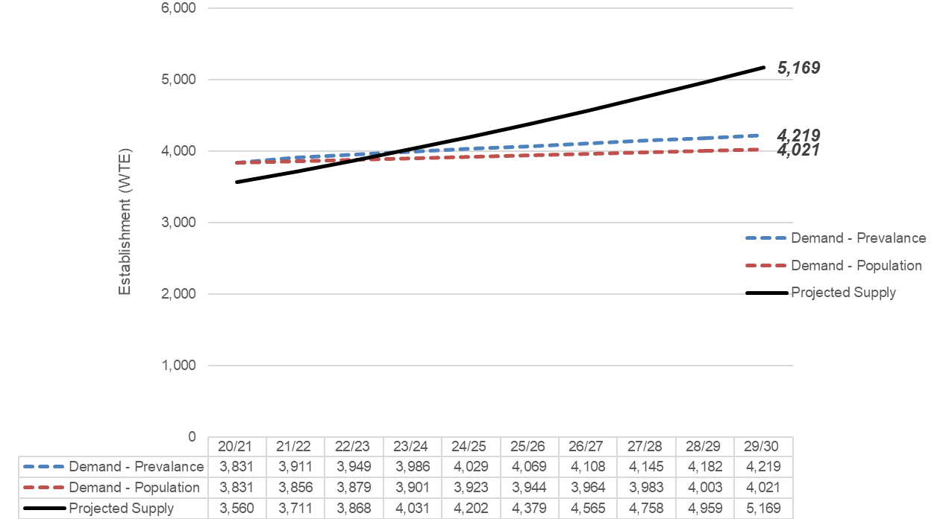
Projected Supply and Workforce Size - Next 10 Years
1.1. Clinical Coding – 4.2%

Slide 32
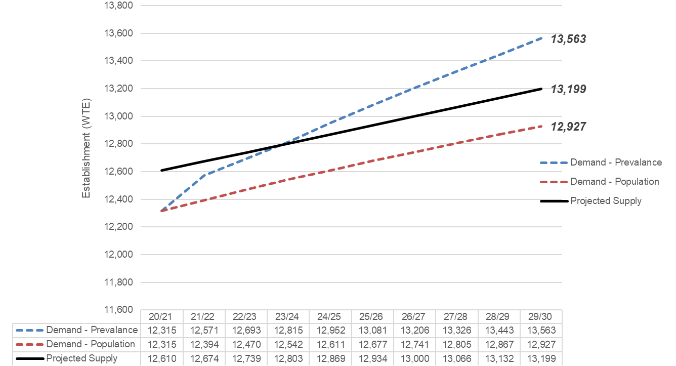
Projected Supply and Workforce Size - Next 10 Years
1.2. Health Records – 0.5%

Slide 33
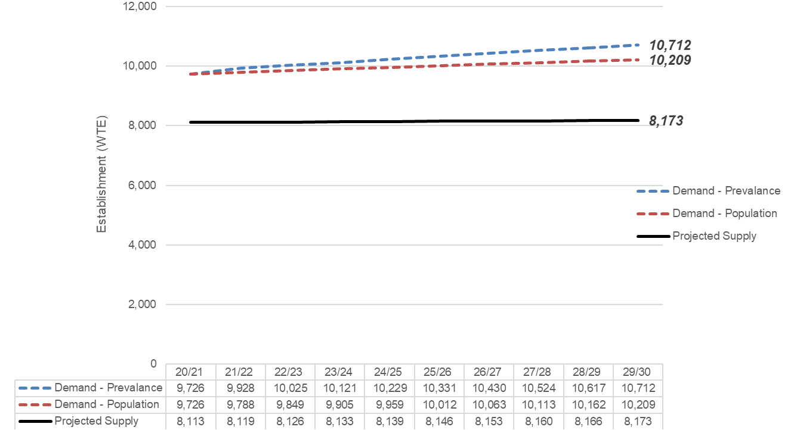
Projected Supply and Workforce Size - Next 10 Years
1.3. Information Management – 0.01%

Slide 34
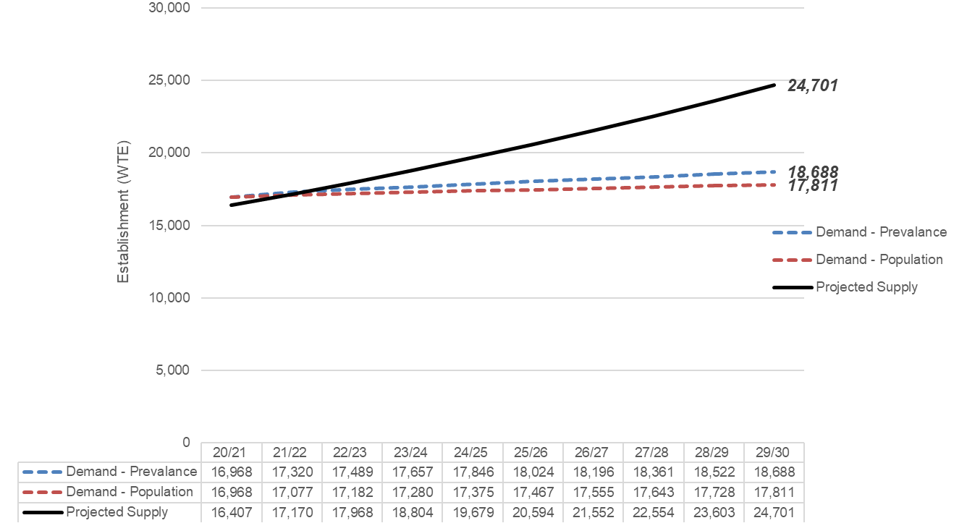
Projected Supply and Workforce Size - Next 10 Years
2.1. Information and Communication Technology – 4.65%

Slide 35
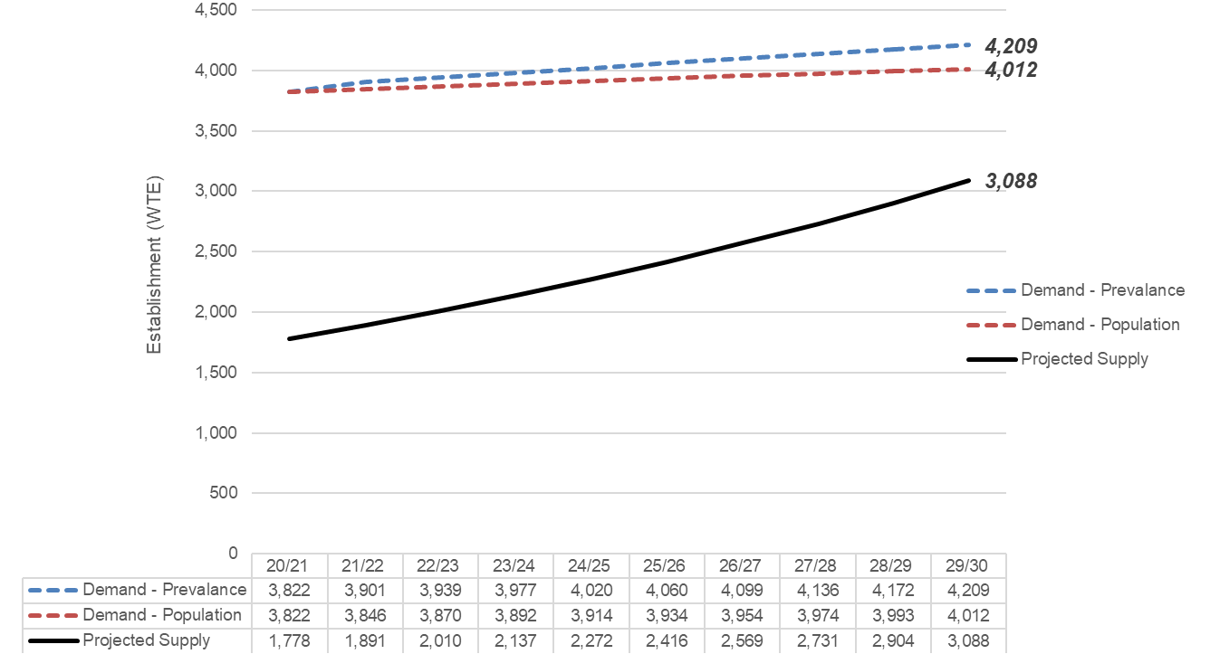
Projected Supply and Workforce Size - Next 10 Years
3.1. Clinical Informatics – 6.3%

Slide 36
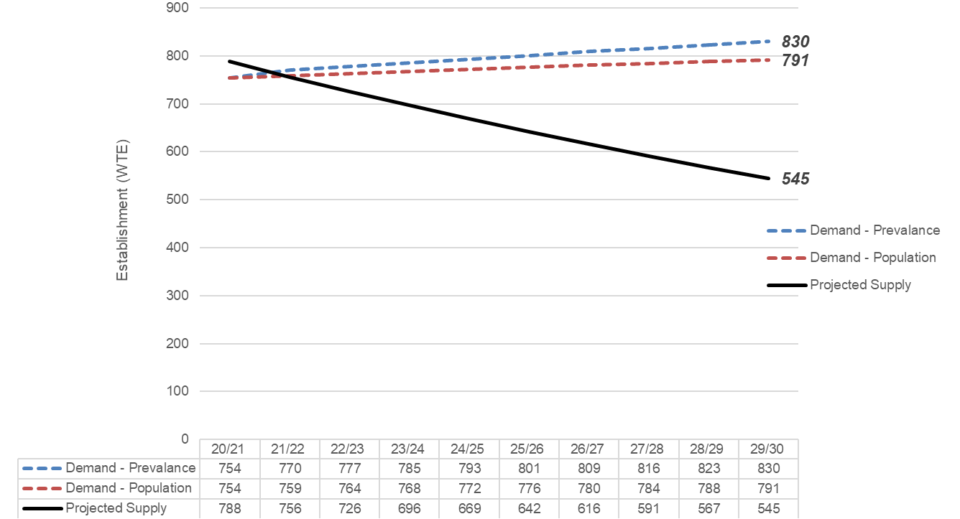
Projected Supply and Workforce Size - Next 10 Years
3.2. Knowledge Management – 4%

Slide 37
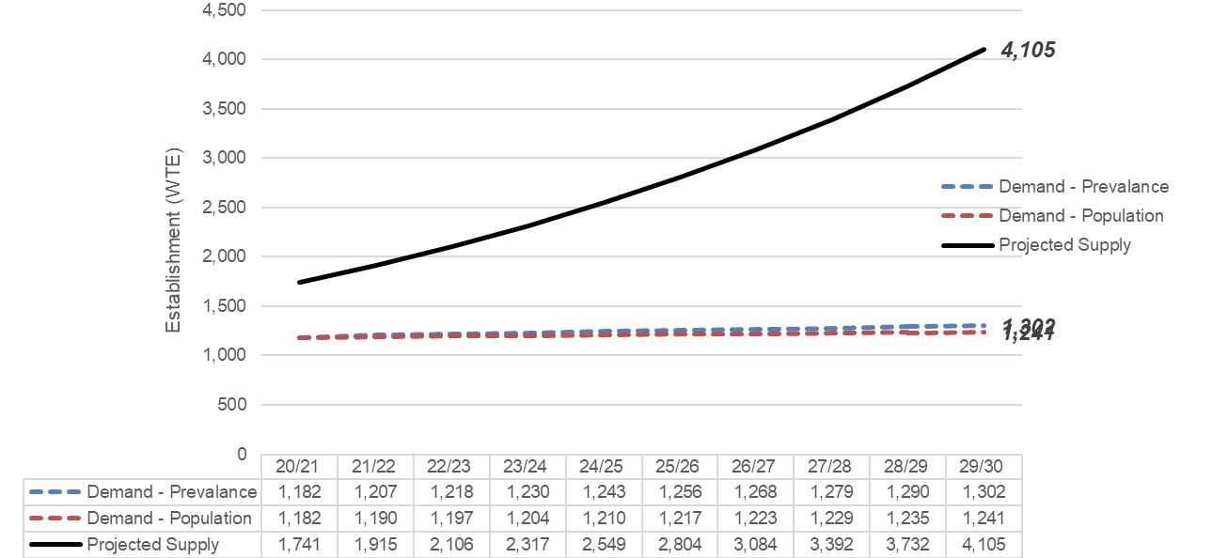
Projected Supply and Workforce Size - Next 10 Years
4.1. Programmes and Project Management – 10%*
N.B. Flow analysis using HEFT suggests a 24% increase in the programmes and projects workforce per annum. This is considered to be an overestimate due to how the methodology of HEFT is affected by the implementation of new categorisations. For the purpose of this assessment growth is limited to be 10%

Slide 38
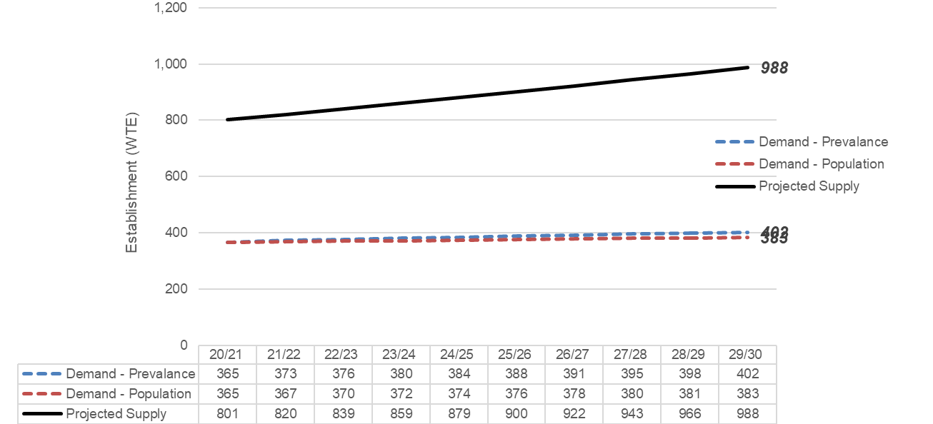
Projected Supply and Workforce Size - Next 10 Years
4.2. IT and Informatics Strategy and Development – 2.4%

Slide 39
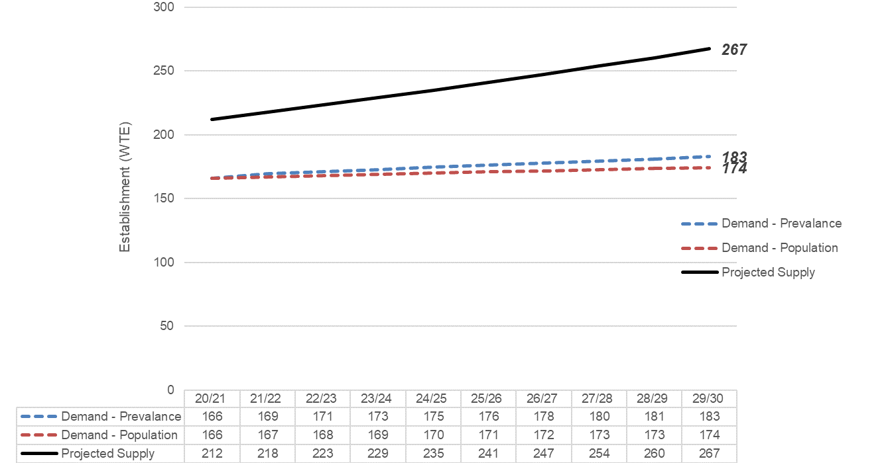
Projected Supply and Workforce Size - Next 10 Years
4.3. IT and Informatics Education and Training – 2.6%

Slide 40
Six Steps Methodology to Integrated Workforce Planning
Step 3 Define the Required Workforce
Identifying the workforce needed to deliver reconfigured services:
Skills needed
Types of staff required
Numbers of staff required
Workplace demand = Right types and right numbers of staff with the right skills needed

Slide 41
Scenario-based Workforce Planning
Method used to encourage stakeholders to think how work and working practices might change in the future and how they will need to respond to these changes.
HEE Strategy Team. Scenario Development (Version 1). 2020
Scenario planning looks ahead at alternative views of the future…and identify workforce gaps against future needs. These include positive gaps (more staff needed), negative gaps (less staff needed) and gaps in skills but not in numbers (staff need to be retrained).
CIPD. Workforce Planning Practice: Guide. 2018
Defining the required NHS digital technology and health informatics workforce in 2030 – key elements to the approach:
Scenarios: HEE to set out two alternative visions of what the future will look like in 2030 for this workforce – Scenario A: Data Driven Future and Scenario B: Data Desert Future
Typical NHS acute NHS trust: HEE to describe and set out the current (2020) workforce size in the nine ESR areas of digital technology and health informatics work – the benchmark data
Forecast future demand: Require expert and informed judgements from stakeholders in projecting future demand and types of staff and skills needed in each of the nine areas of work

Slide 42
Scenario A and B Development: Methodology
3 Steps:
1. Royal Society for the Encouragement of Arts, Manufacturers and Commerce (RSA) Four Futures of Work programme
Examined scenarios developed by the RSA
Based on a strong evidence base
Focussed on the future role of workers in all sectors
2. HEE Future Doctor programme
Using the RSA scenarios to develop four healthcare futures – what healthcare will look like in the next 10 to 15 years
Developed and stress-testing through workshops with healthcare leaders
3. HEE Digital Readiness: Supply and Capacity programme
Workshops with representatives and leaders of different sectors of the healthcare digital technology and health informatics sectors
Used the Future Doctor programme scenarios to identify key drivers expected to influence the development of the digital technology and health informatics workforce
Identification of drivers used to produce two alternative scenarios – A. Data Driven Future 2030 and B. Data Desert Future 2030 – in order to make forecasts as to future demand for this workforce.

Slide 43

Scenario A: Data DRIVEN Future 2030 - Summary
Context
Ubiquitous flow of data around health and social care system
Data is shared extensively within the NHS and with partners (research and commercial bodies)
Increasing professionalisation of the digital tech and informatics function with representatives at senior levels within organisations.
Infrastructure and application
Proliferation of IT in the NHS and health and well-being sensors amongst a digital literate population
IT solutions and cyber-security and information governance safeguards in place to connect and share data
Creation of large and complex datasets supported by machine learning and AI
Development of bioinformatics and genomic information and increasing hybridization of clinical practice and informatics.
Key drivers:
Proliferation of sensors
Internet of Things
Machine learning and AI
Genomics and precision medicine
Integration of health and social care
Digital literate population
Notes:
At end, hand over to Andy Gill

Slide 44
Scenario A: Data DESERT Future 2030 - Summary
Context
Long period of austerity and lack of investment in NHS infrastructure and IT. Commercial companies have little incentive to develop new IT and data products
Heralded growth on genomics stifled by lack of investment in research.
Cyber-security concerns and lack of public trust has limited how data is captured, shared and used.
Infrastructure and application
Merging of ‘backroom’ functions incl. IT and data management across NHS organisations to cut costs and create greater efficiencies.
Development and maintenance of technical infrastructure outsourced to private contractors.
Organisational digital transformation held back as fewer IT and informatics programmes are underway.
Focus is on supporting preventive healthcare and patient self-care to reduce demands made on the NHS.
Key drivers:
Austerity
Political instability
Reduced healthcare investment
Outsourcing to private contractors
Increased self-care by patients
Fragmentation of services
Sharing of back office functions
Notes:
At end, hand over to Andy Gill

Slide 45
Scenario: Typical NHS Acute Trust
Anycity University Hospital NHS Trust
A typical secondary, acute, healthcare provider in a medium-size city offering A&E and inpatient and outpatient services. The NHS Electronic Staff Record (ESR) shows a total of 6,500 FTE staff – of which 227 FTEs (or 3.5%) are primarily in one of the nine ESR areas of work for digital technology and health informatics. Three staff members work at a senior leadership level – CIOs, CCIO and CNIO. Anycity Hospital scored highly in the most recent NHS England Digital Maturity Self-Assessment exercise.
Digital technology and health informatics workforce in 2020
 | 1. Data Architecture |  |  | 2. Technical Infrastructure | 3. Application |  | 4. Organisational Transformation
 | 1.1. Clinical Coding | 1.2. Health Records | 1.3. Information Management | 2.1. Information and Communication Technology | 3.1. Clinical Informatics | 3.2. Knowledge Management | 4.1. Programmes and Project Management | 4.2. IT and Informatics Strategy and Development | 4.3. IT and Informatics Education and Training | Total
Senior leaders | 0.00 | 0.00 | 1.00 | 2.00 | 0.00 | 0.00 | 0.00 | 0.00 | 0.00 | 3.00
Managers | 0.00 | 1.00 | 5.00 | 9.00 | 2.00 | 1.00 | 1.00 | 0.00 | 0.00 | 19.00
Professionals | 7.00 | 6.00 | 21.00 | 48.00 | 5.00 | 1.00 | 2.00 | 1.00 | 2.00 | 93.00
Support staff | 10.00 | 66.00 | 12.00 | 18.00 | 2.00 | 2.00 | 0.00 | 0.00 | 2.00 | 112.00
Total | 17.00 | 73.00 | 39.00 | 77.00 | 9.00 | 4.00 | 3.00 | 1.00 | 4.00 | 227.00
Notes:
At end, hand over to Andy Gill

Slide 46
Forecasting Demand for Anycity University Hospital
For Scenario A and Scenario B
2020 FTEs
Benchmark provided
Number of FTEs
in 2025?
Number of FTEs
in 2030?
ESR Area of Work | Role Family
1.1. Clinical Coding | 1. Data Architecture
1.2. Health Records
1.3. Information Management
2.1. Information and Communication Technology | 2. Technical Infrastructure
3.1. Clinical Informatics | 3. Application
3.2. Knowledge Management
4.1. Programmes and Project Management | 4. Organisational Transformation
4.2. IT and Informatics Strategy and Development
4.3. IT and Informatics Education and Training
Job Levels
Senior leaders
Managers
Professionals
Support staff
?
Notes:
At end, hand over to Andy Gill

Slide 47
Forecasting Demand: Guidance
Organise a workshop with colleagues
Discuss implications of Scenarios A and B
Help to make demand forecasts
1 August to 14 September (6 weeks)
Can result in an intense and insightful debate!
Possible factors increasing or decreasing future workforce numbers (not an exhaustive list)…
Technological and data factors
Technologies complementing or substituting for staff
Sophistication of new technologies
Data and knowledge underpinning health services
Organisational transformation of health services through technology and data
Security and governance requirements of systems
Wider impact factors
Digital literacy of patients
Extent of future health service activity
Drive towards increased productivity and efficiency
Re-organisation of services – mergers and centralization
Outsourcing of activities
Skill-mix factors
Forecasting demand in nine areas of work
Areas of work mapped to four role families
Consider overall skill-mix of each role family
Please record your thoughts in the forecasting toolkit:
Critical or new jobs or skill emerging?
Significant changes in the workforce and how work is undertaken?
Notes:
At end, hand over to Andy Gill

Slide 48
Demand Forecasting Toolkit (1)
Notes:
At end, hand over to Andy Gill

Slide 49
Demand Forecasting Toolkit (2)
Notes:
At end, hand over to Andy Gill

Slide 50
Using Your Demand Forecasting Data
NHS Digital Technology and Health Informatics – Projecting Demand

Slide 51
Using Your Demand Forecasting Data
1.1. Clinical Coding – Projecting Demand

Slide 52
Taking Part – Demand Forecasting Exercise
Register to take part
https://healtheducationyh.onlinesurveys.ac.uk/forecasting_toolkit
Enter contact details
Toolkit will be sent after registration (Excel and PDF versions)
Working with colleagues
Share the toolkit (Excel and PDF versions) with colleagues
Discuss and debate (e.g. through a workshop?)
Timeframe
1 August to 14 September 2020 - to complete exercise and submit final response
Save the Excel toolkit and email to don.liu@hee.nhs.uk
October 2020 - Post-exercise discussion to be organised for participants
Notes:
At end, hand over to Andy Gill

Slide 53
Taking Part – Demand Forecasting Exercise
We hope that the demand forecasting exercise will be an interesting and engaging one for you and your colleagues.
We are relying on stakeholders to provide us with informed estimates as to future demand for the NHS digital technology and health informatics workforce so that we can plan accordingly.
For further information contact:
Don Liu
HEE National Workforce Planner
don.liu@hee.nhs.uk
Tel: 07930375576
Rupert Milsom
HEE National Workforce Planner
Rupert.Milsom@hee.nhs.uk
Thank you!
Notes:
At end, hand over to Andy Gill

