Slide 1
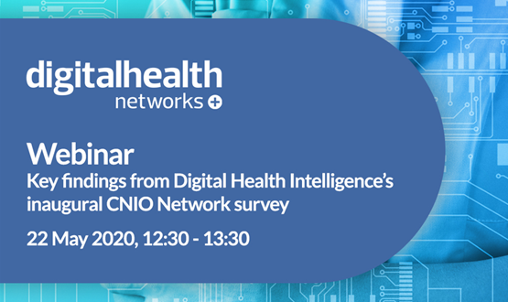




Slide 2

Digital Health Intelligence’s
CNIO Network Survey
2019/20
The key findings
Claire Read
Contributing editor
Digital Health

Slide 3


About the CNIO Network and this survey
Network founded four years ago as a specific source of best practice and collaboration for those working in nursing and allied health professional (AHP) fields
Survey launched to help understand more about current opportunities for nursing and AHP leadership in IT, obstacles, and where we might go from here

Slide 4
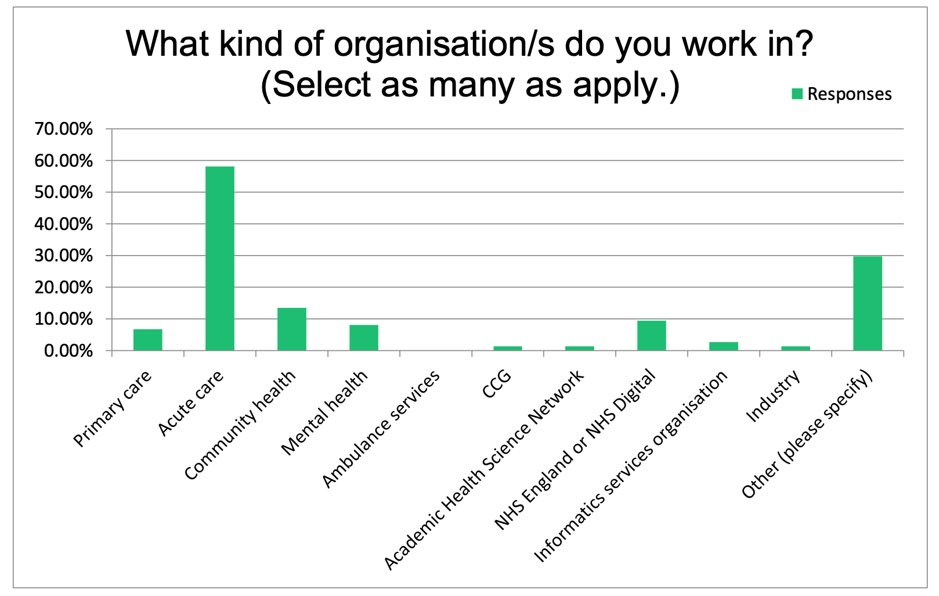
The respondents
76 people from across healthcare

Slide 5
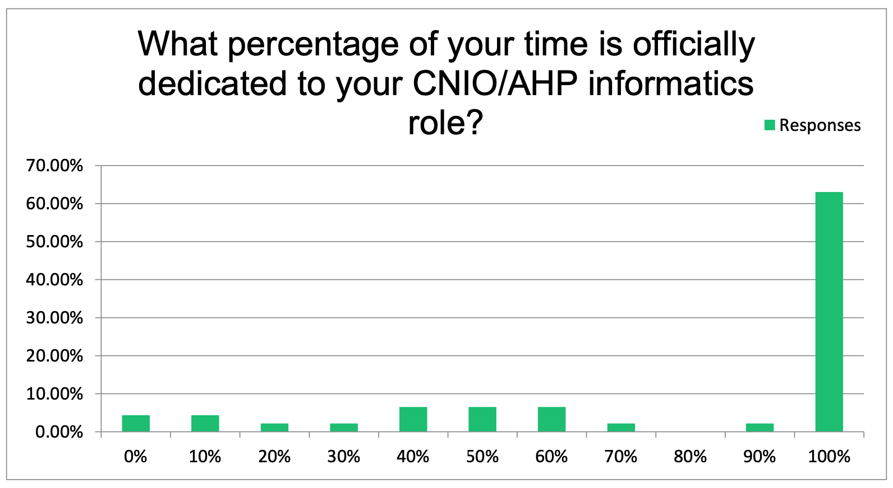
Different types of involvement

Slide 6
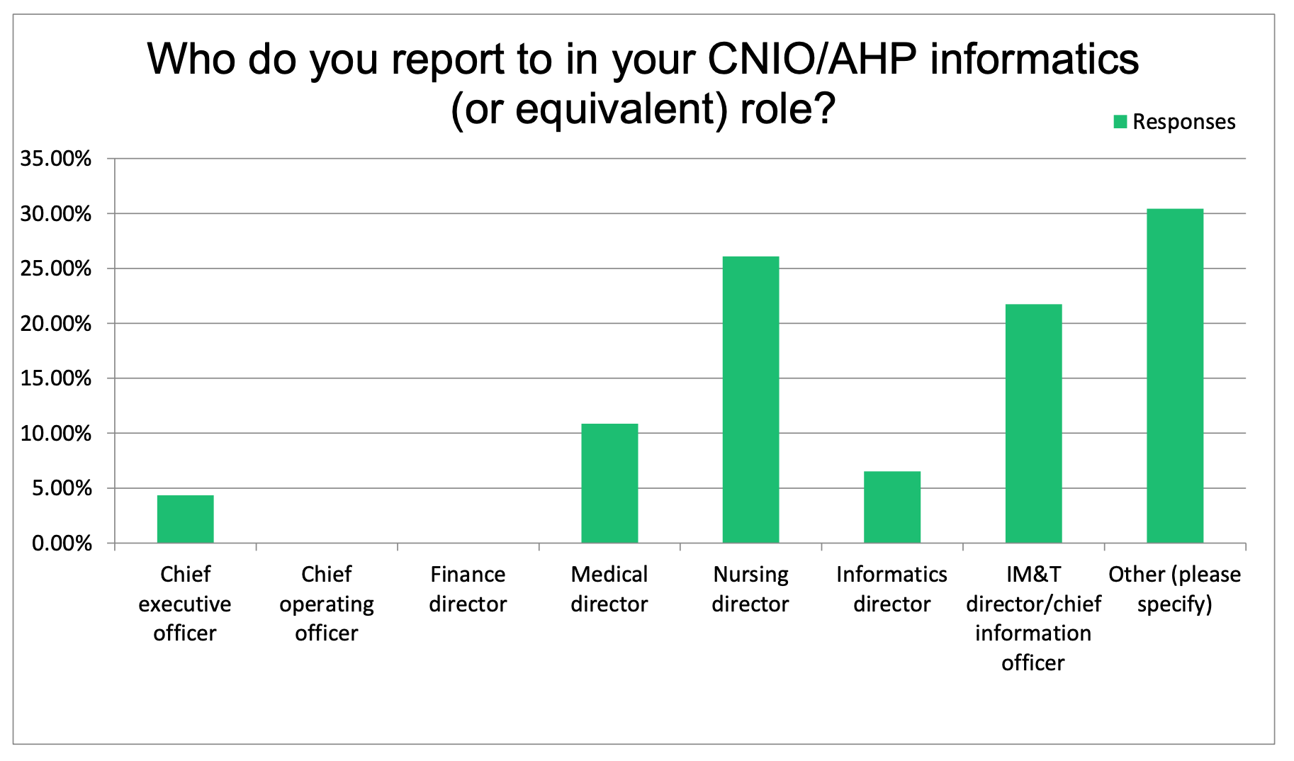
Varying reporting structures

Slide 7
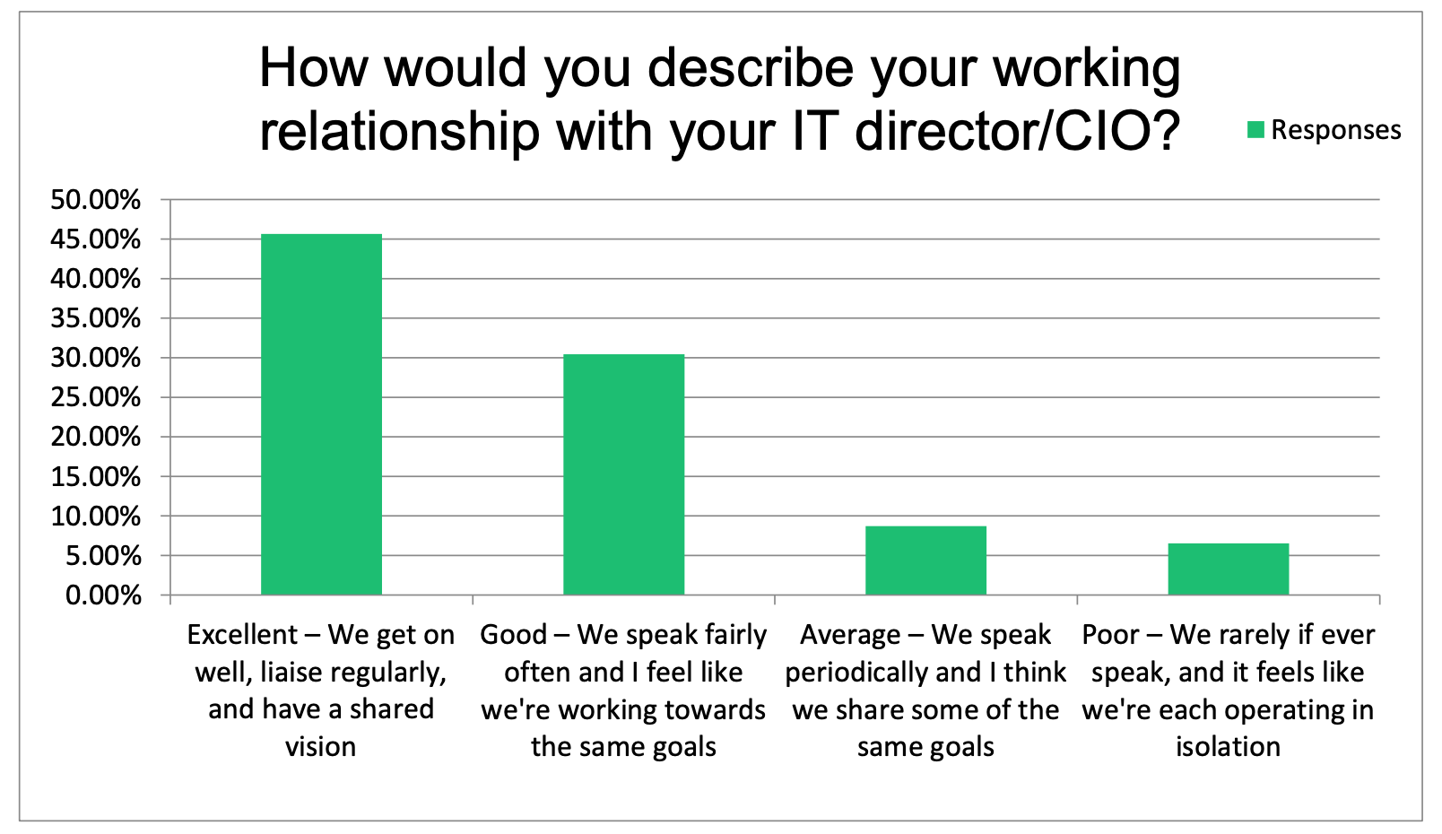
Sometimes challenging relationships…
With the CIO

Slide 8
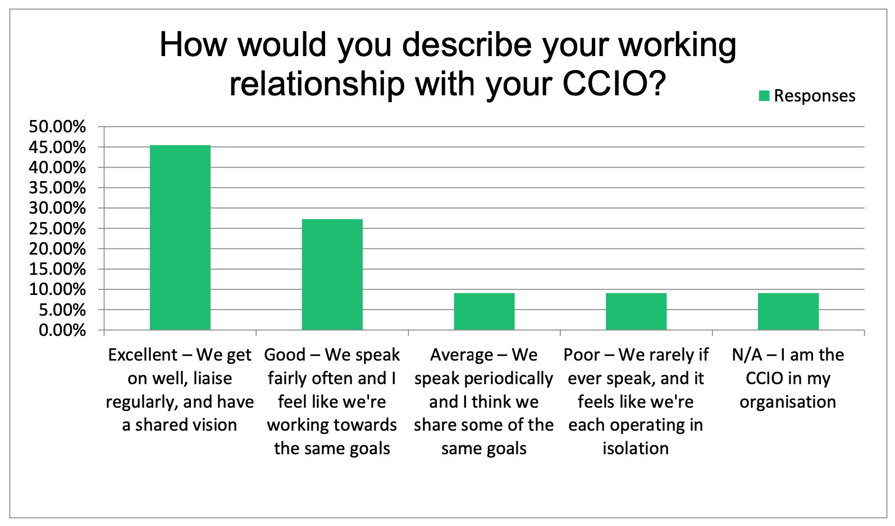
Sometimes challenging relationships…
With the CCIO

Slide 9
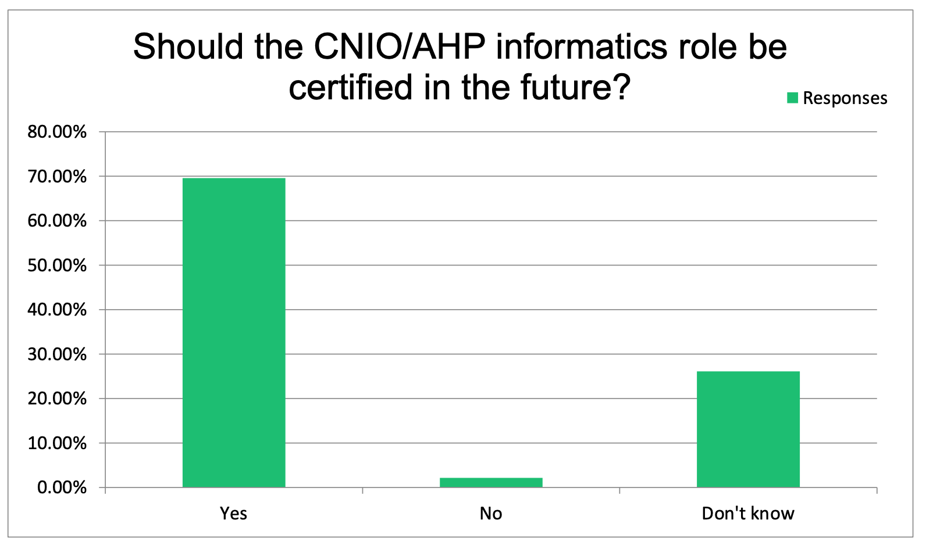
A desire for certification

Slide 10
Seeking a pathway
“I would like there to be a nationally-recognised clinical informatics course for CNIOs. Currently there are several courses around but I’m unsure which is the best route and which qualification to aim for.”
“I feel I have learnt on the job and do not see any personal benefit in more qualifications at my age! I would rather help shape the career framework of the next generation and support them with it.”

Slide 11
Reasons to be cheerful
“I’m very excited that this is the beginning of a journey in the UK with these roles, and I am very glad that I am a part of it.”

Slide 12
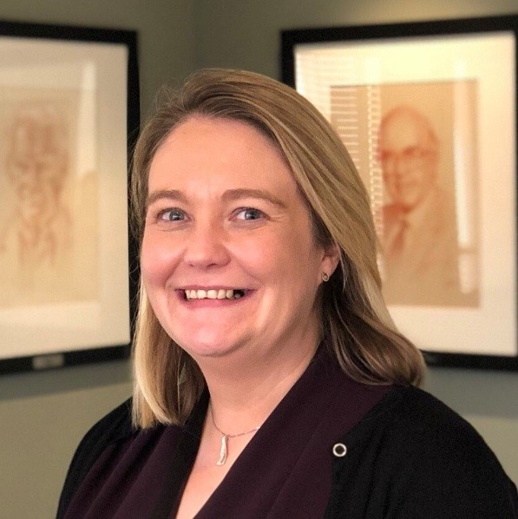
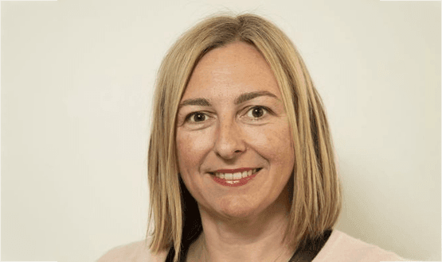
Jo Dickson, Clinical Informatics Director / CCIO, Nuffield Health, chair of the CNIO Network
Dr Natasha Phillips, CNIO, NHSX

Slide 13
Any questions?

Slide 14

www.digitalhealthsummerschools.com

