Slide 1
COVID-19 – Digital Support
More Than Just WiFi, More Than Just Us
#MoreThanJustWiFi

Slide 2
WiFi SPARK - founded in 2003
10+ years providing patient-access WiFi to the NHS
In partnership with over half of the NHS Acute Trusts in the UK
90+ Healthcare organisations collaborate with WiFi SPARK worldwide
Over 2,000 deployments to GP surgeries to date
Solutions from patient WiFi to complex entertainment packages
99% NHS customer retention
WiFi from the NHS’s most respected provider.

Slide 3
Better Together

Slide 4
Bandwidth Support
Can we help?
WiFi SPARK has 1Gb to 10Gb internet lines deployed at the majority of our customer sites.
Can we help provide extra capacity for your services?
Notes:
The Hospital Broadcasting Association is a national charity that supports and promotes Hospital Broadcasting in the UK. SPARK Media will enable hospital radio via any device free of charge.

Slide 5
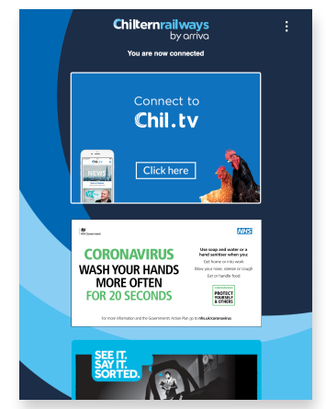
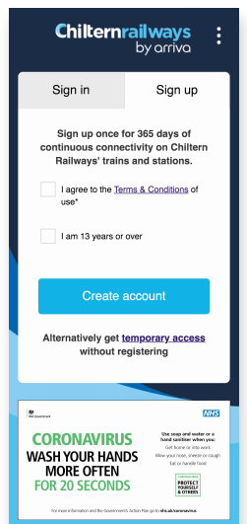
WiFi UX for Raising Awareness

Slide 6
Hospital Radio
Hospital Broadcast Association
“Hospital Radio definitely enhances the wellbeing of patients and helps in their recovery. It feels good to know a song I play can cheer someone up.”
- Davey Downes, Volunteer
Notes:
The Hospital Broadcasting Association is a national charity that supports and promotes Hospital Broadcasting in the UK. SPARK Media will enable hospital radio via any device free of charge.

Slide 7
Print
Access to online Newspapers and Magazines
Notes:
Print is a super service- it enables users to access newspapers and magazines on their own digital device. It is
Free for the patient to access
Great benefit for staff
Reduce the spread of infection
Assist passing time in waiting areas
Affordable options starting for £275 pm
9,562 worldwide titles available

Slide 8
Entertainment
TV & Radio Player, access live TV from any device over the WiFi.
Notes:
Entertainment is the traditional element of patient entertainment- this includes TV and Radio. We will always have channels 1-5 and the radio free 24/7

Slide 9
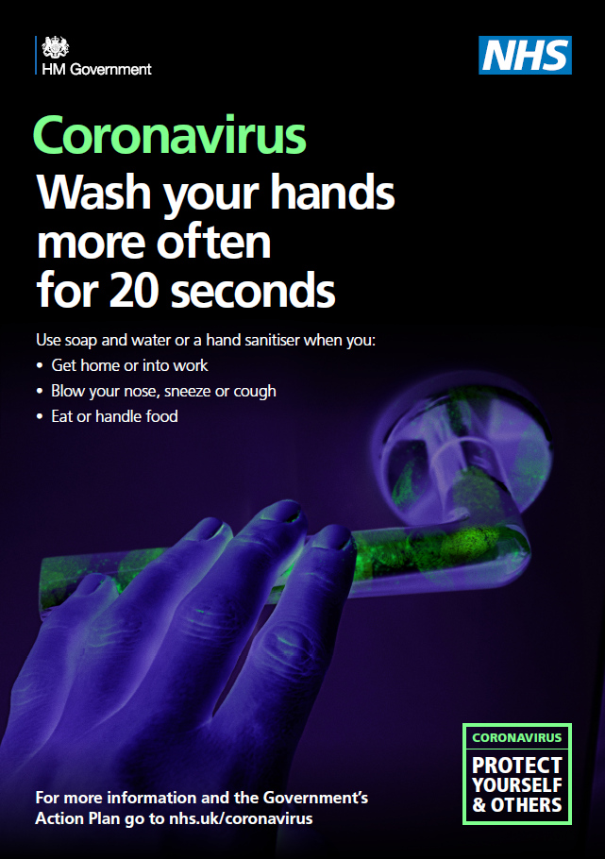
Thank You Please look after yourself and each other
Please contact me if you feel WiFi SPARK can assist in anyway.
Steven Killick – Product Manager
Email: skillick@wifispark.com
Mobile: 07745 753 222

