Slide 1
GP IT Futures Update: Primary Care as Platform (PCaaP) Feasibility, Prototyping and User Testing
Paul Atkinson, GP, CCIO Gloucester CCG, Primary Care Team NHS England & NHS Digital
Richard McEwan, GP IT Lead Architect)
Ben Gildersleve, GP IT Futures Programme Head)

Slide 2



Today’s Presenters
Ben Gildersleve NHS Digital Programme Head – GP IT Futures Programme | Richard McEwan NHS Digital Senior Solution Architect | Paul Atkinson Gloucestershire CCG Chief Clinical Information Officer

Slide 3
Introduction
This webinar aims to share our understanding of the context to tech delivery in General Practice, which has led to feasibility, prototyping and user testing of a target platform model described as ‘Primary Care as a Platform’ (PCaaP).
The purpose of the webinar is to seek challenge and feedback from the CIO / CCIO community on the PCaaP hypothesis, approach, alignment to local transformation and seek opportunities to share and collaborate.

Slide 4
Context

Slide 5

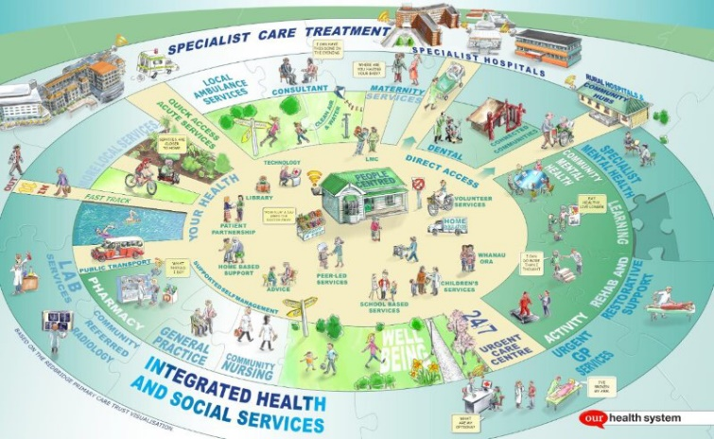
Strategic context and drivers for change
Current arrangements end December 2018 2019
GPSoC served a traditional practice unit and needs to evolve to support extended GP and new models of care
GP systems market doesn't work effectively
Technology and data architecture in General Practice systems needs to better support user needs/local transformation now and in the future
Reduced Burden
Reduced Demand
Increased access
Patient Self Care

Slide 6
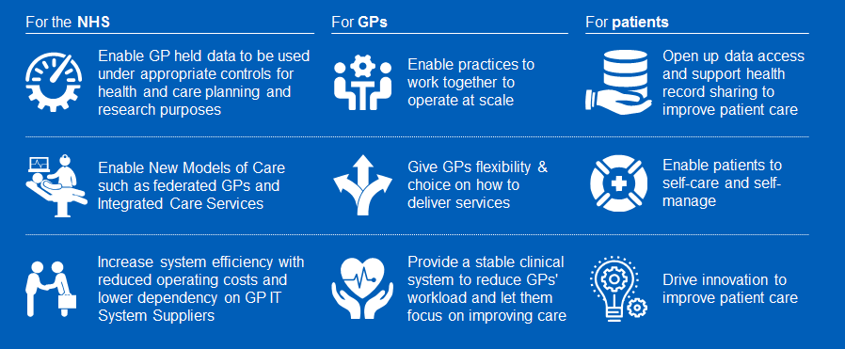
GP IT can fundamentally improve health and care system

Slide 7
What’s in our portfolio currently?
GP IT Futures covers:
New commercial Model – buying catalogue, new framework, revised and new capabilities and technical standards, SaaS charging, assurance services.
Improved Technology delivery – focussing on access to data, removing barriers to entry, more modular deliver of digital capabilities, commoditising components where appropriate
National Funding – GP systems funding to remain nationally funded for 1st framework
The wider GP portfolio includes:
GP Connect
GP Data services
SNOMED
Existing services, such as GP2GP, IM1 plus others
Additional smaller scale deliveries such

Slide 8
Primary Care as a Platform Update

Slide 9
Our principles for a more flexible future architecture are:
  Support open access to data via APIs, Eventing Exchange
  Support transition to cloud native architectures
  Deliver services through use of commodities
  Modular component capabilities, integrated via APIs and Eventing
  Platform based capabilities that can be federated, and which are portable and open
  Vendor and technology agnostic.

Slide 10


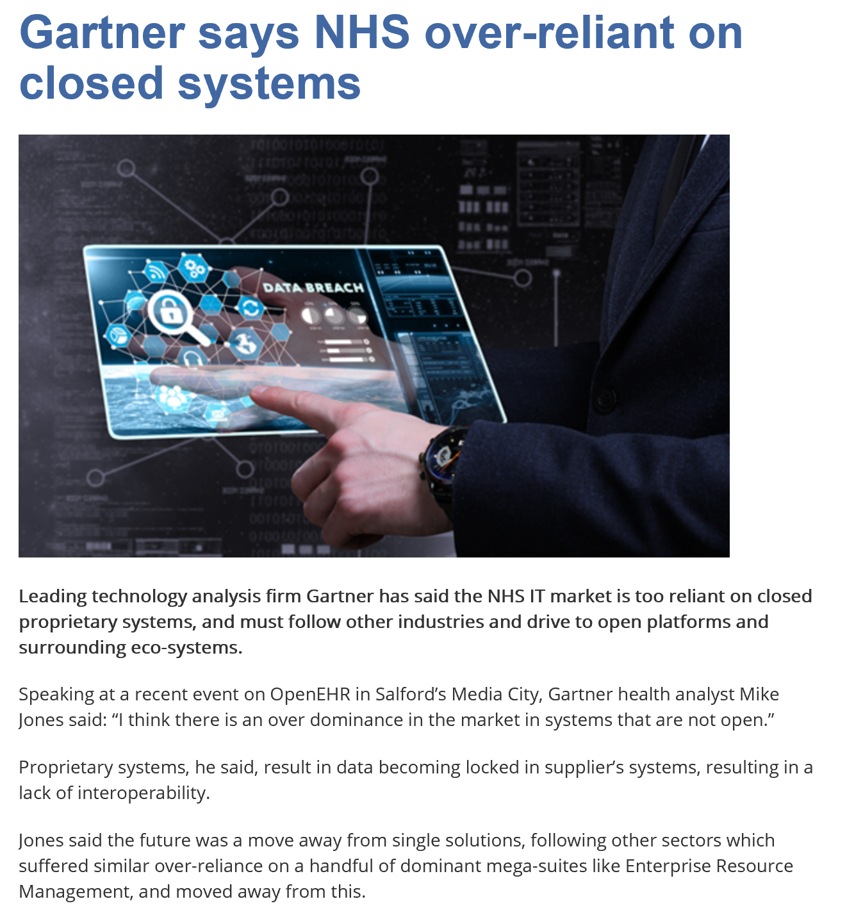


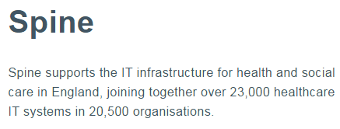


Health Platforms
DIP
DSP
“…….each national or federal health system should consider an open innovation platform that holds healthcare data ……………., and provides data access that is enabled for application programming interfaces as well as common technical IT services such as identity, access, or consent management. This platform would serve as the basis for an ecosystem of digital-health-services innovation……”

Slide 11
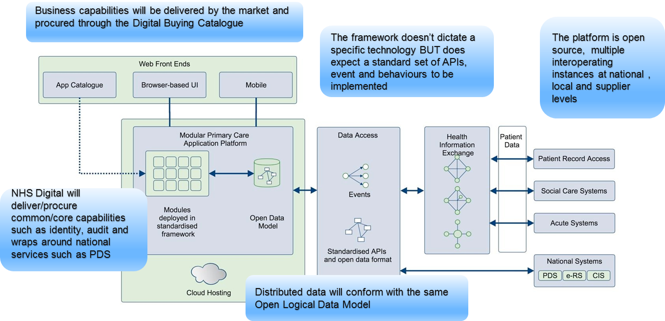
PCaaP Ecosystem in Context

Slide 12
Platform Support Capabilities
Supplier
Functional Capabilities (examples)
National Functional Capabilities (examples)
Open Source Community Capabilities
API Management
Appointment Management
Prescribing
PDS Service
EPS Service
SCR Service
?
Cross Platform Monitoring
Record Management
Online Consultation.
Record Viewer
Clinical Calculators
Consent
Management
Document Management
Etc. etc.
eRS Service
Organisation Directory
Data Sharing Agreement Services
Continuous Integration
User Interface Capabilities
Configuration
CUI Components
UI Widgets
UI event handler
App Workflow
Service Discovery
Core Platform Capabilities
Authentication
Authorisation
Logging
Audit
Configuration
Messaging
MPI
Endpoints
Examples of the type of capabilities that could be made available to support a Platform – this is not intended to be exhaustive and will be tested as part of discovery
Error
Instrumentation
Caching
Reference Data
Workflow
Orchestration
Events
Session Management
Monitoring
PKI
Data Access
File Transfer
Bridging Services
Terminology Mapping Services
Identity Management
Clinical Coding
Data Capabilities
Archetypes
Transformations
Models
Infrastructure Capabilities
Containerisation
Proxy
Web Server
Load Balancer
Infrastructure Management
Cloud Services

Slide 13
LHCR Reference Architecture
LHCR Platform
Individual Care Use
National Infrastructure
DSP
NCDR
DIP
Data Integration
Caseload Management
Shared Care Record
Master Patient Index
Analytical Services
National Record Locator
Local Data Flows
Local Data Landing
Local Event Management
National Data Landing
Data Marts
Federation Broker
De-ID/Re-ID Implementation
Audit
Secondary Use
De-Id/Re-Id Key Management
Analytical Data Catalogue
Event Management
Population Health BI
Commissioning Intelligence
Data Marts and Data Quality
Data Linkage
Normalisation – local and national
Analytical Capability
Data Quality
Population Health Management Dashboard
Authorisation and Authentication
Business Uses
Operational Dashboards
Pathway Management
Patient Activation
National Products
Metadata Catalogue
Reference Data
National Standards
Decision Support
Analytics
Risk Stratification
Open APIs
Terminology and Code Sets
IG and ISAs
Clear areas of commonality between PCaaP & LHCR strategy – we are working with NHS England to join up these activities

Slide 14
Technical Discovery

Slide 15



PCaaP Technical Discovery
User and Stakeholder engagement and collaboration
Supplier Market Engagement
Vision validation
Prototyping
‘Healthcare Tech’ analysis
Outcomes validation and testing

Slide 16
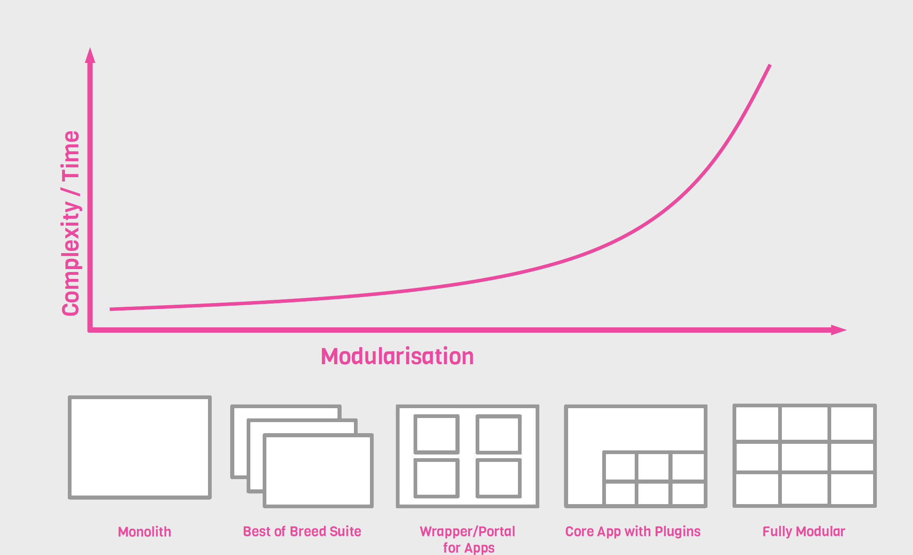
Answer Digital – Solutions Continuum
The vision of a “plug & play” modular architecture where new services can be dropped is technically challenging – we need to find the “sweet spot”…

Slide 17
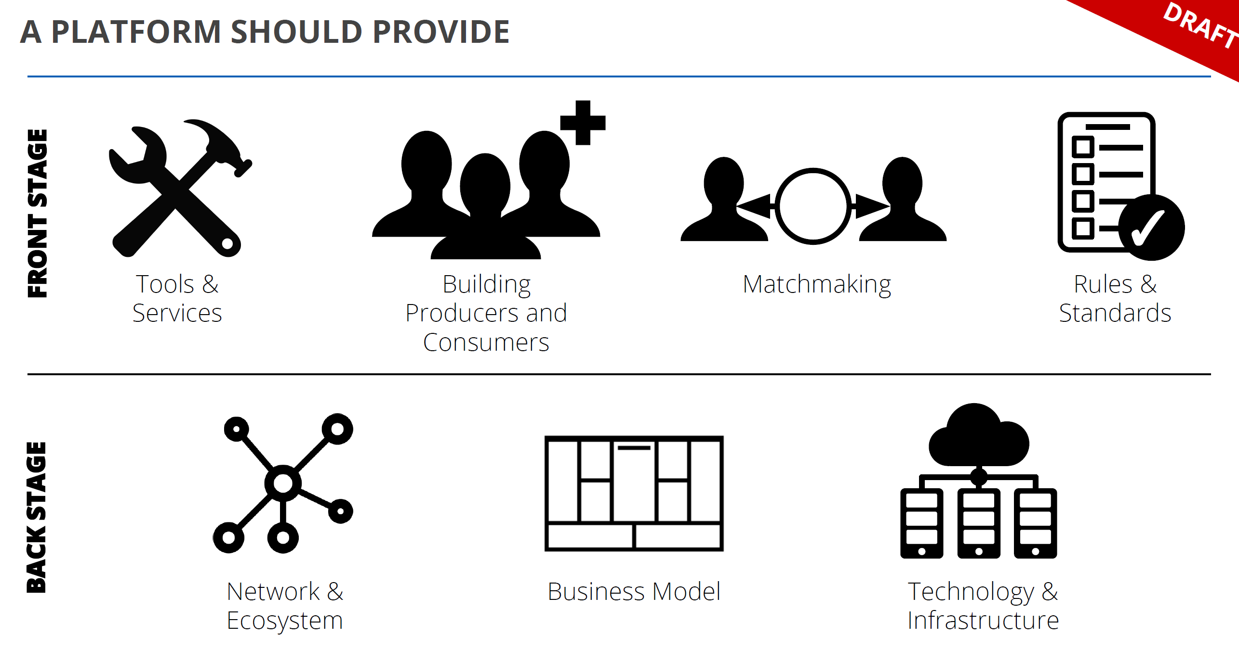
ThoughtWorks Platform Scope...
Platform is an over used and overloaded term…we need to demonstrate what type or pattern of platform are we referring to….

Slide 18
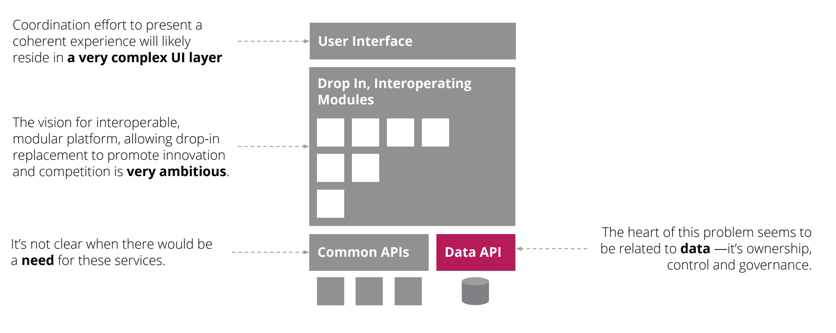
Initial Technical Discovery Findings
Initial findings conclude PCaaP is likely to be viable but is extremely ambitious. Logical transition plan, regardless of outcome, should therefore start with data.

Slide 19
Initial questions for CIOs/CCIOs?
Do we understand the context?
Is this hypothesis appropriate at this stage?
Is our wider portfolio appropriate?
Is this something CIOs/CCIOs and the GP IT Futures team could collaborate on? If so, how?
If this isn’t the right approach, what do CIOs/CCIOs think GP IT Futures should be focussed on to resolve problems and meet new needs?

Slide 20
Find out more

Slide 21
Engage With Us
Outputs from technical discovery activities will be published on the GP IT Futures website
  https://digital.nhs.uk/Future-GP-IT-systems-and-services
Participate in GP IT Futures Programme Show & Tells (See above link)
To contact the GP IT Futures Programme team, e-mail gpitfutures@nhs.net
Contact us atkinson@nhs.net richardmcewan@nhs.net ben.gildersleve@nhs.net

