Slide 1
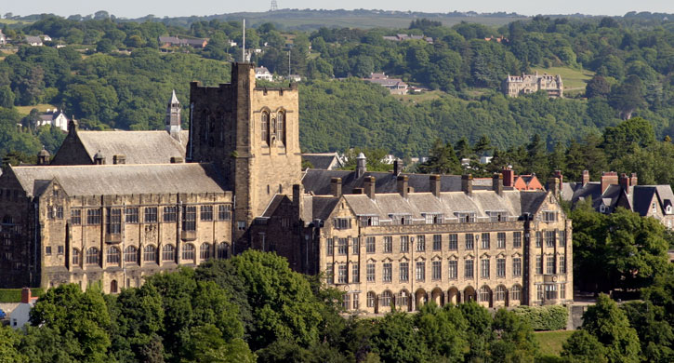
The public cyber security event of 2017
IT and Estates - working together
The public cyber security event of 2017
07 DECEMBER 2017
THE ICC BIRMINGHAM

Slide 2
Who are we?
Simone Barbaresi
Deputy Director IT Services (infrastructure)
Bangor University
Twenty years in system administration
Ian Brown and Matthew Williams O365 technical leads
Diane Moreland sys admin

Slide 3
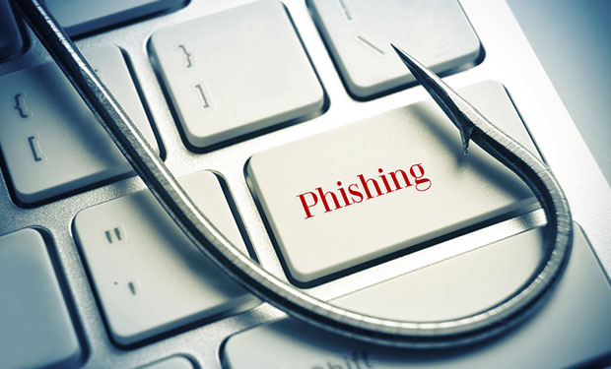
Real world attacks
20 minutes
We are all familiar with “you have been awarded a grant”
Phish at Bangor: free, greed, relevant, appropriate, expected
What we did
What would we do now
What should we do
My Aunty
Questions
BU Email pre and post O365

Slide 4
Pre-Office 365 at Bangor
The setup
UNIX email infrastructure
Any IMAP client you liked
Full time job to manage:
Software and hardware
Operating system
Sendmail configuration
AV, anti-spam, MailScanner, SpamHaus, Grey Listing, RBL, etc
Monthly Password giveaways
Still too much SPAM
Those not in the know demanding we should fix it

Slide 5
Office 365 at Bangor
Standardised email service, O365 and Outlook
Excellent feedback from staff and students
Functionality a huge improvement
Less SPAM. Over-night.
UK-MAIL-MANAGERS mail list
Thankful all my woes had vanished
Pleased anti-spam handled at a global level

Slide 6
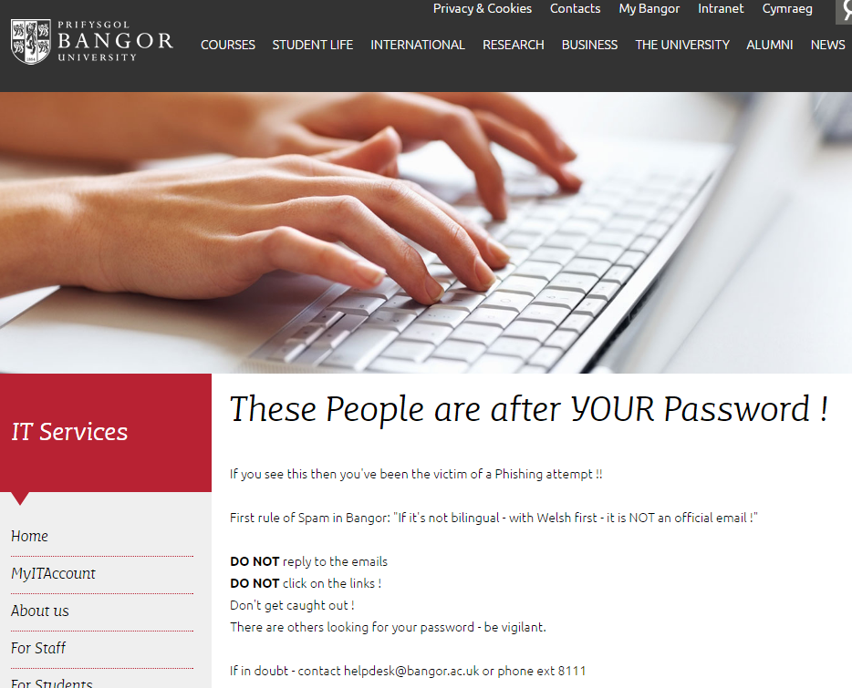
Continued to be Proactive
Periodic reminder to all users
Included in staff and student induction
Already SPF records
BU URL for DNS
JANET’s DNS response policy zone (RPZ) service
https://community.jisc.ac.uk/library/janet-services-documentation/how-block-or-sinkhole-domains-bind
Report incidents
O365, DNS, Firewall updates

Slide 7
The Good Times
Less Spam
Less password divulging
The good times are here
All was well with life

Slide 8
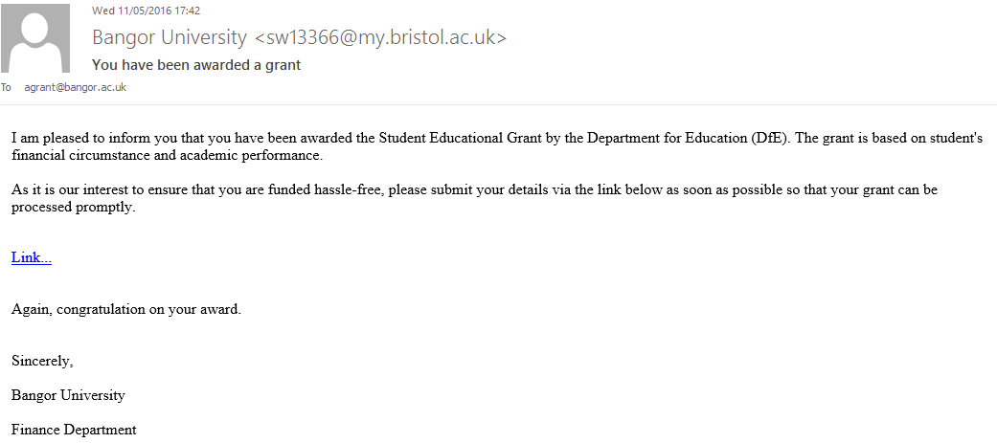
May 2016
Tuesday, 10th May:
Small, tester batch in the evening
essentially free money

Slide 9
Misinformation rules
Wednesday, 11th May:
Students contact IT Support, Student Services or Finance
Other Contacted Bristol University
URL = htttp://pksolar.nl/libraries/simplepie/com_inc/pointer
Blocked at the firewall
Second batch in the evening
Thursday, 12th May: misinformation
Number of students had given their credentials away
In parallel student services reported a successful facebook scammer
How many had been really duped
SysAdmin include. Odd

Slide 10
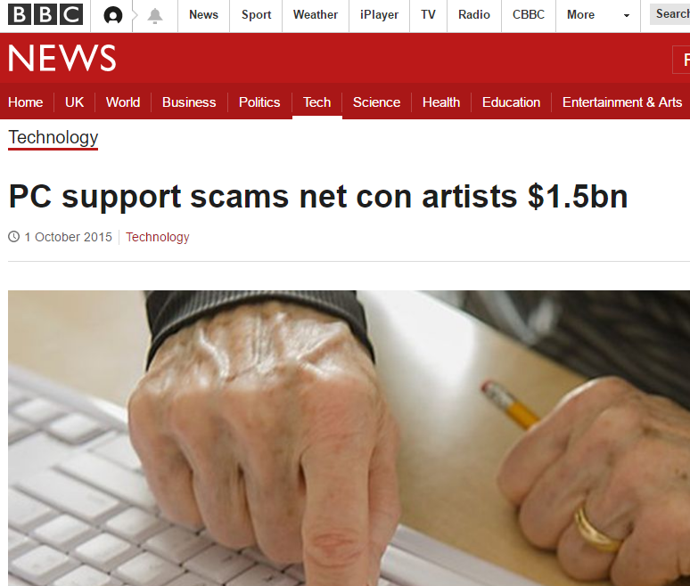
Action taken
Thursday, 12th May:
ITS Team Meeting
ITS director met with BU senior staff
Communication from Marketing. Twitter.
Establish the facts
Only one User had been duped successfully
Others had given details but contacted Banks
My Aunty … user at fault?
http://www.bbc.co.uk/news/technology-34411723
Attempted mass email re-call
DNS updates: local (LAN) and OpenDNS (Wireless)
JANET CSIRT. Police, PhishTank, Bristol, Hosting Company
3rd batch in the evening

Slide 11
Friday, 13th May:
Sender address and URL Target changed
Discussion with JANET
Email exchanges with Bristol (BU students contacting Bristol)
BU sys admins running O365 reports
Open case with MS O365 support
Pattern established
Account suspended
More communications to students
Ready and Waiting for the next batch
Messages stopped

Slide 12
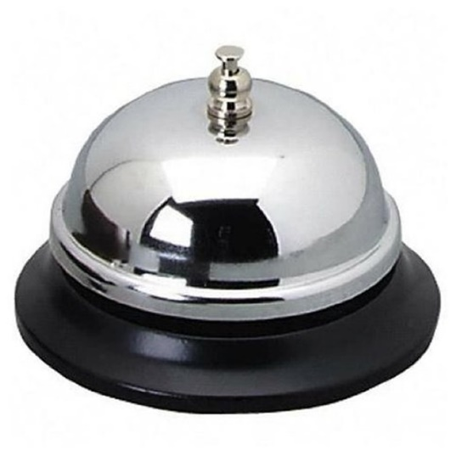
Next Please
Saturday, 14th May: monitor. Quiet
Sunday, 15th May: monitor. Quiet
Monday, 16th May:
Constructive conversation with Bristol
Manchester were next on the phishing trip
Compromised BU account owner spoken to
Close off the activities
Write up the procedure

Slide 13
Sequence
Compromised Bristol account
Compromised BU account
Get all student addresses
Send email to all students
After 7PM
3 evenings, 16 batches (2,6,3)
Each batch included the BU compromised account
Consequently, monitor our communication
Changed sender and URL addresses
Many students caught out

Slide 14
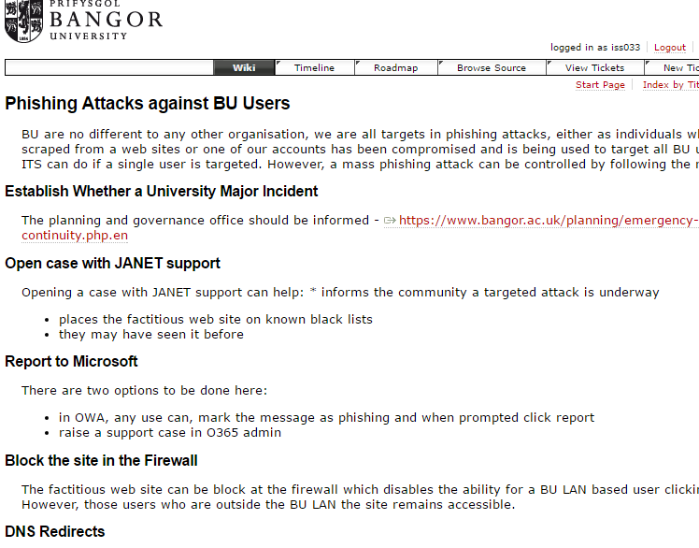
Procedure Written
ITS Technical and Support meeting
Inform senior ITS/BU staff
Marketing for Twitter updates
Email to all users and web docs update
Investigate patterns
Contact JANET
Contact Microsoft
Update firewall
Update O365
Update DNS

Slide 15
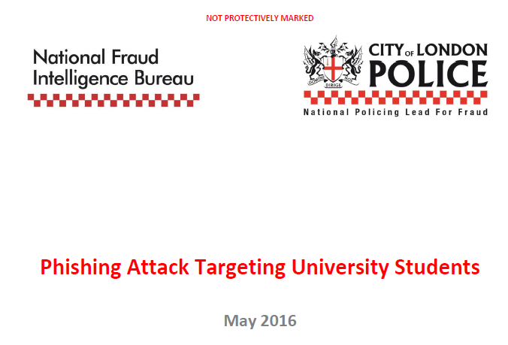
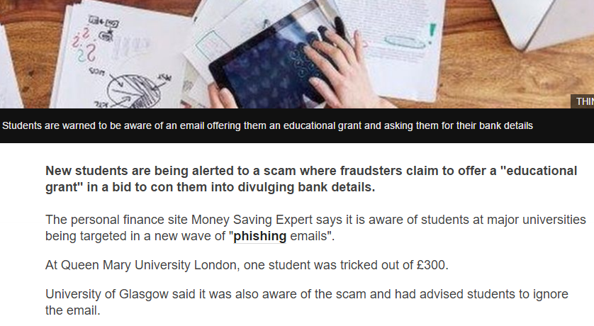
University Sector Wide
May:
BU, Bristol, Manchester, South Wales and others
June:
Email from De Montfort University from the Police
August/September:
University of East Anglia, Hull, Cardiff, Queen Mary
BBC report http://www.bbc.co.uk/news/education-37408373
Our sector speculating if the same gang
Know our UK University process
Structured day by day

Slide 16
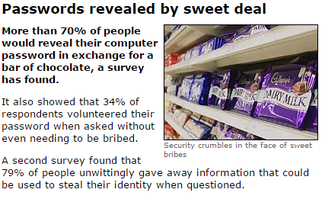
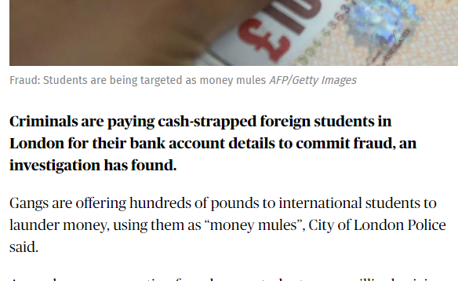
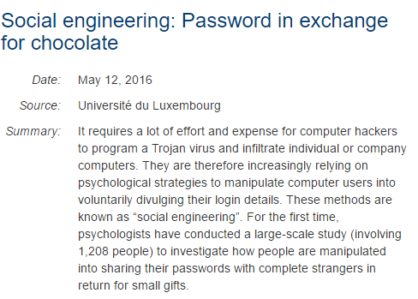
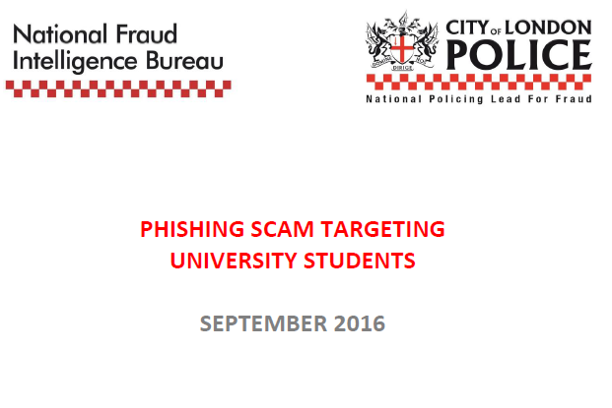
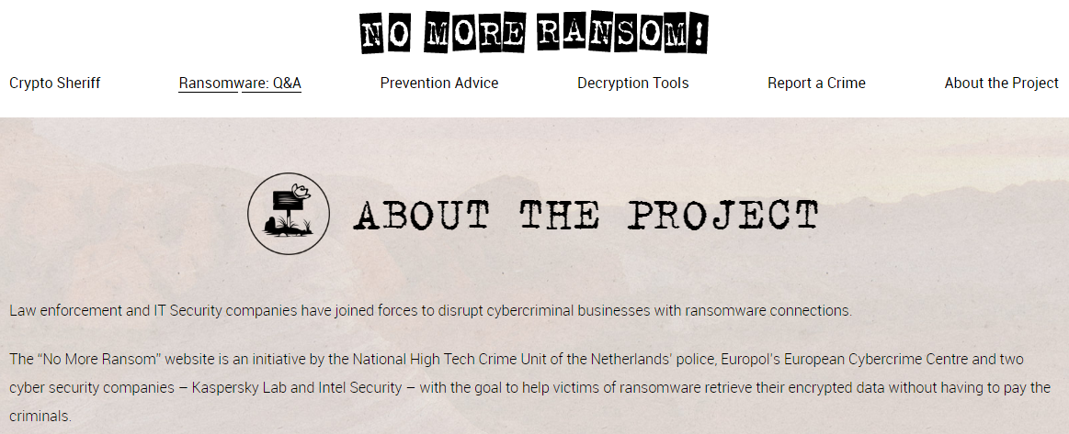
What’s around the corner
Trick with treat:
BBC 2004 http://news.bbc.co.uk/1/hi/technology/3639679.stm
Luxemburg University 2016 https://www.sciencedaily.com/releases/2016/05/160512085123.htm
Round the corner:
More phishing
Ransomware
https://www.nomoreransom.org/about-the-project.html
Student “mule” accounts BBC Radio 4 and
http://www.standard.co.uk/news/crime/criminals-paying-london-foreign-students-for-bank-details-in-money-mule-fraud-a3342901.html

Slide 17
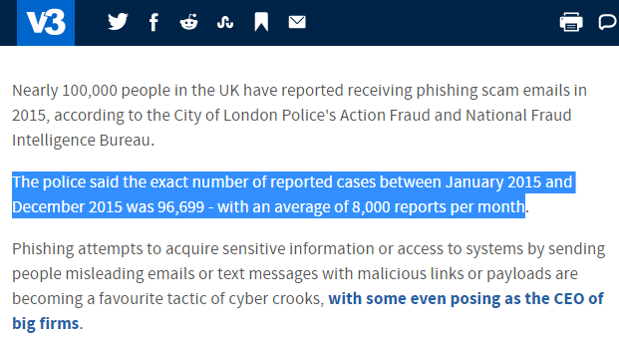
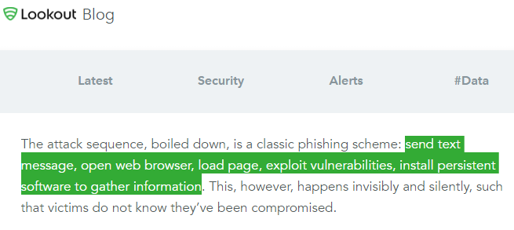
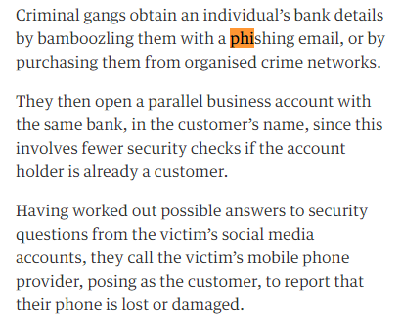
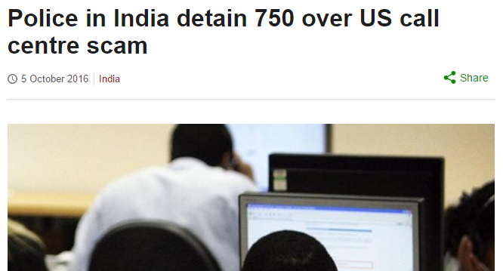
Does anybody have a chance
Students, staff, My Aunty:
https://blog.lookout.com/blog/2016/08/25/trident-pegasus/
8,000 per month
http://www.v3.co.uk/v3-uk/news/2451012/8-000-phishing-scams-reported-to-police-every-month
Sim Card Swap:
https://www.theguardian.com/money/2015/sep/26/sim-swap-fraud-mobile-phone-vodafone-customer
Profitable:
http://www.bbc.co.uk/news/world-asia-india-37564408
Crude estimate “Grant Award” calculation
0.01% success
£1000 per victim
150 Universities
Average 15,000 students
Gross £225,000

Slide 18
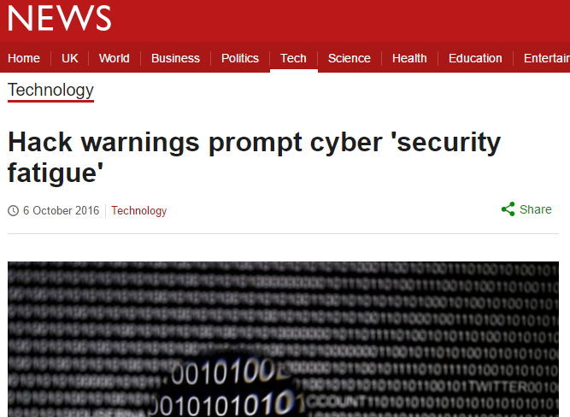
Conclusion
Written procedure
It will happen again
Sophistication
https://www.symantec.com/security-center/threat-report
Weary
http://www.bbc.co.uk/news/technology-37573795
Don’t let your guard down

Slide 20
