Slide 1
Reducing Cyber Security Risks in the UK Public Sector
Alison Whitney
National Cyber Security Centre

Slide 2
What we do
Our Vision
Helping to make the UK the safest place to live and do business online
Reduce the cyber security risk to the UK;
Respond effectively to cyber security incidents;
Understand the UK’s cyber security environment, sharing knowledge, addressing systemic vulnerabilities; and
Nurture the UK's cyber security capability, providing leadership on key national cyber security issues.

Slide 3
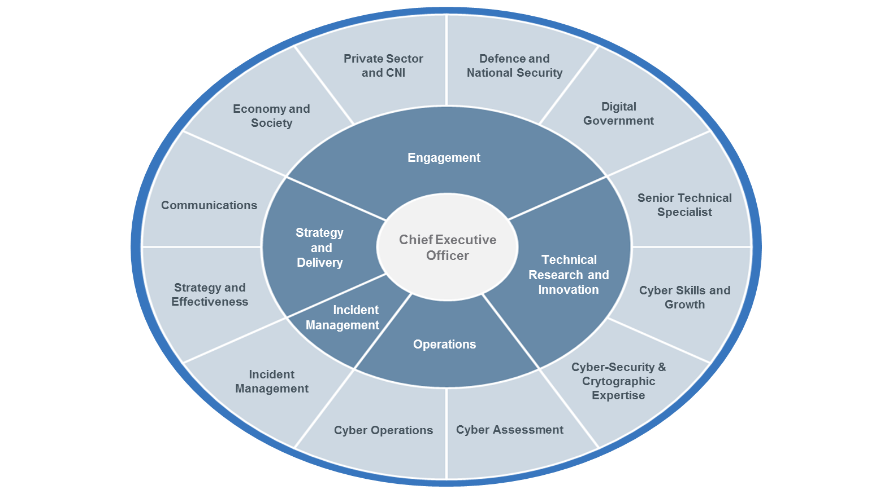

Slide 4
NCSC Digital Government’s Remit
Central Government in all its guises
Local Government
Health and Social Care
Emergency Services
Devolved Administrations
Crown Dependencies and British Overseas Territories

Slide 5
What does help from the NCSC look like?
Alerts, advisories and guidance on our website
Cascading information through associations, trade bodies and similar groups: the one-to-many approach
Briefings at events and conferences
Cyber Security Information Sharing Partnership (CiSP) – private forums
Bespoke consultancy for the most challenging risks
Active Cyber Defence: NCSC provided services to make (public sector) organisations safer
Incident Management
Notes:
Walk through what these things look like
Emphasise that we don’t have finite resources so we have to prioritise
Note that we will sometimes do things because they are the first-use of a new technology even if the risks to the system/service aren’t that high
Our focus is both on citizen-facing online services and Enterprise IT

Slide 6
Active Cyber Defence
WEBCHECK | MAILCHECK
UK PUBLIC SECTOR DNS | PHISHING & MALWARE MITIGATION

Slide 7
UK Public Sector DNS Service
One of the NCSC’s most widely deployed active cyber defence capabilities
Currently available to all public sector organisations
On average the service is actively blocking 70,000 attempts to access known malicious sites each week
Partnership with Government Digital Services (GDS) and Nominet UK
Details on how to register:
  https://www.ncsc.gov.uk/information/uk-public-sector-dns-service

Slide 8
WebCheck
Helping you to secure your public sector websites
Free to use website configuration and vulnerability scanning service
As of October the service had 877 users scanning 5547 unique URLs
151 urgent issues have been fixed following WebCheck notifications
To sign up for the service:
  https://www.webcheck.service.ncsc.gov.uk/

Slide 9
MailCheck
The service supports organisations to adopt the DMARC security protocol
Prototype service - 1760 unique domains registered
Over 41 million spoofed emails of HMG domains have been reported blocked
For further information on how to implement DMARC:
  https://www.ncsc.gov.uk/guidance/email-security-and-anti-spoofing

Slide 10
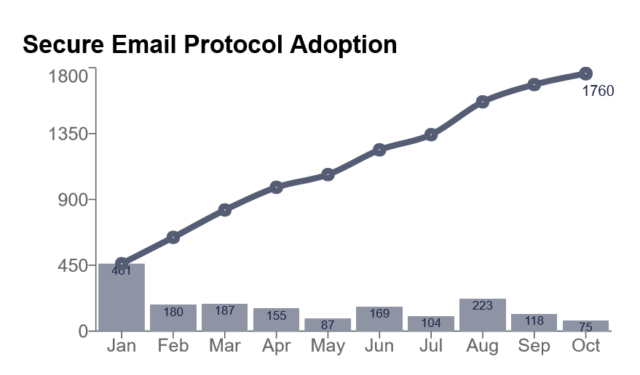

Slide 11
Phishing and Malware Mitigation Service
A service that protects the HMG brand from phishing and common web-inject malware threats
In excess of 141610 attacks successfully taken down
Reduction in average time an attack remains live
Sites hosted in the UK reduced from 27 hours to 1 hour median
HMG brand infringement (phishing) reduced from 45 hours to 7 hours
Web-inject malware hosted in the UK reduced from 526 hours to 43 hours

Slide 12
Questions?
https://www.ncsc.gov.uk/

