Slide 1
Building enterprise wide security architecture fit for critical public services
Mark Jackson, Principal Information Assurance Architect
Cisco

Slide 2
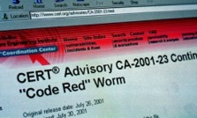
A (brief) malware history lesson
1988
2001
2008
2017
Buffer overflow was exploited in each case

Slide 3
The response?
Technology focussed mitigation
Change is not sustained

Slide 4
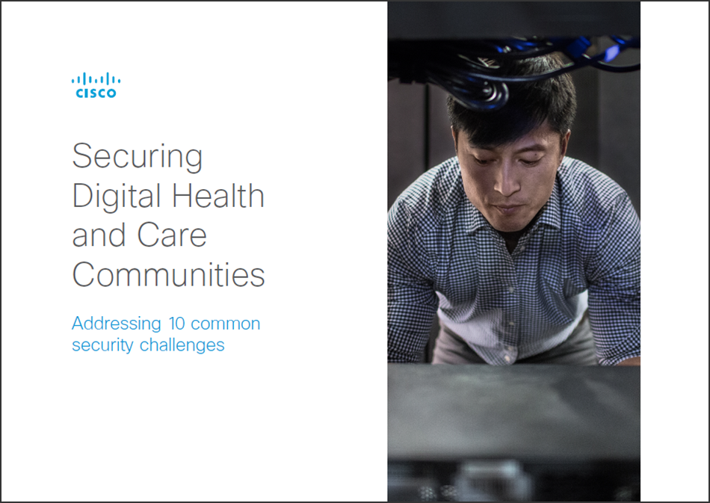
Facing many security challenges…
Availability
The Built Environment
Malware
Threats Closer to Home
Legacy Application Support
Cultural Challenges
Internet of Things (IoT)
Skills and Capability
From Healthcare to Health & Care
Executive Leadership

Slide 5
Getting back to basics
security, n.
Freedom from care, anxiety or apprehension; absence of worry or anxiety
Freedom from danger or threat
Using technology to deliver business benefit attracts risk
Understanding and managing the risk is essential

Slide 6
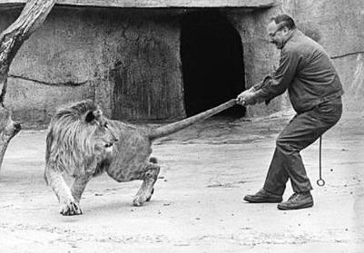
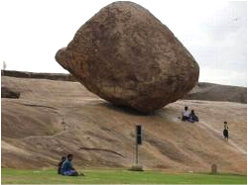
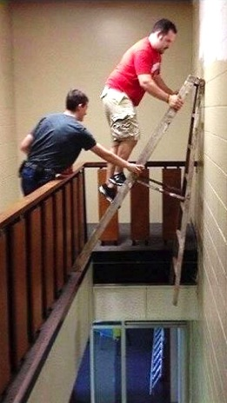
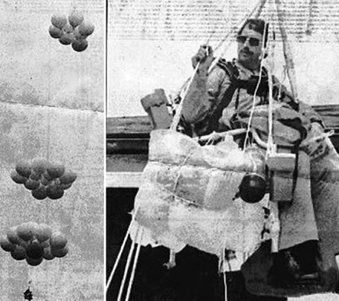
Are we good at Judging Risk?
Your chances of being attacked by a shark
are
1 in 11.5 million.

Slide 7
Risk Reconsidered
Risk
Threats
Opportunities
Loss Event
Beneficial Event
Cost Centre
Business Enabler

Slide 8
What do we mean by ‘an Architectural Approach’ ?
Business Led
Guidance for IT
Closing the ‘Air Gap’
Raise awareness of the potential of IT at Board level
Security investments driven by business requirements
An architectural approach that demonstrates the dependencies of business on IT
A structured approach to security deployment using industry proven architectural models
Conceptual, logical and technical architectures
Reference diagrams that may be used by IT departments as templates
Moving away from ‘operational IT’
Supporting IT in raising its profile within the organisation
Models to support internal business cases
Notes:
Simply put an architectural approach is technology planning that begins with the business. It is most important that the business and clinical leadership are highly engaged in the process from the beginning and throughout the programme of work. This means that they are always consulted and clearly understand the benefits that technology investments will bring. There must be a clear correlation between investment and financial and operational benefits.
IT organisations must therefore be adept at promoting those benefits and clearly articulating them in a consistent way. This includes the use of models to strengthen business alignment and hence business cases.

Slide 9
Security Architecture Phases
Business Risk Assessment
Evaluates the business influence of vital business assets, and the odds and effects of vulnerabilities and security threats.
Security Architecture & Design
Implementation of Controls
Operations & Monitoring
A Capability for the design and architecture of security services, which supports business risk exposure objectives.
Security Services and Processes are implemented, operated and controlled. Assurance services are designed to ensure that the security policy and standards, security architecture decisions, and risk management are mirrored in the real runtime implementation.
Day-to-day processes, such as threat and vulnerability management. Measures are taken to supervise the Operational State, for e.g. SOC

Slide 10
Understanding Business Attributes
The above picture is taken from http://www.sabsa.org/sabsa-institute

Slide 11
Analyse the risks to identified assets
Let us call these proxy assets. From the strategic point of view, value of security is to protect these!
RISK MODEL
Business Attribute
Priority
Threats (to information)
Impact
Likelihood
Research Intensive Technology University/IP
Confidentiality/In our Sole Possession
Breach via Malware
Reputational Damage including lost clients/students
?
HIGH
Excellence
Reputable
Leaked Confidential Information from Insider
Reputational Damage including lost clients/students
HIGH
Lead & Innovate
Admissible
Plagiarised information in New Innovation
Competitive Advantage lost
HIGH
Strategic Partnership
Multi-Sourced
3rd Party Risk Assessment Failed
Lack of Trust in the Supplier
MEDIUM
Note that risks are not always negative; framework such as this one treats positive events.

Slide 12
Risk Distribution From Enterprise Risk Domain to Information Security
Business Attribute
Risk Appetite
Performance Target
InfoSec Attributes
Assets
Research Intensive Technology University/IP
Confidentiality/In our Sole Possession
1% data loss is acceptable
PT is 99%. Could be part of the SLA/UC with the Cloud provider
Confidentiality
Integrity Assured
Risk Appetite
Performance Targets
Illustration ONLY
Excellence
Reputable
Integrity Assured
Available
Lead & Innovate
Admissible
Trustable
Auditable
Strategic Partnership
Multi-Sourced
0% data loss is acceptable
PT is 100%. Could be part of the SLA/UC with the Cloud provider
Integrity Assured
Available
Compliant with Standards
Illustration ONLY

Slide 13
From Project to Programme Oriented
Multi-year planning
Understand the potential for re-use
Deliver capabilities that underscore multiple business needs
Use architectural models to strengthen business cases
Show dependencies – business to technology alignment
Demonstrate that technology is embedded in business planning

Slide 14
Summary
We must learn from history
Reconsider risk
Develop a security architecture that is linked to the business strategy

